Slide 1
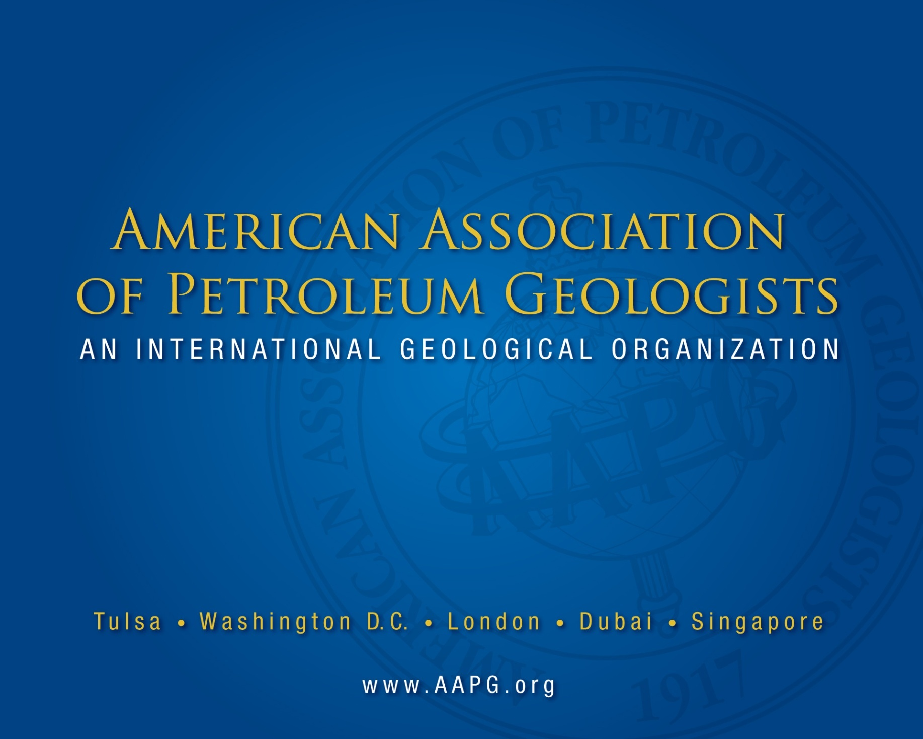

Slide 2
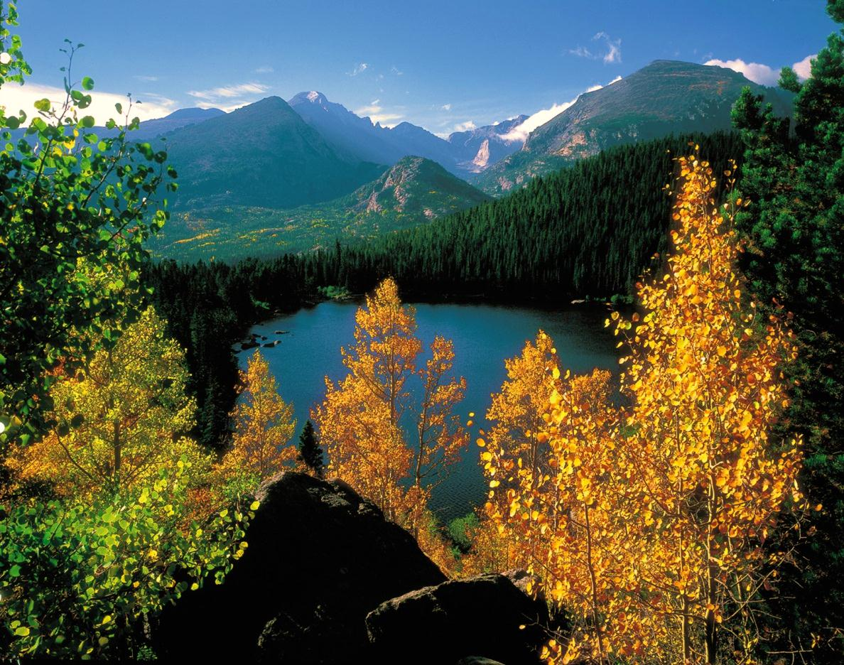


American Institute of
Professional Geologists
Service to the Profession and Professionals
Competence…Integrity…Ethics…
Advocacy
AIPG 50th Annual Meeting
October 23 – 26, 2013
Broomfield, Colorado
www.aipg.org

Slide 3

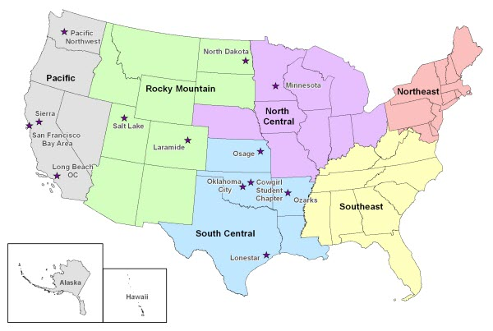
Association for Women Geoscientists
Mission:
Encourage, Enhance, Exchange
Leadership Development
Programs:
Short courses/networking at national meetings
  TUESDAY: AWG/DPA lunch
  THURSDAY: Developing New Leaders in the Energy Industry
Awards recognition
  Oustanding Educator
  Professional Excellence
Scholarships
  Chrysallis
  Travel awards
  Field camp awards
Future challenges:
Fundraising
Increased membership and chapter growth

Slide 4
Association of American State Geologists
For 2012/2013:
President - Harvey Thorleifson, MN
President-Elect - John Parrish, CA
Vice President - Jonathan Arthur, FL
Secretary - Joe Gillman, MO
Treasurer - Michael Hohn, WV
http://www.stategeologists.org/

Slide 5

Association of Earth Science Editors
Communicating Geo-science for the World
Annual Meeting – Tulsa, Oklahoma, Fall 2013
Members include freelance and organization editors, publishers, printers, publication managers and other interested parties
Benefits: Job postings, Blueline Newsletter, ListServ for discussing editorial issues, networking
www.aese.org

Slide 6
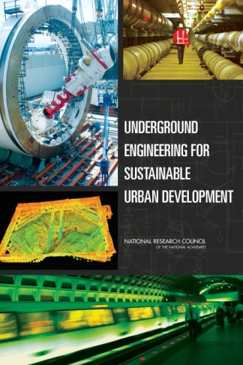
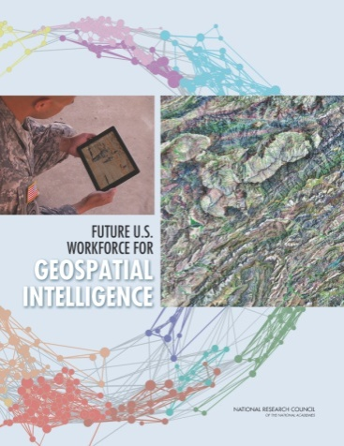
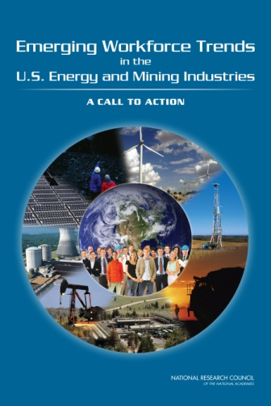
Board on Earth Sciences and Resources (BESR)
of the National Research Council
In 2013, the Board and its standing committees released the following reports:
Future U.S. Workforce for Geospatial Intelligence
Underground Engineering for Sustainable Urban Development
Emerging Workforce Trends in the U.S. Energy and Mining
Industries: A Call to Action
Studies underway include:
Subsurface characterization, monitoring, and remediation
of fractured rocks
State of the art and practice in earthquake induced soil
liquefaction assessment
Needs and research requirements for land-change modeling
Development of unconventional hydrocarbon resources in the Appalachian Basin: A Workshop
Trends and opportunities in federal earth science education and workforce development
BESR coordinates activities on Earth science issues and coordinates studies of national importance for the NRC. Contact: eeide@nas.edu

Slide 7
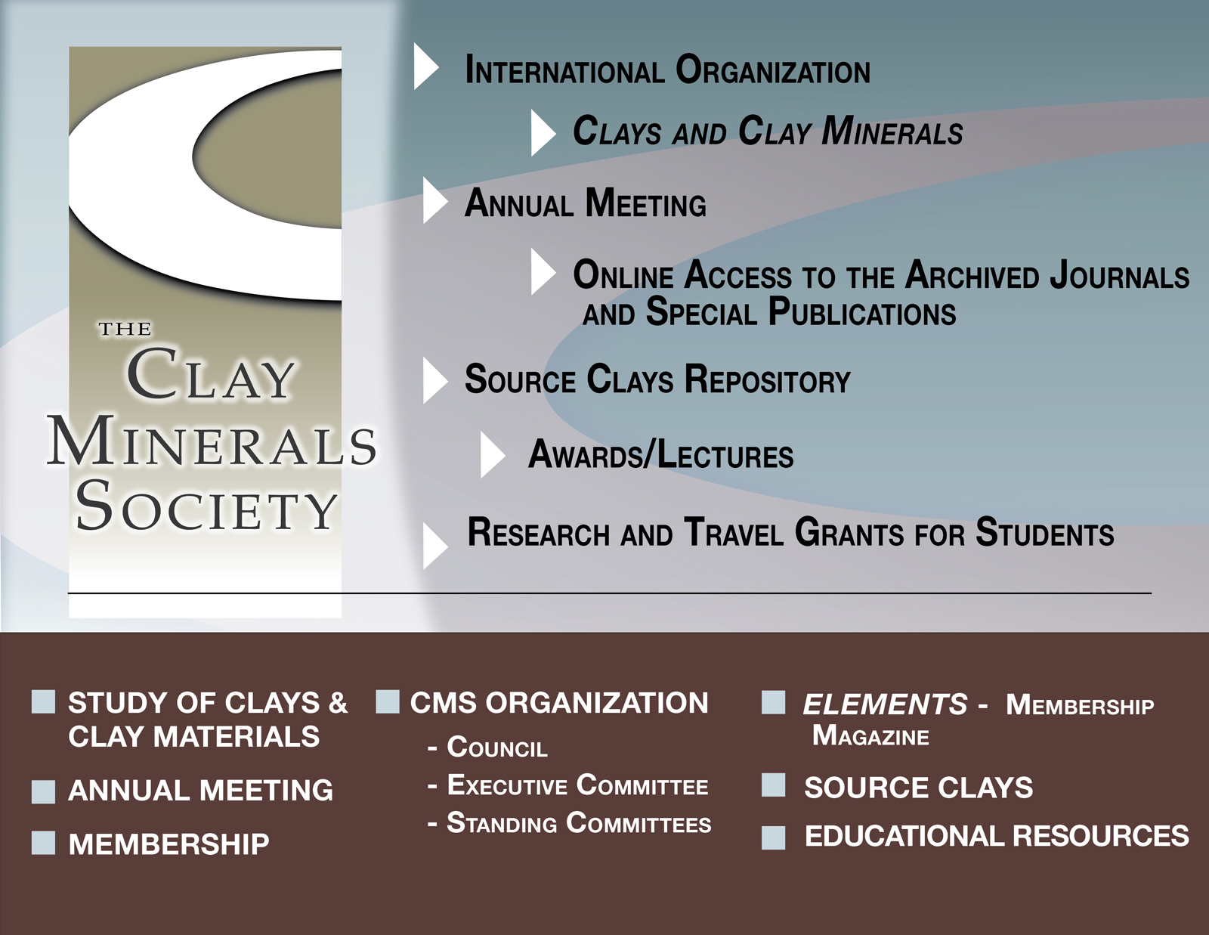

Slide 8

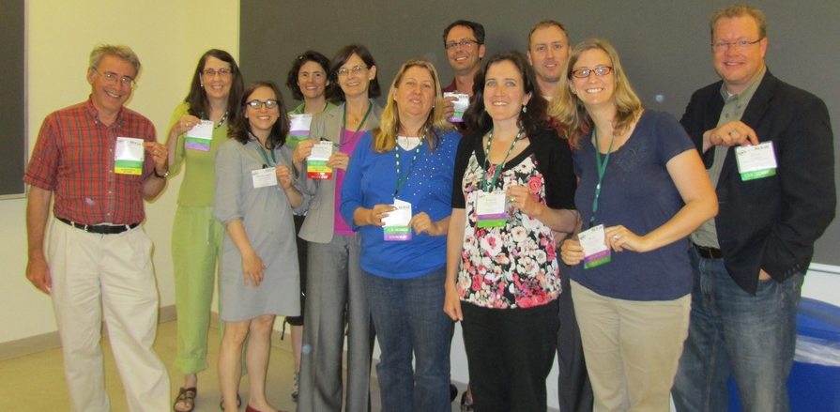
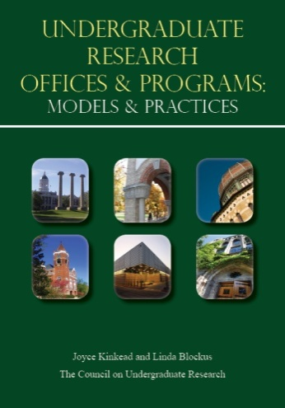
Council on Undergraduate Research
GeoCUR and the On the Cutting Edge designed a website on the serc system: “Undergraduate Research as Teaching Practice”
GeoCUR Workshops at GSA and AGU
  GSA 2011 & 2012: “Getting Started in Undergraduate Research for New and Future Faculty"
  AGU 2011 & 2012: “How to Get an Undergraduate Research Program Started”
GeoCUR initiated a new Undergraduate Mentoring Award
  2011 winner: John Brady, Smith College
  2012 winner: Tracey Holloway, University of Wisconsin--Madison
GeoCUR contributed to Undergraduate Research and the Two-year College. In: J.Kinkead & L. Blockus (Eds.), Undergraduate Research Offices & Programs: Models & Practices
www.cur.org

Slide 9

14% avg. annual membership growth since 2000*
16% avg. annual Goldschmidt conference registration
growth since 2000**
International. 3,793 members in 60 countries
5,000+ subscribers to weekly e-newsletter
(Geochemical News)
1,000+ likes on www.facebook.com/geochemsoc
* 1,416 members in 2000; 3,793 members in 2012.
** 1,000 participants in 2000; 2,968 participants in 2012.
www.geochemsoc.org

Slide 10

Celebrating the Society’s 125th Anniversary
125th Anniversary GSA Annual Meeting- 27-39 October 2013 in Denver, CO
Membership Stands at 25,475
66 Associated Societies
Awarded 315 Graduate Student Research Grants for $582,340
“Roof of the World” International Section Meeting in Chengdu, China,
17-19 June 2013
Dr. Victor Baker, 2012–2013 Distinguished International Lecturer
Launching “On to the Future” Diversity Initiative to bring 125 diverse, first
time students to the GSA Annual Meeting in Denver
Science - Stewardship - Service

Slide 11

Gold and Green Open Access policies agreed to ensure full compliance with United Kingdom researcher funder requirements
With others in the geoscience community advised UK government on Earth science in the new National Curriculum for England
January – international two-day conference with AAPG Europe on ‘Carbon Capture and Storage: From Research to Implementation’, concluding with a discussion with parliamentarians and government officials on policy implications
April - Holocene Climate Change conference which attracted over 120 delegates
Fabienne Michaud appointed to new post of Library and Information Services Manager

Slide 12

Geoscience Information Society
Purpose – to manage, preserve, and disseminate geoscience information in cooperation with scientists and other professionals.
Issues of Concern:
  Educating geoscience information users to effectively locate, assess, use, and manage geoscience literature.
  Respect for Intellectual Property through proper citation, collection development and management.
  Access to publications, information & data.
  Preservation of information & data.

Slide 13
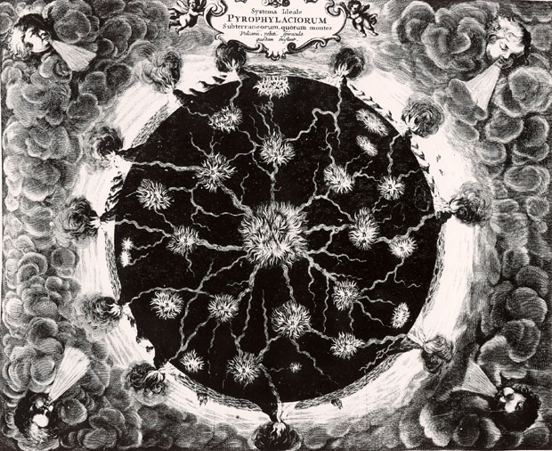
History of the Earth Sciences Society http://www.historyearthscience.org
Founded in 1982
Publishes Earth Sciences History, now in its 31st year
Cooperates with GSA History and Philosophy of Geology Division and with INHIGEO

Slide 14

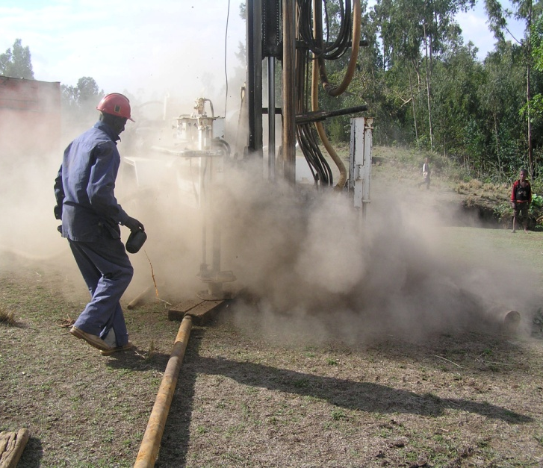




INTERNATIONAL ASSOCIATION OF HYDROGEOLOGISTS
the worldwide groundwater organisation
founded in 1956, now 3900 members in 140 countries
39 Congresses – 2012 Niagara Falls; 2013 Perth
40 National Chapters – more being formed
rejuvenated scientific commissions and networks
high quality Hydrogeology Journal published
active early career network and mentoring scheme being developed
We are now a worldwide professional community, a scientific forum and publisher, and an advocate for groundwater
IUGS Affiliate
UNESCO-IHP Partner
WWC
Member
GWP
Member

Slide 15
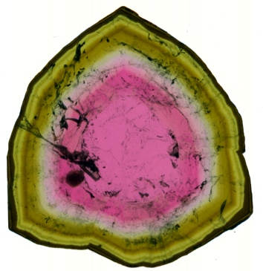
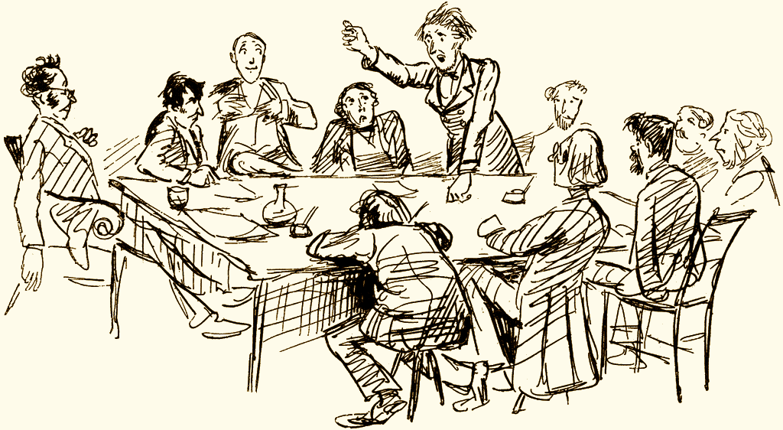
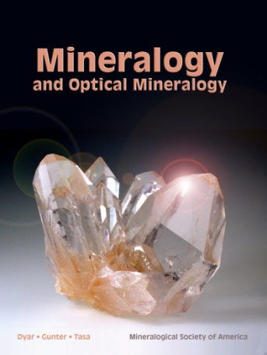
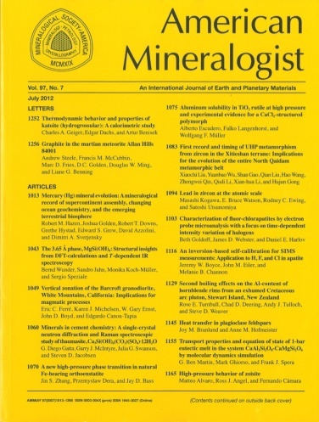
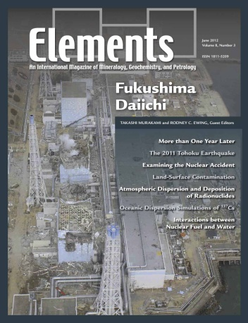
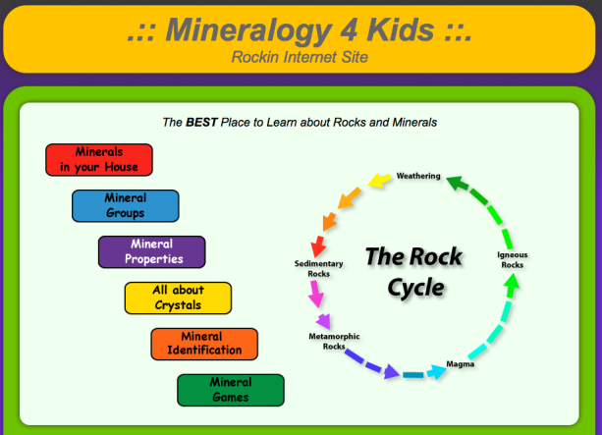
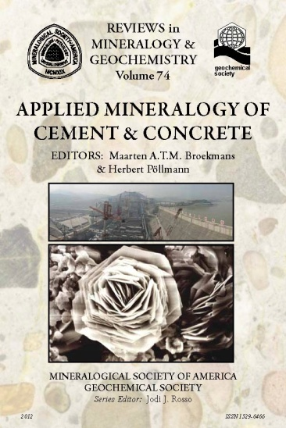
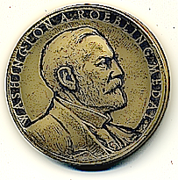
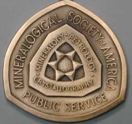
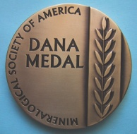
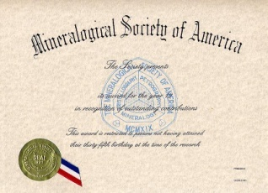

Mineralogical Society of America

Slide 16

publishes The Journal of Geoscience Education & In the Trenches
members include 4 year college and university faculty, 2 year college faculty, K-12 teachers, informal educators, education researchers
sponsors regional meetings and field trips; supports students through field camp scholarships
sponsors workshops through CLEAN, InTeGrate, Cutting Edge, GSA and AGU
organizes the education portions of GSA's Annual Meeting (with G.E.D.)

Slide 17


Slide 18

NCKRI accomplishments since April 2012:
Initiate nationwide survey of cave and karst resources, research, management, and educational/interpretive programs throughout the US National Park system.
Geophysical investigation of gypsum sand aquifer and underlying carbonate aquifer at White Sands National Monument.
Develop exhibit designs for NCKRI’s National Cave and Karst Museum.
Establish international workshop program on the management of karst aquifers.
www.nckri.org

Slide 19


New headquarters completed in Huntsville, AL and available for events
16th International Congress of Speleology will be held in Brno, Czech Republic from July 21st – 28th, 2013
NSS Convention will be held in Shippensburg, PA from August 5th – 9th, 2013
NSS Research Grant applications deadline: May 31st
www.caves.org

Slide 20

http://www.agiweb.org/nacsn/
26 members from the United States, Canada and Mexico
Keepers of the North American Stratigraphic Code
Provides advice, education on stratigraphic topics
Co-sponsor special session T168. Mid-Atlantic Coastal Plain Stratigraphy and Paleontology at the Charlotte GSA Annual Meeting
Annual business meeting is 1:00-5:00 today (Nov 5th)

Slide 21

Seventh largest natural history research collection in North America
Support for research through facilities, research labs, SEM, scholarships and opportunities to publish your manuscript in one of the oldest academic journals in paleontology
Leader in informal Earth science education and national teacher professional development
Support broader impact and public outreach through our Museum of the Earth featuring the 11,500-year-old Hyde Park Mastodon
For more information:
Elizabeth Brando
Brando@museumoftheearth.org
MuseumoftheEarth.org

Slide 22

•Founded in 1908 and now has over 1400 members from around the world.
•Dedicated to advancement of all aspects of the science of paleontology.
•Publishes two professional journals: Paleobiology and Journal of Paleontology.
•Administers numerous grants for student research in paleontology.
•Partnering with GSA and SEPM, through the coordinating office STEPPE, to promote
sedimentological and paleontological research analyzing the deep-time environmental
and evolutionary history of our planet.

Slide 23


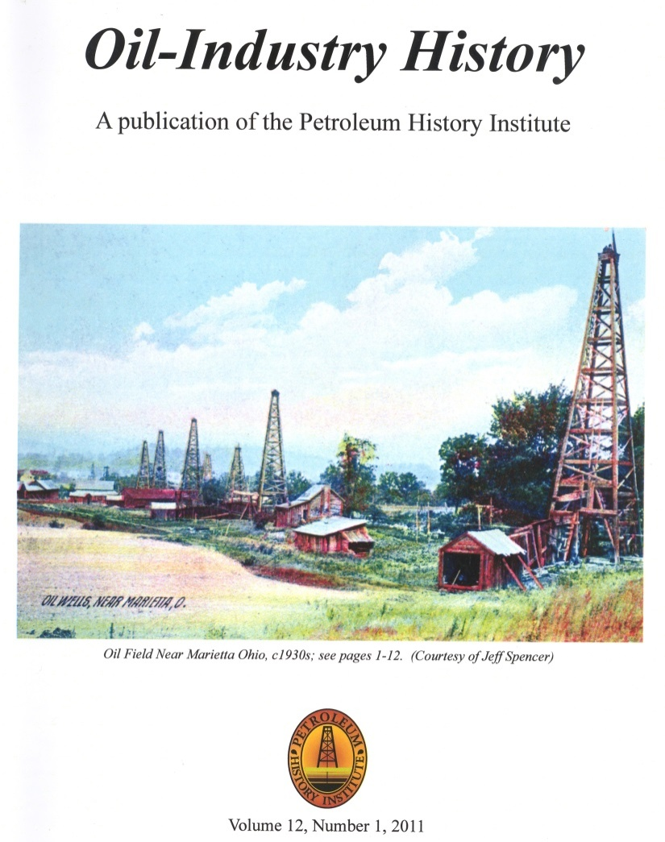
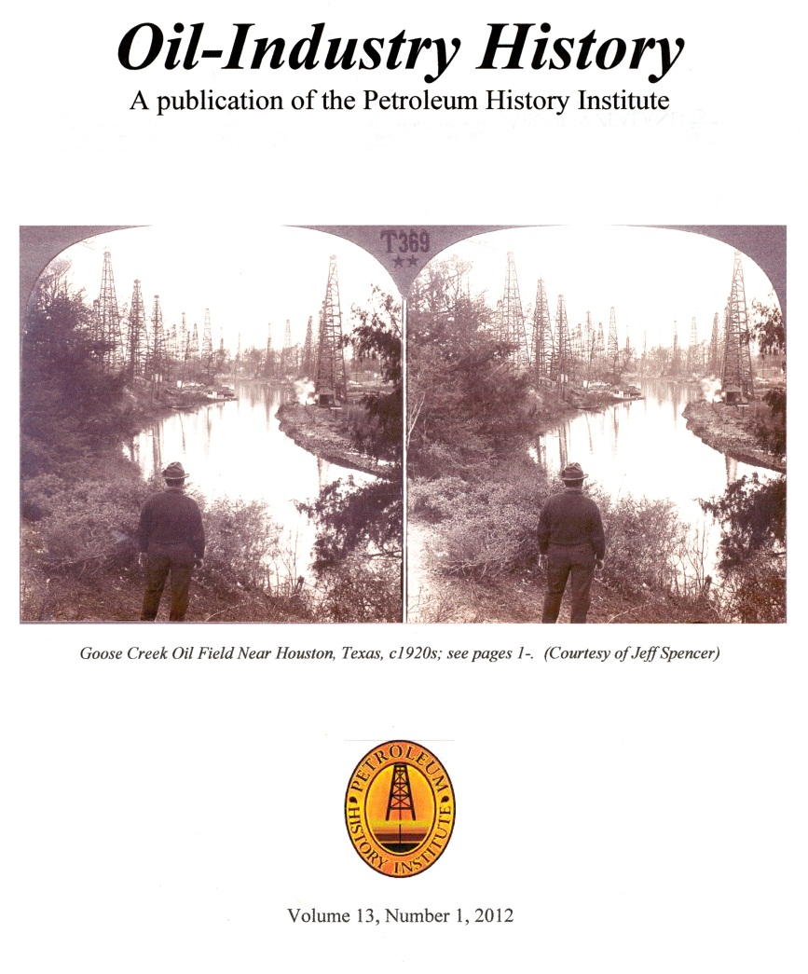
PETROLEUM HISTORY INSTITUTE
Co-sponsor w/ Petroleum History Society Symposium – Field Trip
Calgary, Alberta; May 8-10, 2014
(Tentative Dates)
Publisher of
Oil-Industry History
All back issues available in original printed form
www.petroleumhistory.org

Slide 24

The Seismological Society of America:
  Statement of Purpose: To Advance seismology and the understanding of earthquakes for the benefit of society
  Is working to implement our new Strategic Plan
  Has now posted all archival issues of both journals on GeoScience World
  Held successful meeting April 17-19 in Salt Lake City (despite govt travel cuts)
  Is planning Anchorage meeting 30 April - 2 May 2014

Slide 25

Society for Sedimentary Geology
JSR and PALAIOS went to Continuous Publishing
Five new Book Publications including
  SP102 Sedimentary Geology of Mars
Three New Council seats created for –
  Student Councilor;
  Early Career Councilor and
  Web & Technology Councilor
http://sepm.org/

Slide 26

(President (2011-2013): Dr. Isabel Suarez-Ruiz)
A society for scientists and engineers (called TSOP) involved with the microscopy of organic rich sediments (kerogen, coal, solid bitumen) that defined as organic petrology. The society organic petrologists is closely associated with organic geochemistry and other related disciplines in geosciences that deals with the organic sediments in nature. We study the genesis and temperature history of the organic sediments.
We have over 200 members in 30 countries. If you are interested to be a part of the organic petrology community, we invite you to join TSOP (see our webpage: www.tsop.org)
TSOP have annual meetings worldwide (Halifax, Canada 2011; Beijing, China 2012; Sosnowiec, Poland 2013; Sydney, Australia 2014) & research grants for students
TSOP is a member society of AGI & an associated society of AAPG

Slide 27
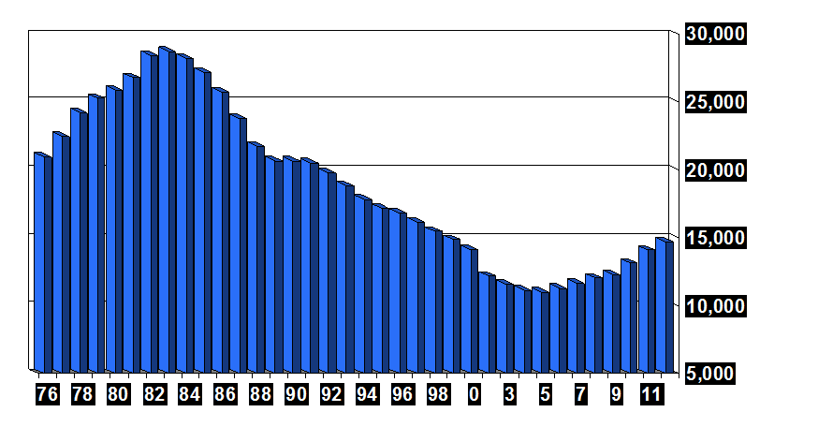
Society for Mining, Metallurgy & Exploration
OneMine.org with > 103,400 documents; 1.8 million pages
Popular eBooks (e.g., Mining Engineering Handbook, Industrial Minerals and Rocks)
Scholarships, including some specifically for geos
Government Relations & Public Affairs Committee: 10 briefing papers
Annual meeting (23-26 February 2014, Salt Lake City – “Leadership in Uncertain Times” & specialty meetings (underground construction, mining finance, safety and reliability, etc.)
14,686 members
(4.3% growth
from 2011 to 2012)
http://www.smenet.org/

Slide 28
Society of Exploration Geophysicists
The international society of applied geophysics
Advancing the science and technology of applied geophysics …
Serving a global membership …
Accelerating geophysical innovation …
Inspiring the geoscientists of tomorrow
www.seg.org

Slide 29

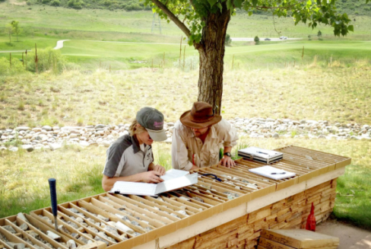
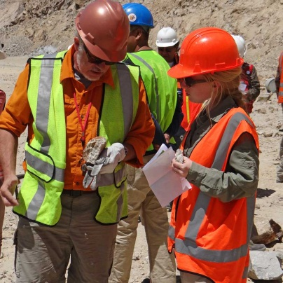

Society of Economic Geologists
SEG Education and Training Curriculum
  30 courses and field trips offered at the SEG Headquarters in Littleton, Colorado, USA and abroad
Whistler 2013: Geoscience for Discovery
  Registration Now Open: September 24-27, 2013, Whistler, BC, Canada
Student Grants and Fellowships
  More than $0.5 million awarded annually
New SEG Member Benefits
  e-Docs, available for immediate download, including special issues of Economic Geology
  Geofacets-SEG Millennium Edition, with SEG member access to maps from Economic Geology, 2000-Present
For more information, please visit www.segweb.org

Slide 30
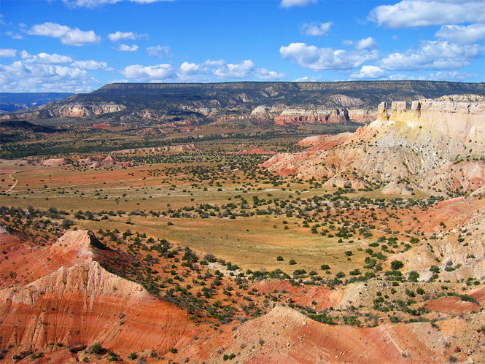

SOCIETY OF INDEPENDENT PROFESSIONAL EARTH SCIENTISTS
Celebrating 50 Years
SIPES 50th Annual Meeting & 2013 Convention
June 17-20, 2013 - Santa Fe, New Mexico

