Slide 1
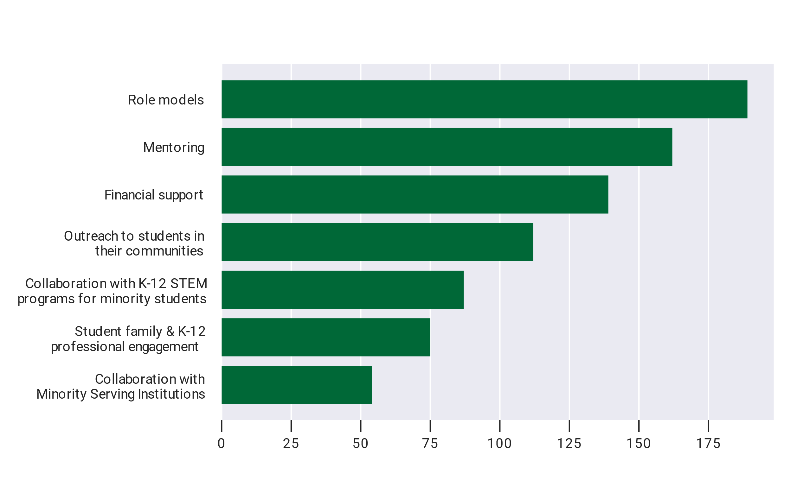
Systematic Efforts to Broadening Participation
Organizations reporting
Notes:
Figure A-63
Survey Question: Does your department/company/organization have or plan on any systematic efforts to encourage broadening participation and retention of a more diverse student population?

