Slide 1
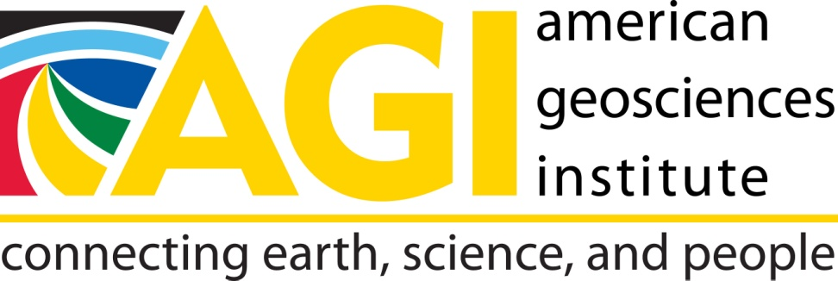
This Webinar Series is co-hosted by
The American Geophysical Union
and
The American Geosciences Institute

Slide 2
Strengthening a Community College Geoscience Program Through Collaborations with University and Research Faculty
Allison Beauregard
Northwest Florida State College

Slide 3
Northwest Florida State College
2 year college
2 other geoscience faculty in department
Heavy teaching load
Lack of research “culture”
Challenge top students without losing general education students

Slide 4
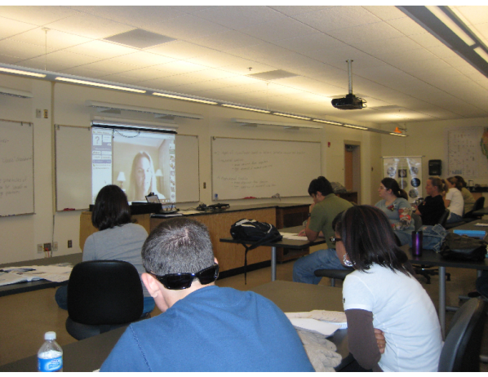
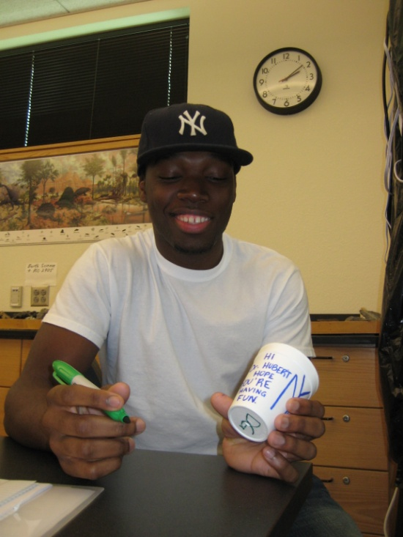
1. Marine Biological Laboratory
Funded under NSF – Biological Oceanography (broader impacts)
Incorporates cutting-edge hydrothermal vent science into NWFSC curriculum
Researcher-student contact
Vent curriculum
Internship program

Slide 5
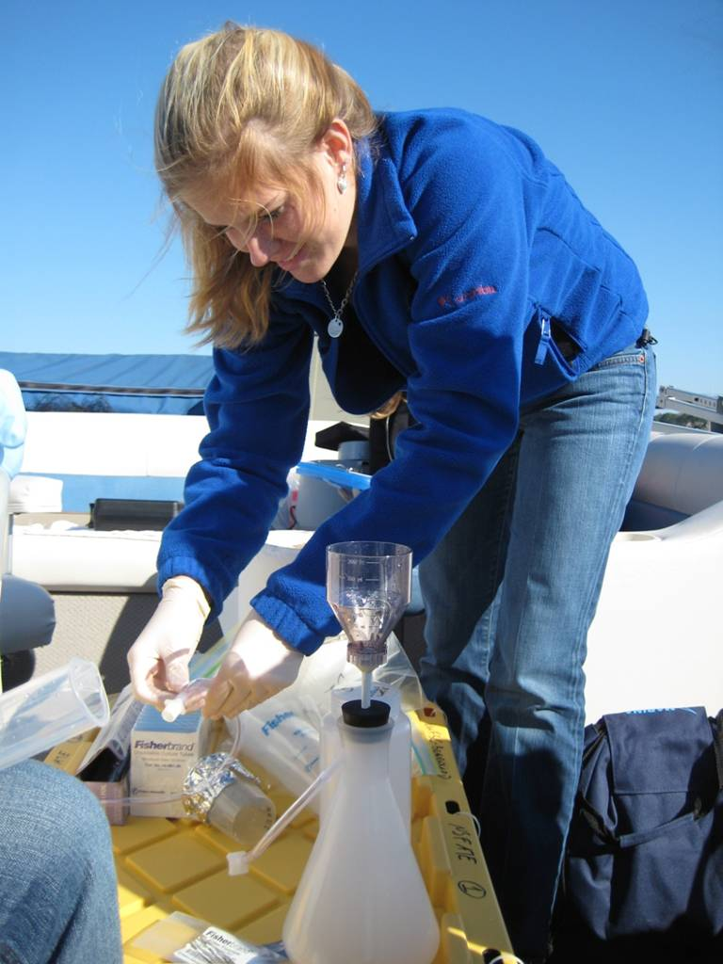
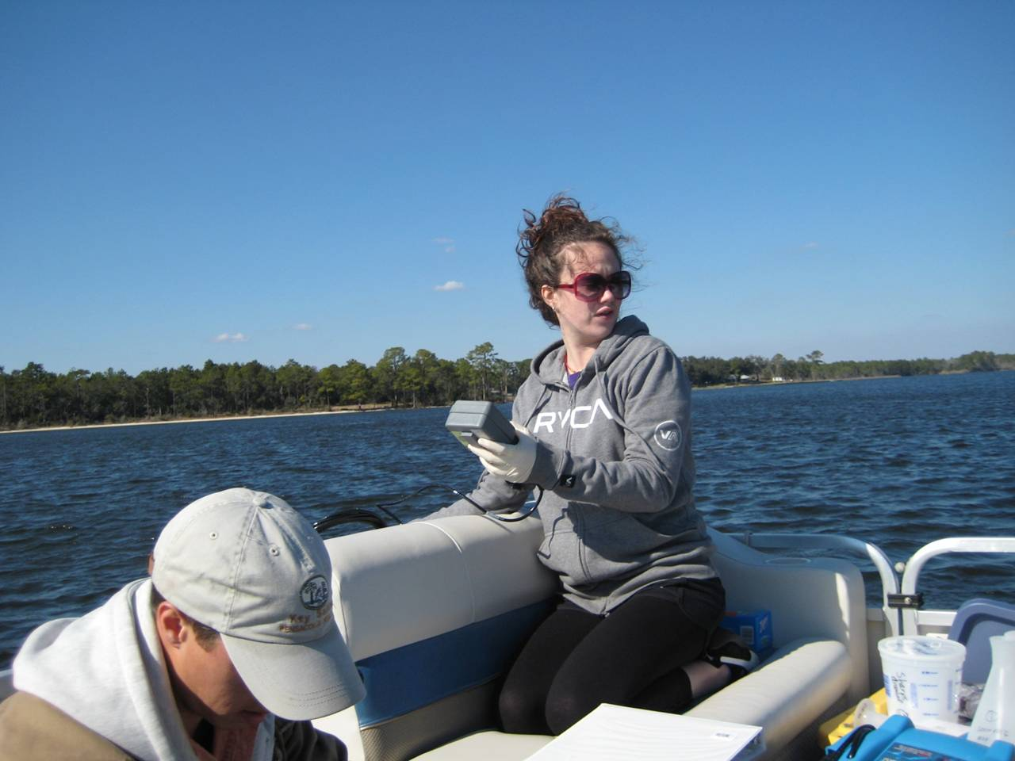
2. University of West Florida
Research In the Classroom
Funded under NSF – ATE program
Developed new field/technology -based course at NWFSC (community college)
Co-taught by faculty from NWFSC & UWF & graduate student from UWF
Research Internships
8 year collaborative research project
27 NWFSC student interns, 2 UWF undergraduate practicums, 3 UWF graduate theses

Slide 6
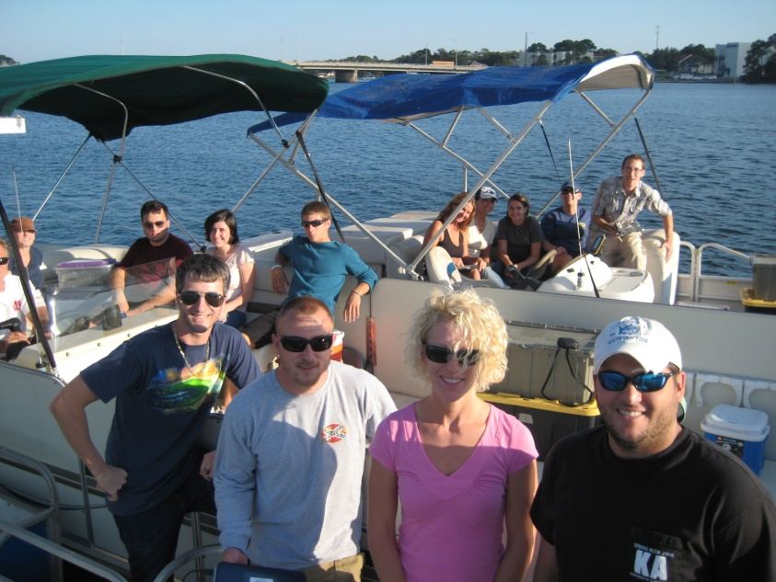
Outcomes & Benefits of Collaborations:
For 2YC Partner:
Access to grant resources (IRB, budgeting, Fast Lane, etc.)
Access to boats, equipment, etc.
Boosts reputation of community college
For 4YC or Research Partner:
Student recruitment
Access to community college funding sources!
Meaningful broader impacts strengthens proposals
Great PR

Slide 7
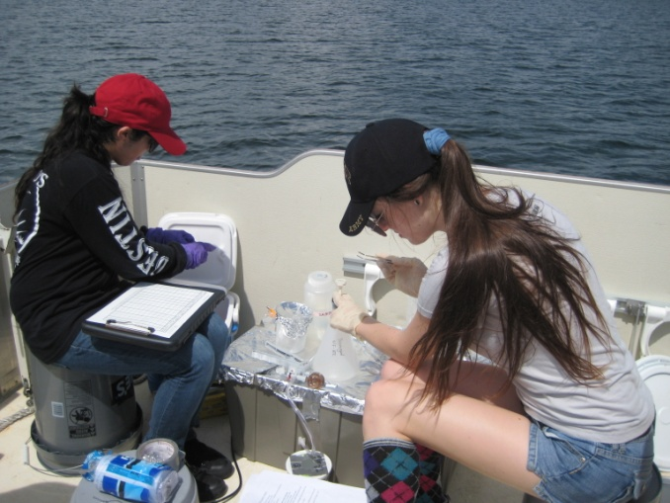
Student Feedback
In class research - “… you still hold the distinction of facilitating the toughest, most challenging, most rewarding class I’ve taken in college…. The class that you and Dr. S put together is absolutely awesome and I feel that I’m a better student from being exposed to yours and his instruction.”
MBL internship – “My favorite part of the internship was being able to extract and run
DNA on the gel by myself. I loved
that the post-docs trusted us with the
equipment… That really built my
confidence ...”

Slide 8
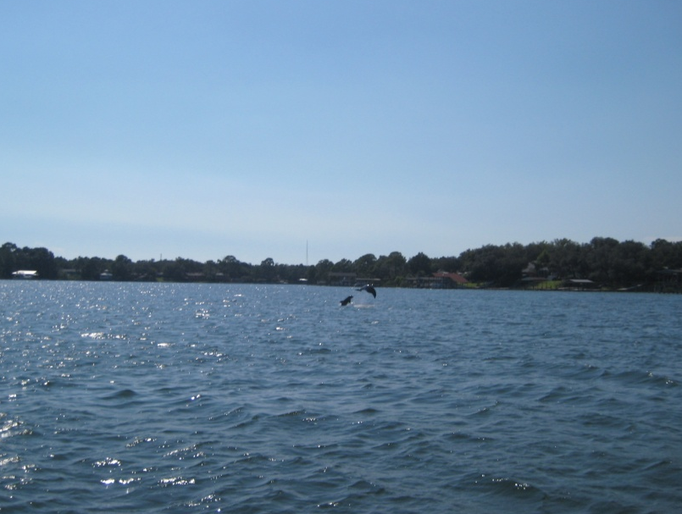
Acknowledgements
Dr. Matthew Schwartz, University of West Florida
Dr. Julie Huber, Marine Biological Laboratory
NSF Advanced Technological Education
DUE-0902898 (Beauregard)
DUE-0902897 (Schwartz)
NSF Biological Oceanography
OCE-0929167

Slide 9
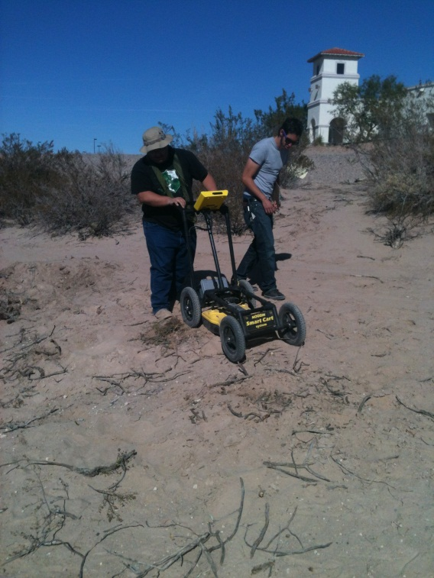
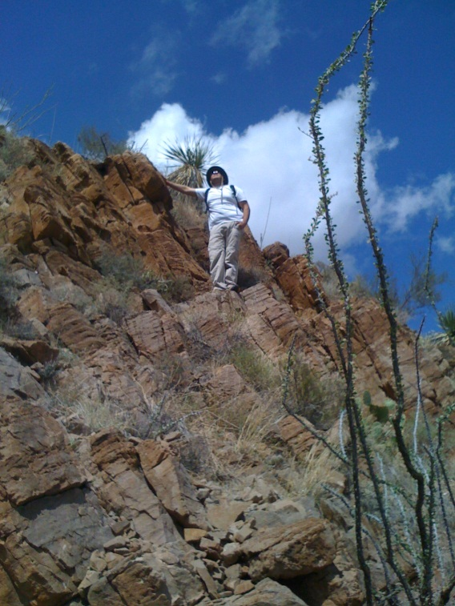
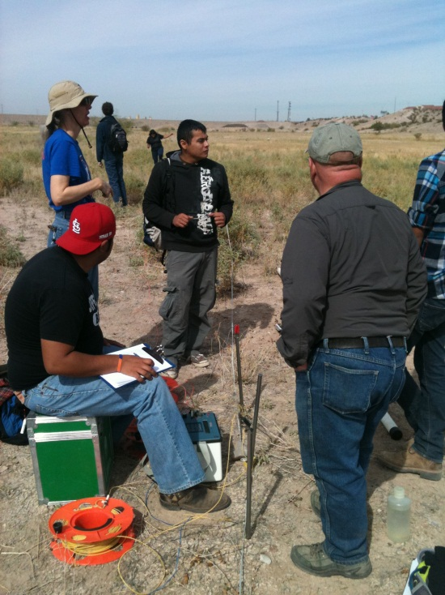
A 2YC Perspective On Building An Effective 4YC Collaboration
Joshua I. Villalobos
El Paso Community College
Diane Doser
University of Texas at El Paso

Slide 10
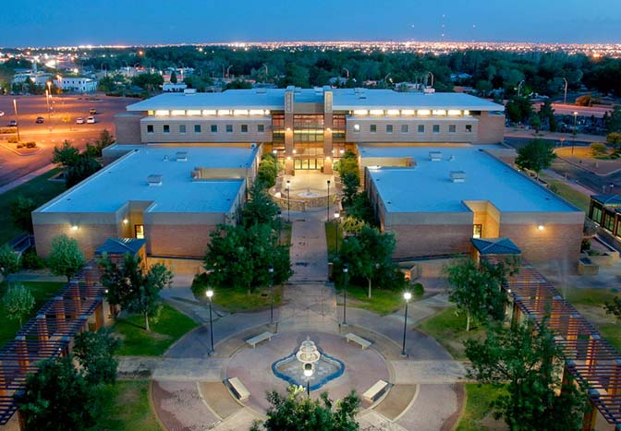
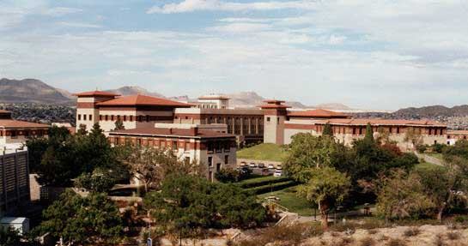
Background
EL Paso Community College
30,000+ students
85% Hispanic
5 campuses
Over 130 programs of study
Geological Sciences A.S.
University of Texas at El Paso
22,000+students
77% Hispanic
Geological Sciences
Bachelor, Masters, Doctoral programs
Notes:
EPCC is currently the fastest growing 2YC in Texas. Recent trends in student profiles indicated for the first time the median student age at EPCC is below the age of 25. This trend illustrates that more local high school students are entering college in El Paso through EPCC than in previous years. The change in student demographics indicate that many of these students will matriculate to UTEP.

Slide 11
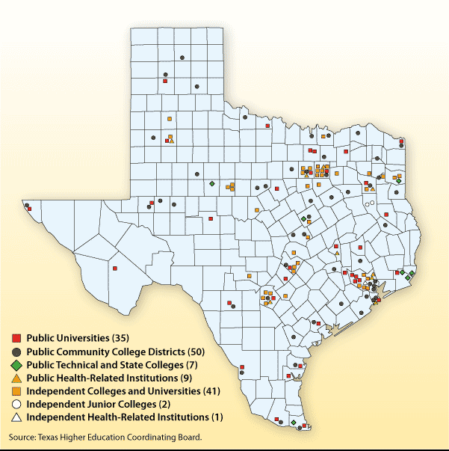
Why Form a Collaborative?
Share resources
Enhance curriculum
Increase awareness
Improve department dynamics
Improve quality of students
Notes:
Shared resources:
4YC: cost heavy equipment and facilities that 2YC cant afford or maintain are shared.
2YC: 2YC faculty often have more flexible hours to mentor students or provide assistance on collaborative efforts.
Enhanced curr.:
4YC:Student enter the 4YC with a more specific knowledge background.
2YC:curriculum can be improved by 4YC faculty recommending current or new concepts in geology, new types of successful pedagogy, and concepts. collaborating with UTEP faculty on what is to be expected for students to understand before they transfer to UTEP .
Increased Awareness: Collaborations help 2YC faculty and students understand the requirements and environment of the 4YC institutions. This understanding leads to better mentoring of students and a higher chance of success for students transferring into a 4YC geo-program.
Improved dynamics: 2YC and 4YC collaborative often involve joint projects with 2YC faculty and students. These endeavors help facilitate conversations and relationships between 2YC faculty peers which often are minimal due to multi-campus institutions or schedule conflicts. They also can facilitate conversations and partnerships between individual 2YC and 4YC professors.
Improved students: students enter the 4YC will a more specific skill set and knowledge in the geosciences that has been customized by 4YC instructors and developed by 2YC faculty.

Slide 12
Where to Begin?
Define your department's goals.
Ensure that curriculum is standard across both institutions.
Ensure Geology Majors matriculate successfully to a B.S. degree program.
Understand who your students are.
Know key demographics, financial issues, any cultural or social perspectives on STEM degrees.
Know where students go after graduating from your institution.
Be familiar with your future collaborator.
Know what degree plans they offer.
what they expect from incoming students.
Financial aid/programs/activities they offer to students
visit with faculty…don’t wait for someone else to start the conversation!
Notes:
Define your department's goals: creating a set of goals for your department allows you to create benchmarks for success.
Understand who your students are: by understanding your students you have a better chance of creating reasonable goals for you and your students.
Be familiar with your future collaborator: The more familiar you are with your collaborating 4YC institutions courses, degree plans, programs, and faculty members the great chance of success for your goals and students.

Slide 13
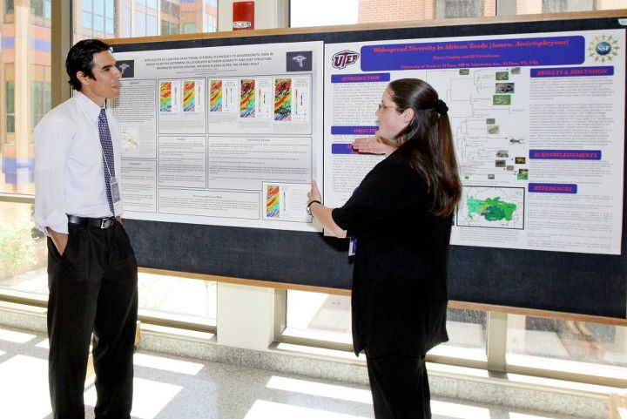
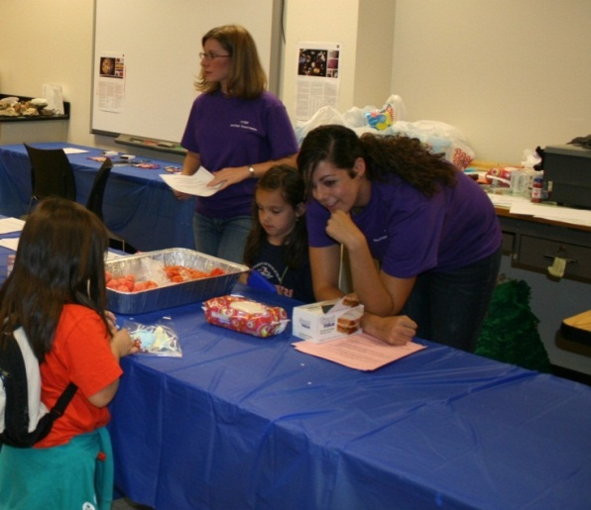
How Do You Gauge Success?
Quantitative:
Institutional tracking
Know what department/office collects institutional and student data
Know the type of data collected and how it is used
Qualitative:
Keep track of students (majors) via alumni networks, newsletter, Facebook, Linked-In, etc.
Notes:
Quantitative: All 2YC will have an office or department that tracks student enrollment, graduation rates, majors, student demographics etc.
Collecting this data helps justify collaborations to 4YCs as well as 2YC administrators for the need and support of collaborations.
Knowing what data is most important (i.e. for institutional and state funding, accreditation, or curriculum development) will help in building the necessary steps for a successful collaboration. (e.g. UTEP requested EPCC build more course diversity in our A.S. degree plan. Therefore we justified the addition and creation of geology capstone courses to EPCC administrators by showing the number of geology majors, graduates, and course enrollment over the course of a 5 year period.)
Qualitative: The POV of students on their experience at your 2YC and their experience in the transfer process to a 4YC is an invaluable resource. Students often have a hard time during the transition phase from a 2YC to a 4YC. Providing a means for students to express qualitative information on this transition allows for students feel more comfortable during this phase as well as provides a measure on how you can improve your 2YC program and collaboration.

Slide 14
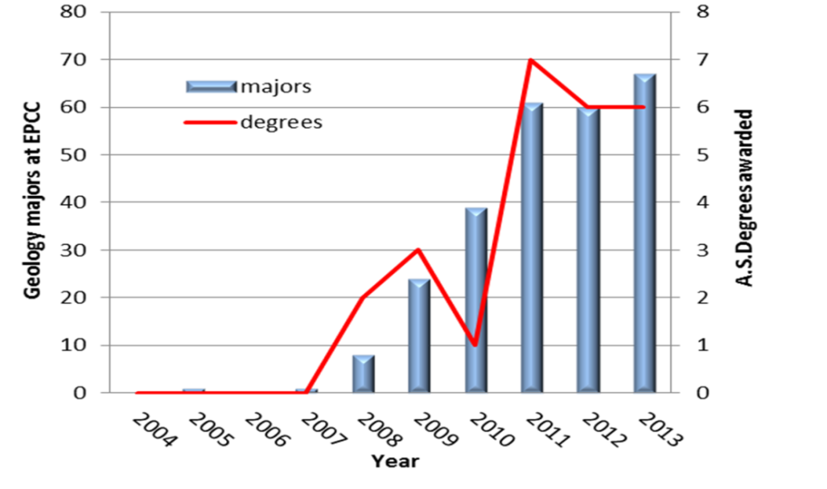
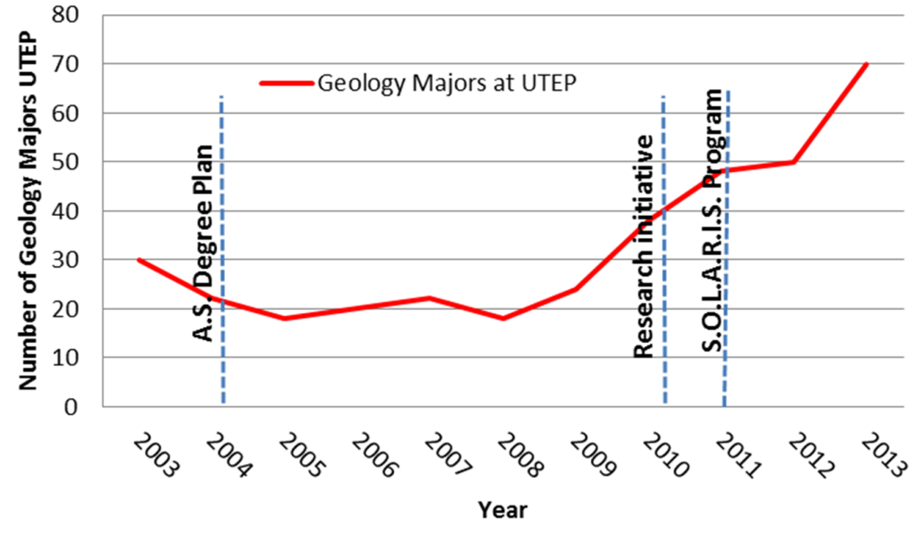
How Do You Gauge Success?
Quantitative data :
EPCC
UTEP
Notes:
This is an example of data that was presented to the EPCC administrators and curriculum committee to justify the creation of the most recent capstone course (Mineralogy GEOL 2411) at EPCC. The data was also used to demonstrate to UTEP faculty on the possible correlation of UTEP enrollment increase in the geosciences with the increase of declared geology majors and graduates at EPCC.

Slide 15
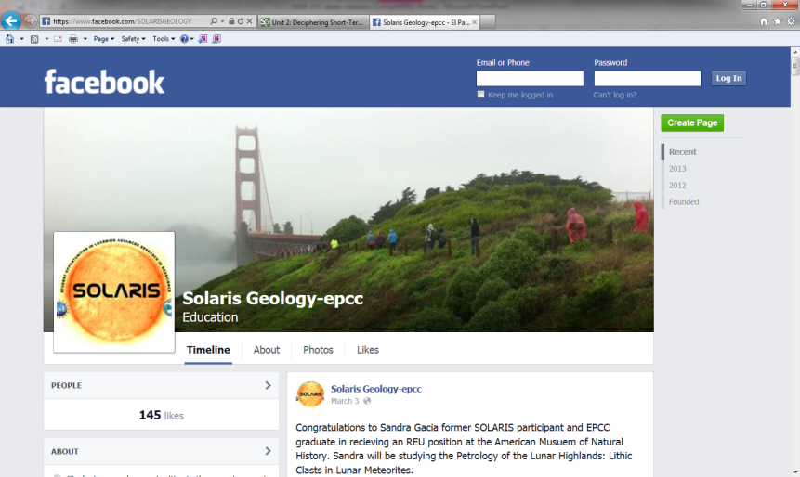
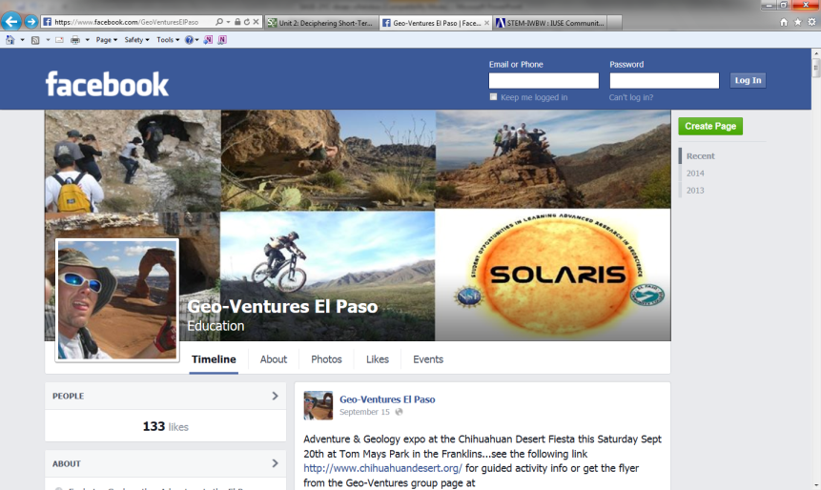
How Do You Gauge Success?
Qualitative:
https://www.facebook.com/SOLARISGEOLOGY
Promotes the SOLARIS activities, research, milestones and former EPCC students current successes at UTEP.
https://www.facebook.com/GeoVenturesElPaso
Helps promote geology courses and degree by developing outdoor learning experiences utilizing local geological sites.
Notes:
Facebook provides a means of reaching out to students to promote their successes, events, as well as a means for personal communication.
SOLARIS: NSF funded program that initiated the research collaborative between EPCC and UTEP. The SOLARIS FB page provided a means to highlight current and past student achievements. These achievements help promote collaborative efforts between EPCC and UTEP, how these efforts translate to successful student transfers to UTEP and beyond, and a means to self promote the geo-dept at EPCC to a socially tech-savvy student population.
GeoVentures: Not related to the GSA geoventures program, EPCC’s Geoventures help introduce EPCC students, who are not geology majors, to geology by combining outdoor recreational activities (rock climbing, mountain biking, hiking, etc.) with informative geological hands on activities and demonstrations.
Quantitative data (number of likes, comments, views, and shares) is collected for both FB sites and is used to help the EPCC geology discipline plan future projects.

Slide 16
Thanks to:
Contact information:
Joshua Villalobos
Email: jvillal6@epcc.edu
El Paso Community College
Diane Doser
Email: Doser@utep.edu
University of Texas at El Paso

Slide 17
Heads & Chairs Webinar Series Schedule
Join us for the next webinar
When: October 24, from 1-2 pm EST
Topic: How to Work Towards Effective Articulation between 2-Year and 4-Year College Geoscience Programs
Register for this webinar and others at: http://www.americangeosciences.org/workforce/aguagi-heads-and-chairs-webinars/

Slide 18
Wrap-up
Audiovisual recording of today’s webinar will be available in the coming weeks.
If you have additional questions or comments about the webinar series, or would like to join the AGU Heads and Chairs listserv, or participate in the workshop at the AGU Fall Meeting, please contact Pranoti Asher at Pasher@agu.org

