Slide 1
Human Capacity Building
UNESCO’s Inspiration, Geosciences’ Global Footprint
Christopher M. Keane, American Geosciences Institute
Sarah M. Gaines, UNESCO
2 November 2015

Slide 2
UNESCO’s Capacity Building
Current Themes
  Building Knowledge Societies
  Education for the 21st Century
  Science for a Sustainable Future
All lead towards improving the human condition through sustainable development – economic, environmental, political, cultural pillars
Aligning with evolution in geoscience development and promoting complementary initiatives
Notes:
Outline how a number o fUNESCO’s current themes underpin the overarching capacity building argument. Also note that the geoscience profession is evolving towards the construct of a priority for local talent development.

Slide 3
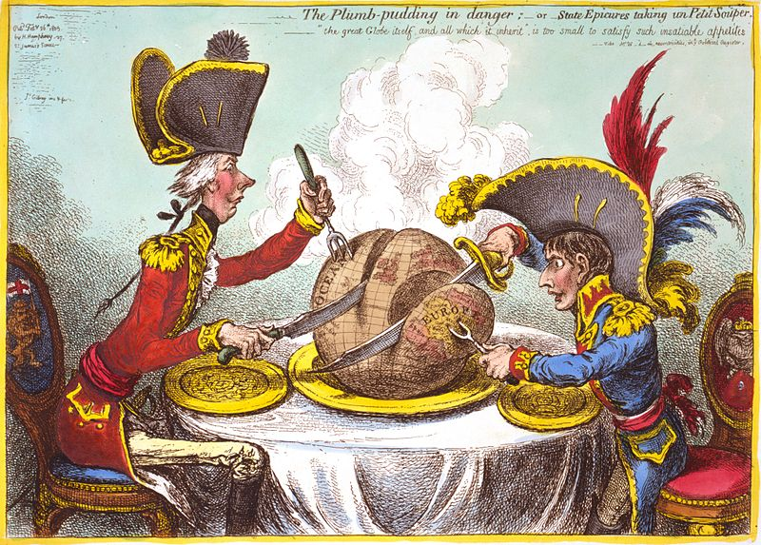
A Traditional Model of Talent Deployment
Professional geoscientists and managers come from developed countries
Labor usually is local
Majority of revenue repatriated to operating company’s country
Notes:
The general relationship of geology to the developing world prior to the end of the cold war.

Slide 4
Where are geoscientists sourced?
United States: 300,000 geoscientists
Russia: 80,000 geoscientists
Europe: 60,000 geoscientists
China: 50,000 geoscientists
Canada: 30,000 geoscientists
Africa: ~15,000 geoscientists
South America: Unknown
Middle East: Unknown
  Iraq: 5,000
India: Unknown
Not widely seen outside of their region
Source: AGI/IUGS Taskforce on Global Workforce
Notes:
The current distribution of talent also reflects this history.

Slide 5
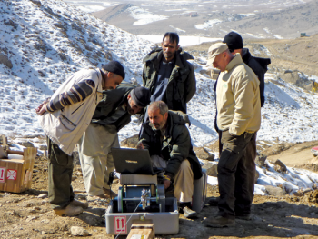
Rise of In-Country Development
Post Cold War Trend
Expats can be very expensive
Local talent has local advantage
Untapped intellectual potential
More wealth stays local
Examples
  Schlumberger globally
  Exxon in former Soviet republics
  USGS in Afghanistan
Notes:
Following the collapse of the USSR, with newly opened areas, the idea of developing local talent became palatable – both because of costs and because there was a pool of well educated individuals in those countries.

Slide 6
Brain drain issues
But sometimes there is not enough local work
Notes:
But, if the jobs are not lucrative enough, even with demand, local talent may flee.

Slide 7
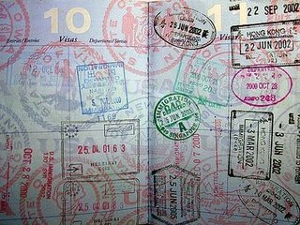
The Journeyman Geoscientist
What is a geoscientist’s citizenship?
  The education and career pathway can cross many nations
Development of local talent brings opportunities for expert solutions to critical issues
Development of local talent on a global level brings about mobility, economic and cultural exchange, and remittances
Notes:
But – as mobility barriers drop, this highly mobile workforce may become a critical good towards promoting local talent development – addressing local opportunities but also bringing in outside money back home and/or new investments later.

Slide 8

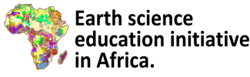
Build local talent to solve African geoscience challenges
Broaden recognition of the development role geoscience plays
Improve connection between industry, government and academia to catalyze talent development
Integrate African geoscience globally
Development of field mapping schools and a network of African geoscience programs
Notes:
Focus on the point that this is a UNESCO program focused on developing local African talent that is on par globally and has opportunities.

Slide 9

To facilitate exchange and collaboration in research and education among member institutions
To promote the use of modern technology and system approach in Earth sciences research and education
To facilitate linkages between universities/research institutions and Industries
To promote Earth sciences education in primary and secondary schools
To promote gender equity in access to Earth Science education
www.anesi.org
Notes:
UNESCO’s Earth Science Education Initiative is now being implemented through the African-owned and run African Network of Earth Science Institutions (ANESI) which is supported by UNESCO Nairobi

Slide 10

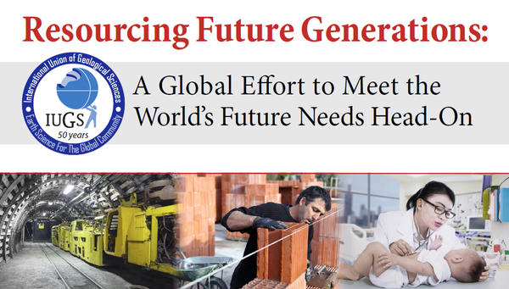
Uniquely spurred on by the geoscience community itself
Building capacity to promote reasonable development
Notes:
Don’t need to say much as Edmund is speaking about this just before. But real point is that the geo community is thinking about these issues-an with RFG, I think UNESCO’s mission presence really has helped this along.

Slide 11

INTRAW
International Raw Materials Observatory
EU-funded program, focused on sustainable materials development
Response to drop in access to resources outside of Europe
Focus on implementing/sharing global best practices
Yield new economic development in Europe, including economically stressed areas
A model for define a domain’s best practices openly
Notes:
A similar model, but EU focused, which has its own development challenges now. Plus, one output is an open platform on best practices that can be leveraged by global effort s like RFG or the Earth Science Initiative in Africa

Slide 12
The global footprint
Geoscience’s future is global
UNESCO’s presence is a mission in itself towards this ultimate end
Geoscience engaging in local capacity building can be transformative given our relationship with base economic activity!
Geoscience needs to find a role – and a profile - in the 2030 Sustainable Development Goals
Notes:
We are on our way towards being a profession that is embracing global local capacity building and given our role in base economic activites, can be transformative.

