Slide 1
Potential Future Member Services
AGU Talent Development Initiatives
Chris McEntee
Executive Director

Slide 2
Notes:
Focus on talent pool part of the plan and opportunities for collaboration

Slide 9
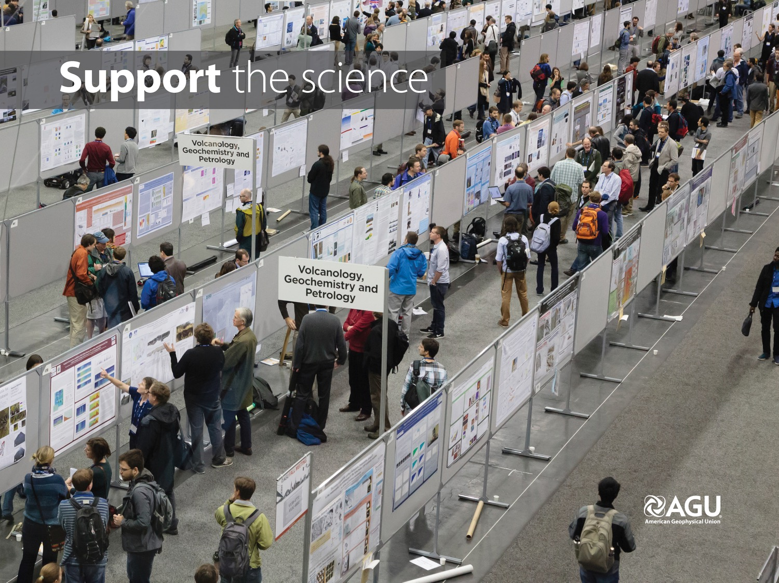

Slide 13
Virtual Poster Showcase
GeoLEAD
New Talent Pool Engagement Opportunities

Slide 14
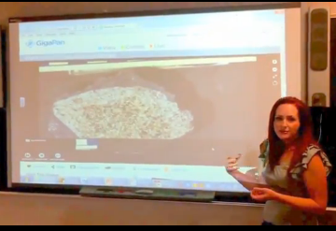
Virtual Poster Showcase
Notes:
Reduces cost and time commitments
Makes the opportunity to present widely available
Develop skills in more students
Build broader engagement and retention
Help faculty leverage their time and effort

Slide 15
Virtual Poster Showcase Process
Evaluation:
Round One
Evaluation:
Round Two
Submit an abstract
Upload a poster and presentation video
Top posters in each division reviewed by expert judges
Participate in peer evaluation
Top posters recognized
Time Period:
Two weeks
Two weeks
Two weeks
Upon acceptance of their abstract, each undergraduate student will upload an electronic version of their poster and a three to four minute video presentation (or link to a video).
Each student will evaluate two to three of their peers’ posters. Students may ask questions and post responses. The highest ranked in each division will be evaluated by the expert panel.
A panel of expert judges will review the highest rated posters from round one. Judges may ask questions and discuss reactions. The number of posters evaluated in this round depends on the number of judges.
Notes:
The process to participate – from anywhere
Abstract submission
Upload e-poster and video (or video link)
Peer evaluation
Expert judging

Slide 16
Next Steps: Pilots
Testing pilots this fall
Projected 2016 schedule:
April: multi-organization poster showcase
October: multi-organization virtual poster showcase
November: AGU Fall Meeting virtual poster showcase
Develop virtual student conference capability as an optional phase, so that poster award recipients can discuss their posters in a live format, and to add additional features, such as career development webinars and virtual job fairs

Slide 17
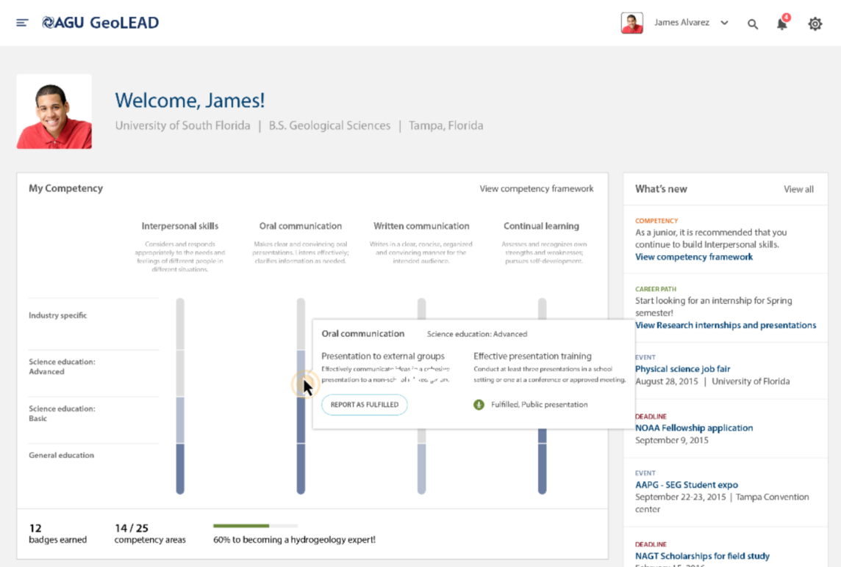
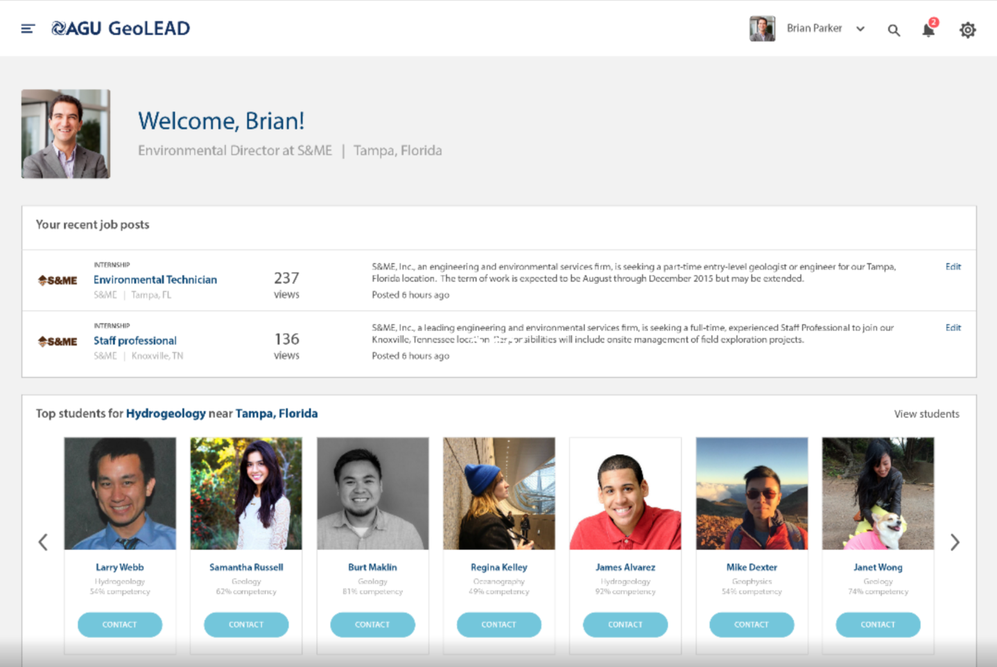
GeoLEAD
Opportunities
Attract more students
Retain more students
Get more students into
the workforce
Current status
Validated need and
opportunity with students,
faculty, employers, societies
Prototyped site design
Conducted initial round of testing on prototype
Notes:
This is the governance diagram

Slide 18
What is in GeoLEAD For Students
1. Search for programs and services
Resume Writing
Student Chapters
Mentors
Internships
SEARCH
Jobs
Training
2. Search Plus Recommendations

Slide 20
Learn more at
http://education.agu.org/
For more information:
Harry Furukawa Billy Williams
hfurukawa@agu.org bwilliams@agu.org
Notes:
This is the governance philosophy

Slide 21
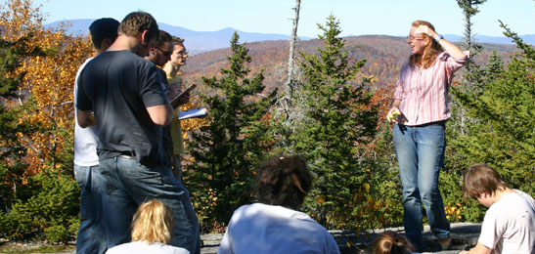
Discussion
What are other future services for offering
by our Scientific Societies?

