Slide 1

Getting our Message to the Public and Policymakers
Steve Pierson
Director of Science Policy
American Statistical Association

Slide 2
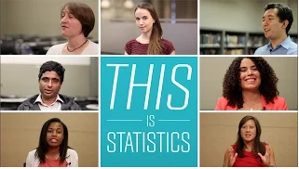
This is Statistics
ASA’s PR Campaign

Slide 3
Outline
Our challenges/goals
The American Statistical Association
Public Relations Campaign
Policy Efforts

Slide 4

Statisticians’ challenges
Statisticians are:
  People consulted after data collection to analyze data in support of desired result
  Mathematicians who deal with probability
  People who collect numbers
  People who do surveys
  None of the above
Statistics: Singular or Plural?
  Plural: data , numbers
  Singular: science of learning from data and quantifying associated uncertainty
Notes:
Share BDSSG story

Slide 5


Statisticians’ challenges (cont’d)
Google “Statistics Definition”: The branch of mathematics dealing with numerical data
Big Data
% of HS Stats teacher with Stats degree <10%
NAS and NSF Panels
Data Science, Analytics, Machine Learning, econometrics, psychometrics, sabermetrics, …
Notes:
Share National Academy and NSF panel stories

Slide 6
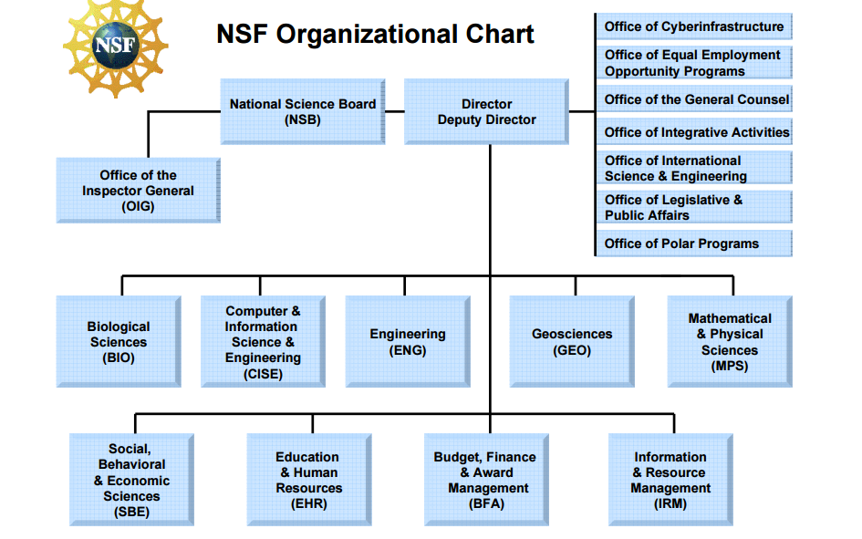
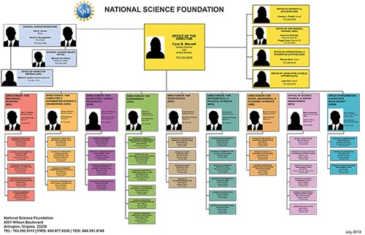
Challenges: Research Funding

Slide 7
What Statistics has going for it
NCES IPEDS

Slide 8
What Statistics has going for it
NCES IPEDS

Slide 9

What Statistics has going for it
Positive press and ratings
  For Today’s Graduate, Just One Word: Statistics, New York Times, August 5, 2009
  Statistical Analysis and Data Mining top “The 25 Hottest Skills That Got People Hired in 2014”
  Careercast names Statistician one of 2015 top jobs for millennials
  …
Nature’s 100 most cited research articles ever:
  Nine by statisticians

Slide 10
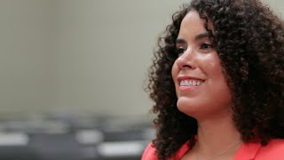
How we’d like you to view Statistics
Independent scientific discipline
Not a tool bag but a type of critical thinking
Statistics improves science, business, policy …
Statistical literacy helps everyday decisions whether personal (health, finance) or career
Statistics prepares one
for diversity of careers

Slide 11
American Statistical Association
19,000 Members
  Membership a concern but not addressed by TiS
35 Staff Members (1.5 Statisticians, Three PhD’s)
Annual Budget: $9.2 million
Main Revenue: dues, journals, meetings
One major meeting 6000-7000 attendees
New positions in last 8 years
  Director of Science Policy 2008
  Public Relations Coordinator 2012
  Director of Development 2014

Slide 12

This is Statistics Campaign
$200K/yr contract with DC communications firm
Launched August 2014
Primary Audience: HS and undergrad students
Message: benefits of statistics knowledge/degree for career
Contract covers: webpage content, media outreach, social media, outreach to teachers/counselors associations, content development (videos, profiles)
http://thisisstatistics.org/

Slide 13

This is Statistics

Slide 14

ASA Process and Selection
Three board meeting discussions: 2013
  Subcommittee appointed
RFP in Fall 2013
Proposal review October 2013
Interview/selection in November 2013

Slide 15
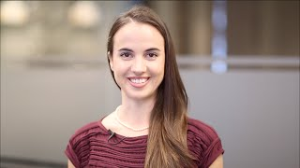
Management
Contact several times a week
Monthly call to review progress and next steps
Quarterly meeting of principals
Annual contract

Slide 16
Metrics
Twitter Followers: 2,230; Facebook likes: 3,643
Video views: 1,200 to 22,000
Media outreach
Website visits:

Slide 17
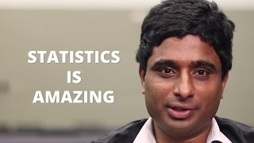
Work to be done:
How to leverage ASA resources
  Ongoing, expanding
  19,000 members
  Numerous communication channels
  100+ Statistics/Biostatistics departments
  Other partners (e.g., federal statistical agencies)
Better reach students
Next steps for campaign?
  Media pitches
  Videos
  Advertising?

Slide 18

Policy Work
Increased activity spurred in 2012
  rejected proposal to change NSF Division of Mathematical Sciences to Division of Mathematical and Statistical Sciences
Whitepapers/one-pagers on how statisticians can advance OSTP Initiatives
Meetings at NIH, NSF, OSTP
ASA Board statement on Data Science: Foundation is
Database management + Statistics/Machine Learning
+ Parallel/Distributed computing

Slide 19

Summary
ASA’s challenge: lack of visibility and understanding of statistics
One prong of ASA response: This is Statistics
Multi-faceted approach also includes PR, Policy
Results?
        TBD

Slide 20

Questions?
pierson@amstat.org

