Slide 2
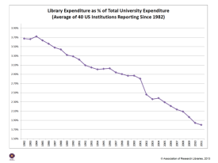
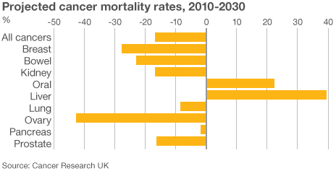
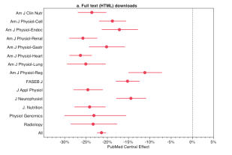
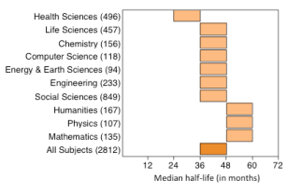
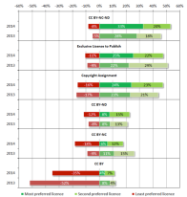
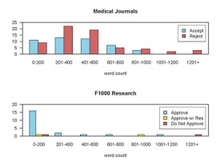
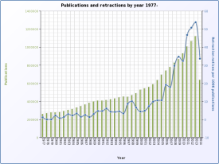
Technology and Social Trends
Some trends society leaders are facing in the early 21st Century
Kent R. Anderson
Publisher, AAAS/Science

Slide 3
Trend #1
Science Is Taken for Granted

Slide 5
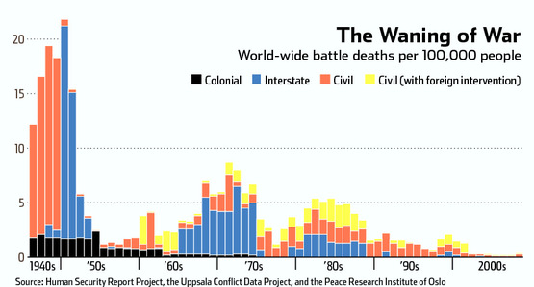

Slide 6
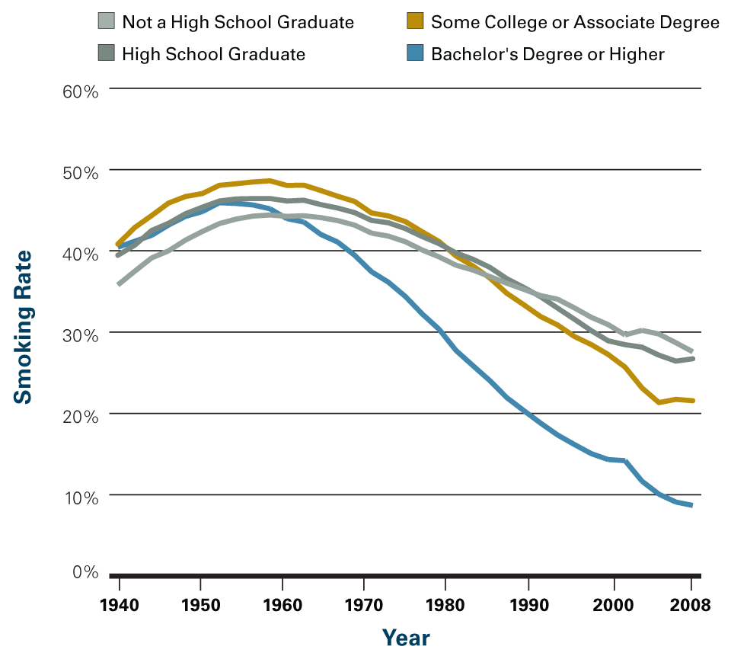

Slide 8
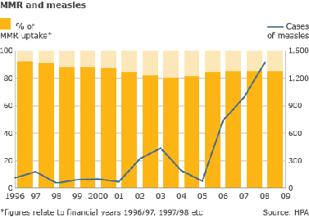

Slide 9
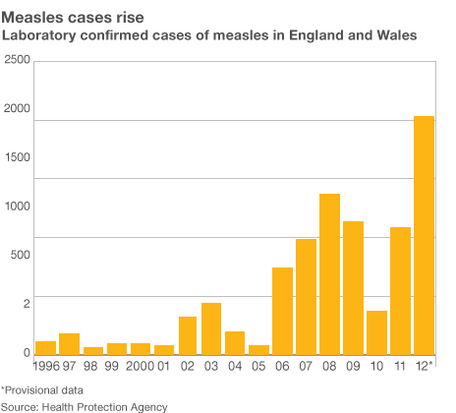

Slide 10
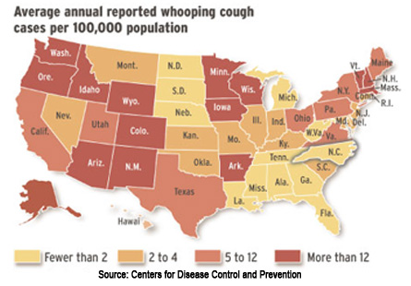

Slide 11
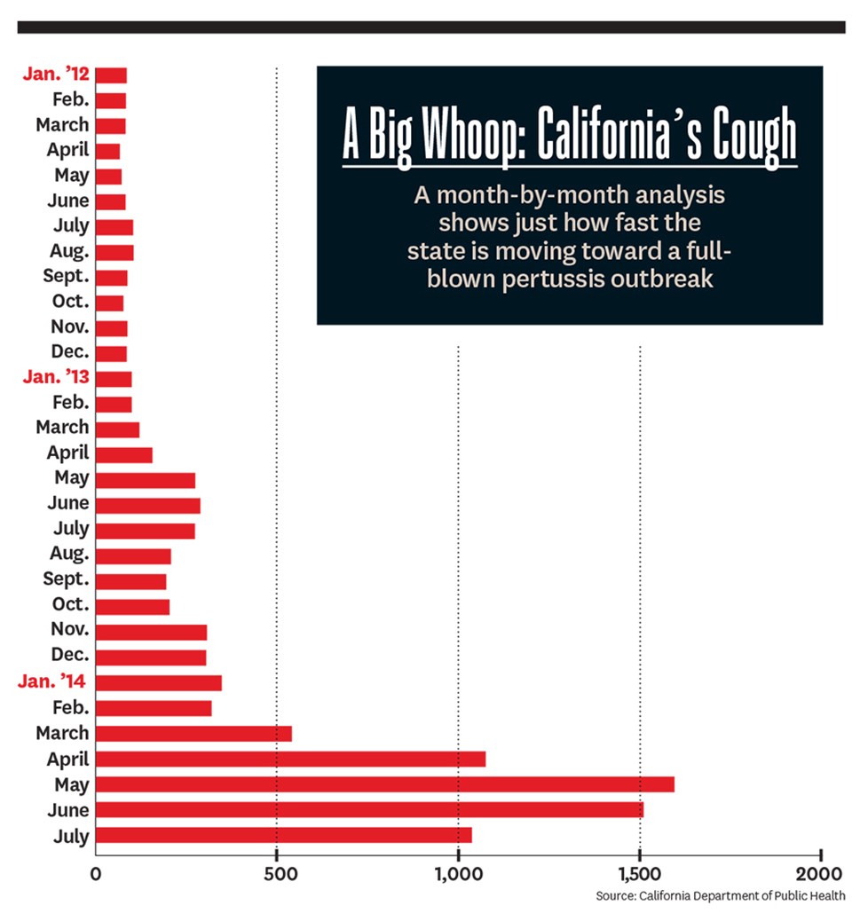

Slide 12
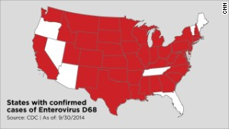

Slide 13
Trend #2
Too Many Scientists, Not Enough Funding

Slide 16
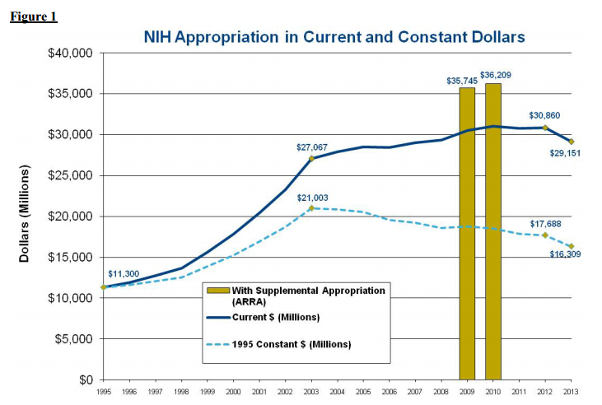

Slide 17
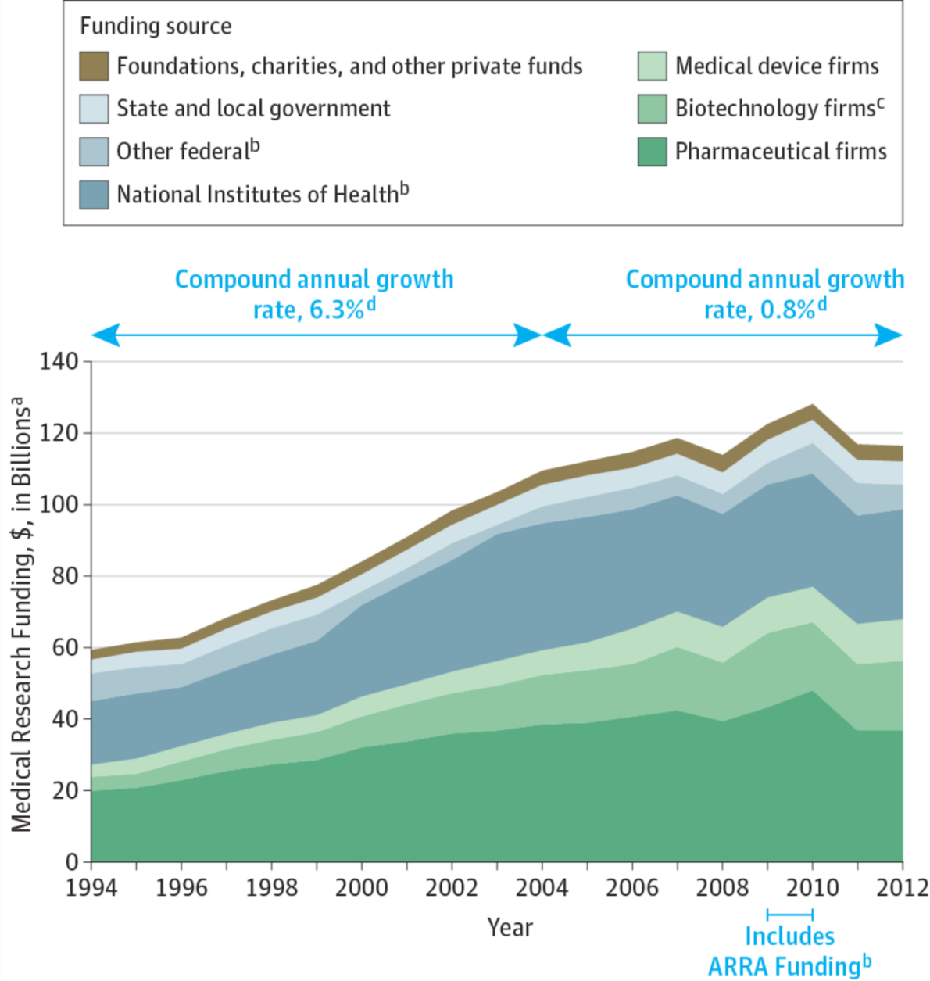

Slide 19
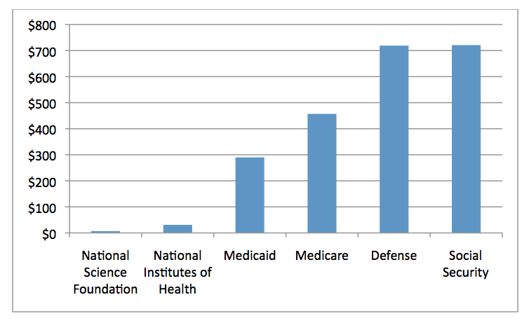

Slide 20
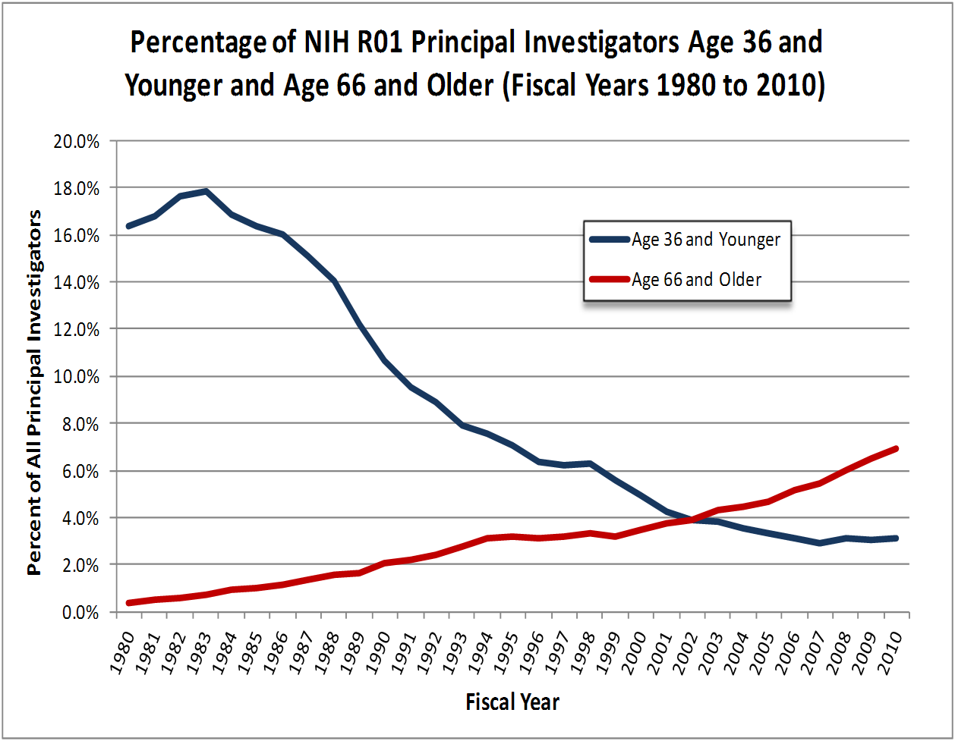

Slide 21
Talk to actual scientists, and . . .
Top concern is funding
Younger scientists are checking out
Glut of scientists
Older scientists hanging on too long
Top concern is funding
Careers are too uncertain
Contracts are unfair, research is serfdom
Top concern is funding

Slide 22
Trend #3
“Publish or Perish” Drive Quality vs. Quantity Tensions

Slide 23
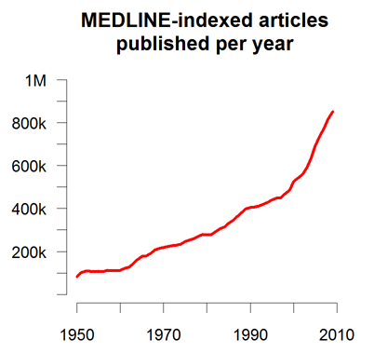

Slide 24
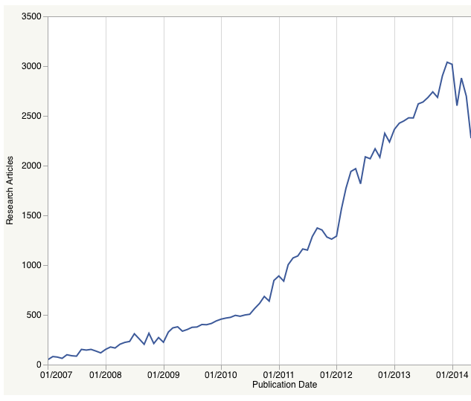

Slide 25
More Papers per Journal
+15%

Slide 26
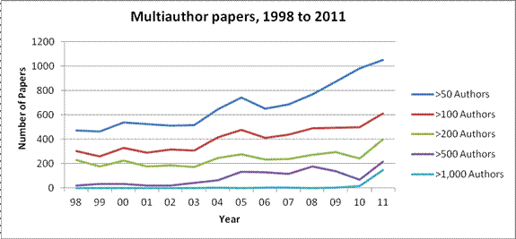

Slide 27
Retractions: On the Rise

Slide 29
Growth in OA Slowing Dramatically
Publication rates of 20 major OA journals, 2012-2014

Slide 30
Growth Slowing Dramatically
CAGR of article publication for 20 major OA journals, 2011-2014
CAGR
17.0%
CAGR
-2.2%
CAGR
63.7%
CAGR
3.3%
CAGR
21.2%
CAGR
48.7%

Slide 31
Trend #4
Inequities in Society Are Reflected in Academia

Slide 32
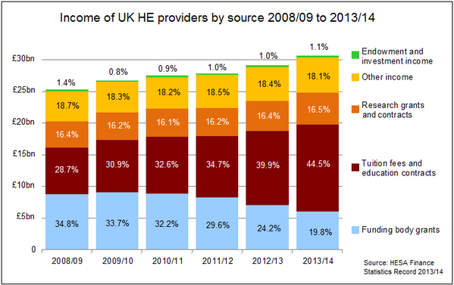

Slide 33
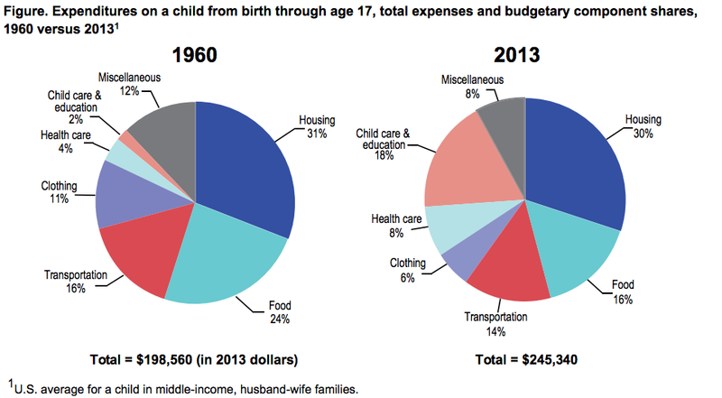

Slide 34
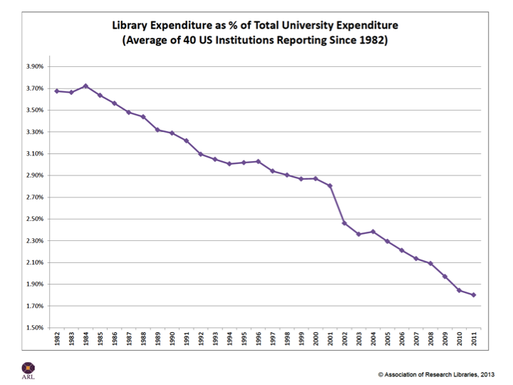

Slide 35
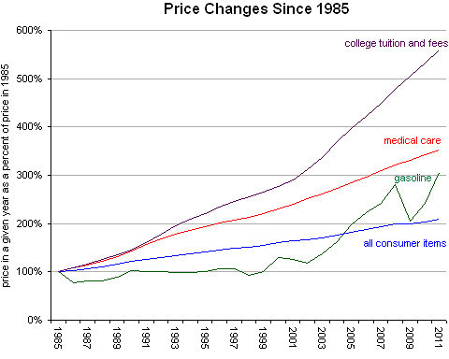
=
X

Slide 39
“Stop Universities from Hoarding Money”
Last year, Yale paid about $480 million to private equity fund managers as compensation — about $137 million in annual management fees, and another $343 million in performance fees, also known as carried interest — to manage about $8 billion, one-third of Yale’s endowment.
In contrast, of the $1 billion the endowment contributed to the university’s operating budget, only $170 million was earmarked for tuition assistance, fellowships and prizes. Private equity fund managers also received more than students at four other endowments I researched: Harvard, the University of Texas, Stanford and Princeton.
August 19, 2015 – The New York Times – Victor Fleischer

Slide 40
Sitting on Piles of Money

Slide 41
Rich Schools, Poor Students
“. . . the highest-endowment colleges and universities, which need government subsidies the least, get the greatest subsidy per student.”
January 2015 – American Institutes for Research

Slide 42
Harvard’s “Journals Crisis”

Slide 43
Companies
Revenues
7.4%
71%
92.6%
29%

Slide 45
Trend #5
Hiring for the Future Means More Analysts and Technologists

Slide 46
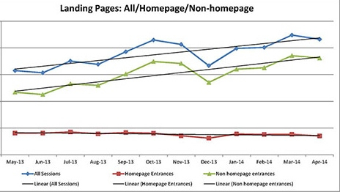

Slide 47
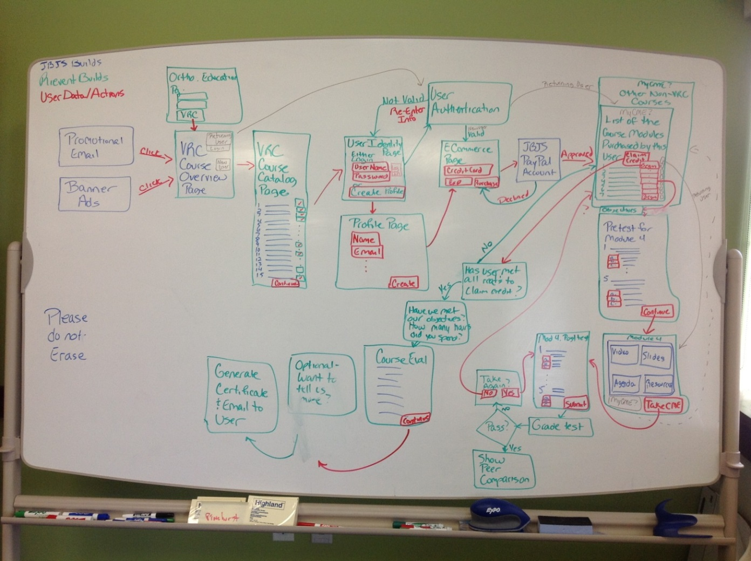
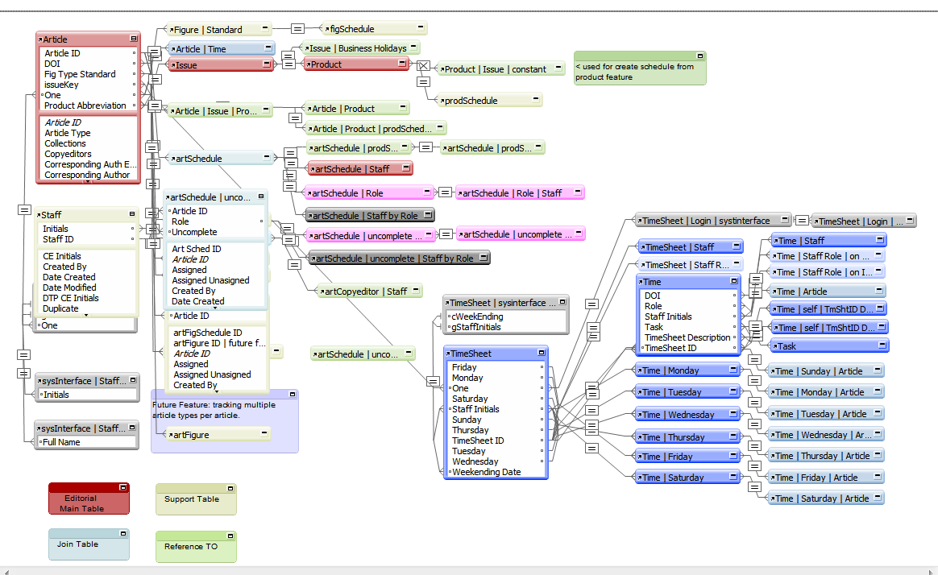
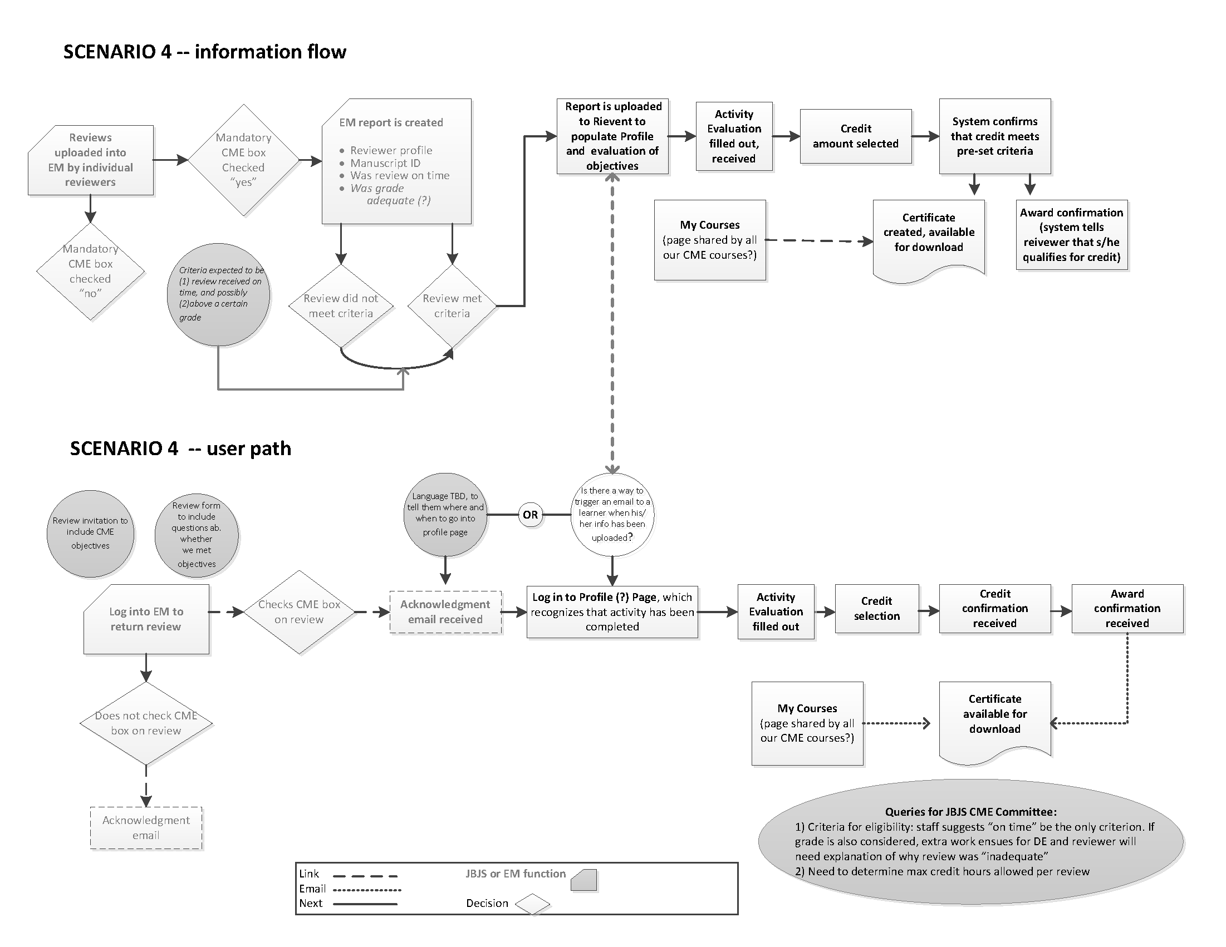

Slide 48
Trend #6
The Internet Sucks

Slide 49
Why the Internet Sucks
It creates bigger companies
It has undercut the Fourth Estate
It feeds income and societal inequities
It’s not where we want it (wi-fi on planes)
It’s where we don’t want it (tracking locations)
It’s the location of today’s Cold War
It’s more expensive to manage, but pays less
Sexy sells – get used to it

Slide 50
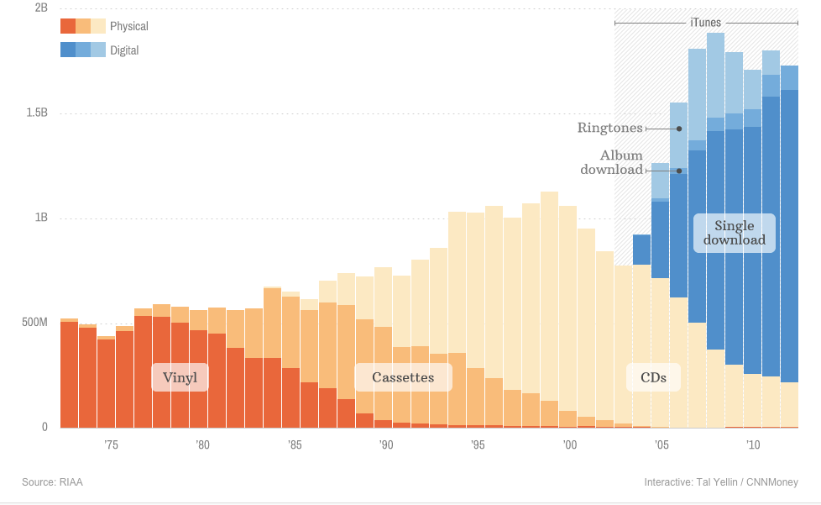

Slide 51
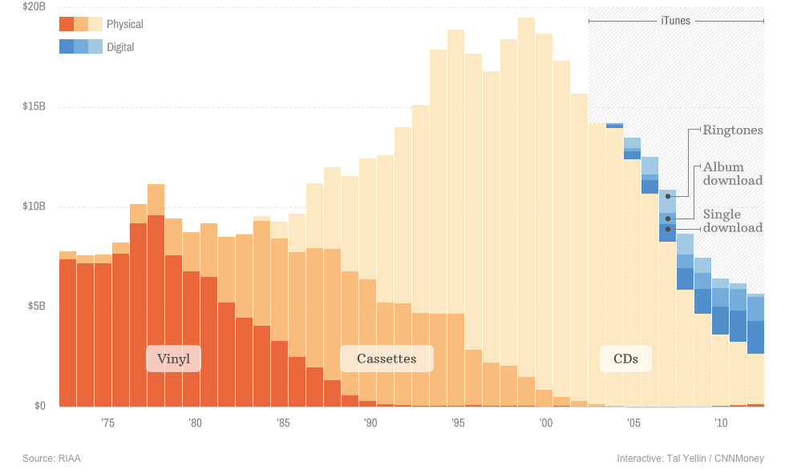

Slide 52
Trend #7
More Data, Less Analysis, and Bad Ideas Echo Far Too Long

Slide 53
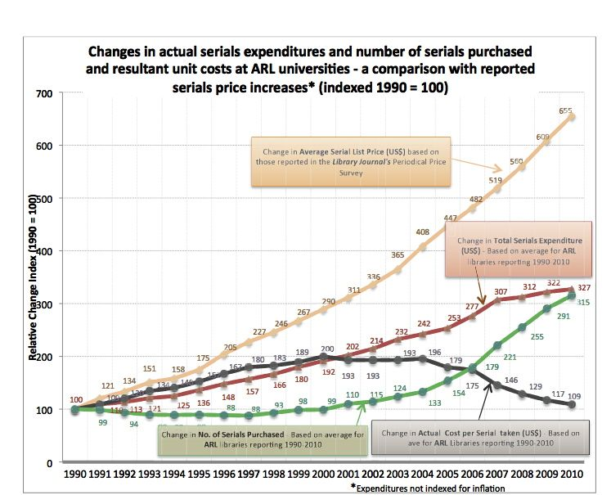

Slide 56
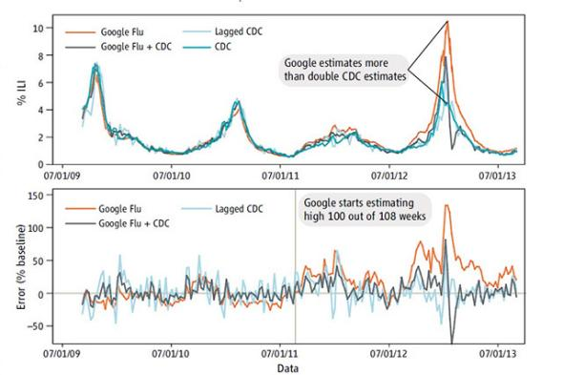

Slide 57
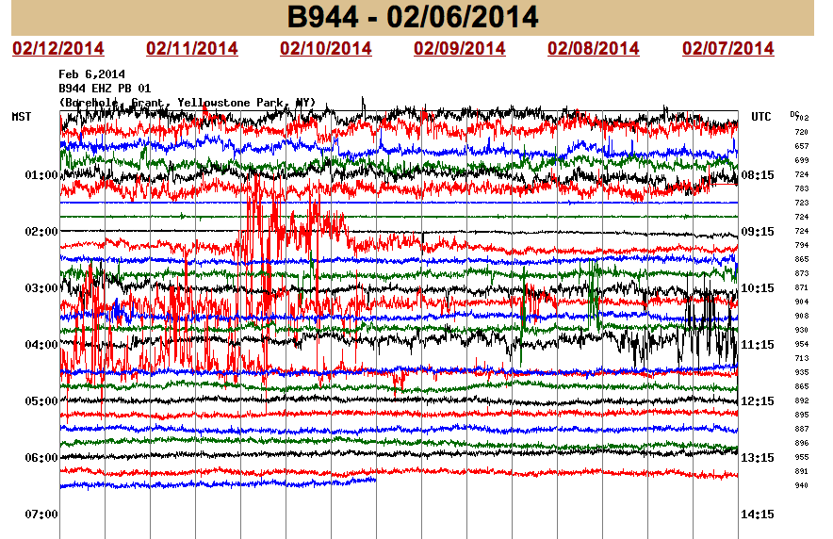

Slide 58
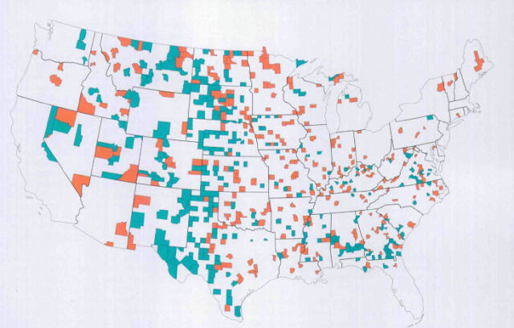

Slide 61
Ideas Have Become Politics
“Trickle down” economics is 35 years old, completely disproven, yet still persists
Anti-vaccination worries are bunk, yet the notion persists, even in educated ranks
Climate change is upon us, yet large swaths of the public believe it is a hoax
Bad ideas hide behind the “I’m not a scientist” shield, which completes as, “I’m a politician”

Slide 62
What Does It All Mean?
Until the funding of education and science improves, margins and growth are throttled
Technology costs will continue to increase
“Big data” and related efforts will be more difficult to realize, can be treacherous
Quality and quantity tensions will grow
The “Higher Ed Bubble” will leak or pop
The culture wars will continue to demand blood and treasure from scientific societies

Slide 63
“The #1 issue in public access is the public funding of science.”
Fred Dylla, AIP

Slide 64
Thank You
Kent R. Anderson
@kanderson

