Slide 1


Rock Types in the Contiguous U.S.
Put together by the American Geosciences Institute utilizing
The Cooperative National Geologic Map
by the U.S. Geological Survey and the Association of American State Geologists
Thank you to Sam Johnstone and Joe Colgan, USGS, for creating and sharing the maps.

Slide 2
Details and Directions
On slide 4 is a build of map layers of igneous rocks, metamorphic rocks, sedimentary rocks, unconsolidated sediment, and glacial till. These maps can be viewed in any combination you like utilizing the “Selection” tool on power point.
Click on an image.
Select “Picture Format” from the top tool bar.
On the right pane, select the eyeball icon to turn a layer on/off.
Feel free to use the map build, pull pieces from it, and/or utilize individual maps (slides 6-10).
These maps were created from the Cooperative National Geologic Map, which is available on an Earth Science Week poster and a USGS interactive database. For more information about how this map was created, watch this Earth Science Week Geologic Mapping and Modeling webinar and/or read this USGS report.

Slide 3
Map Build

Slide 4
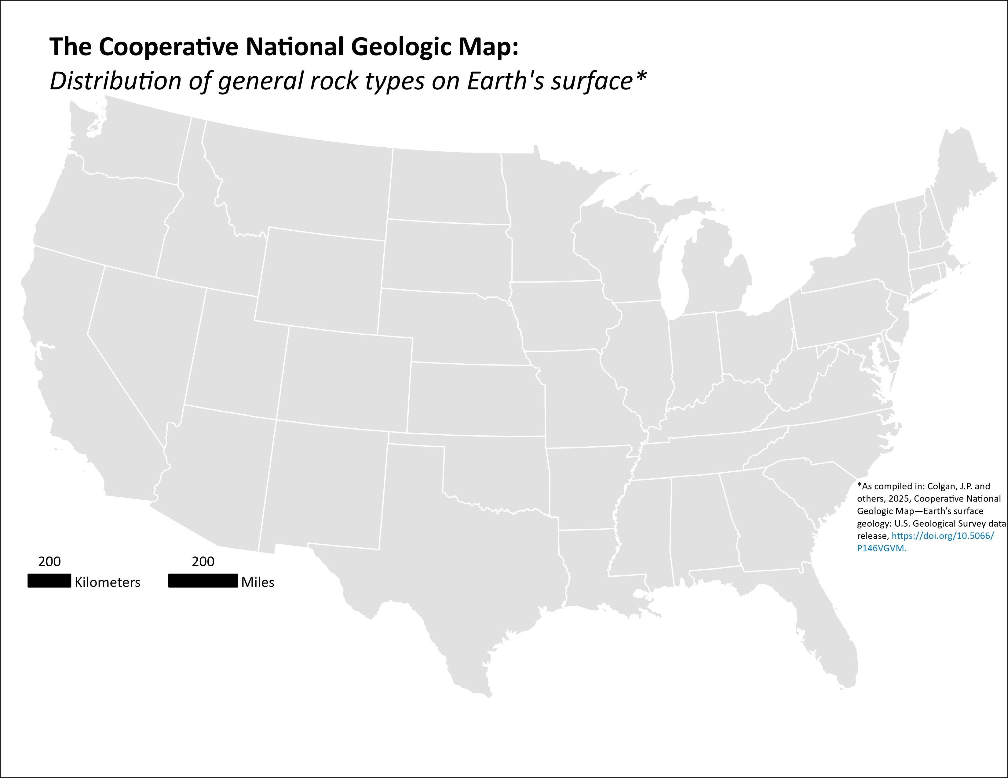
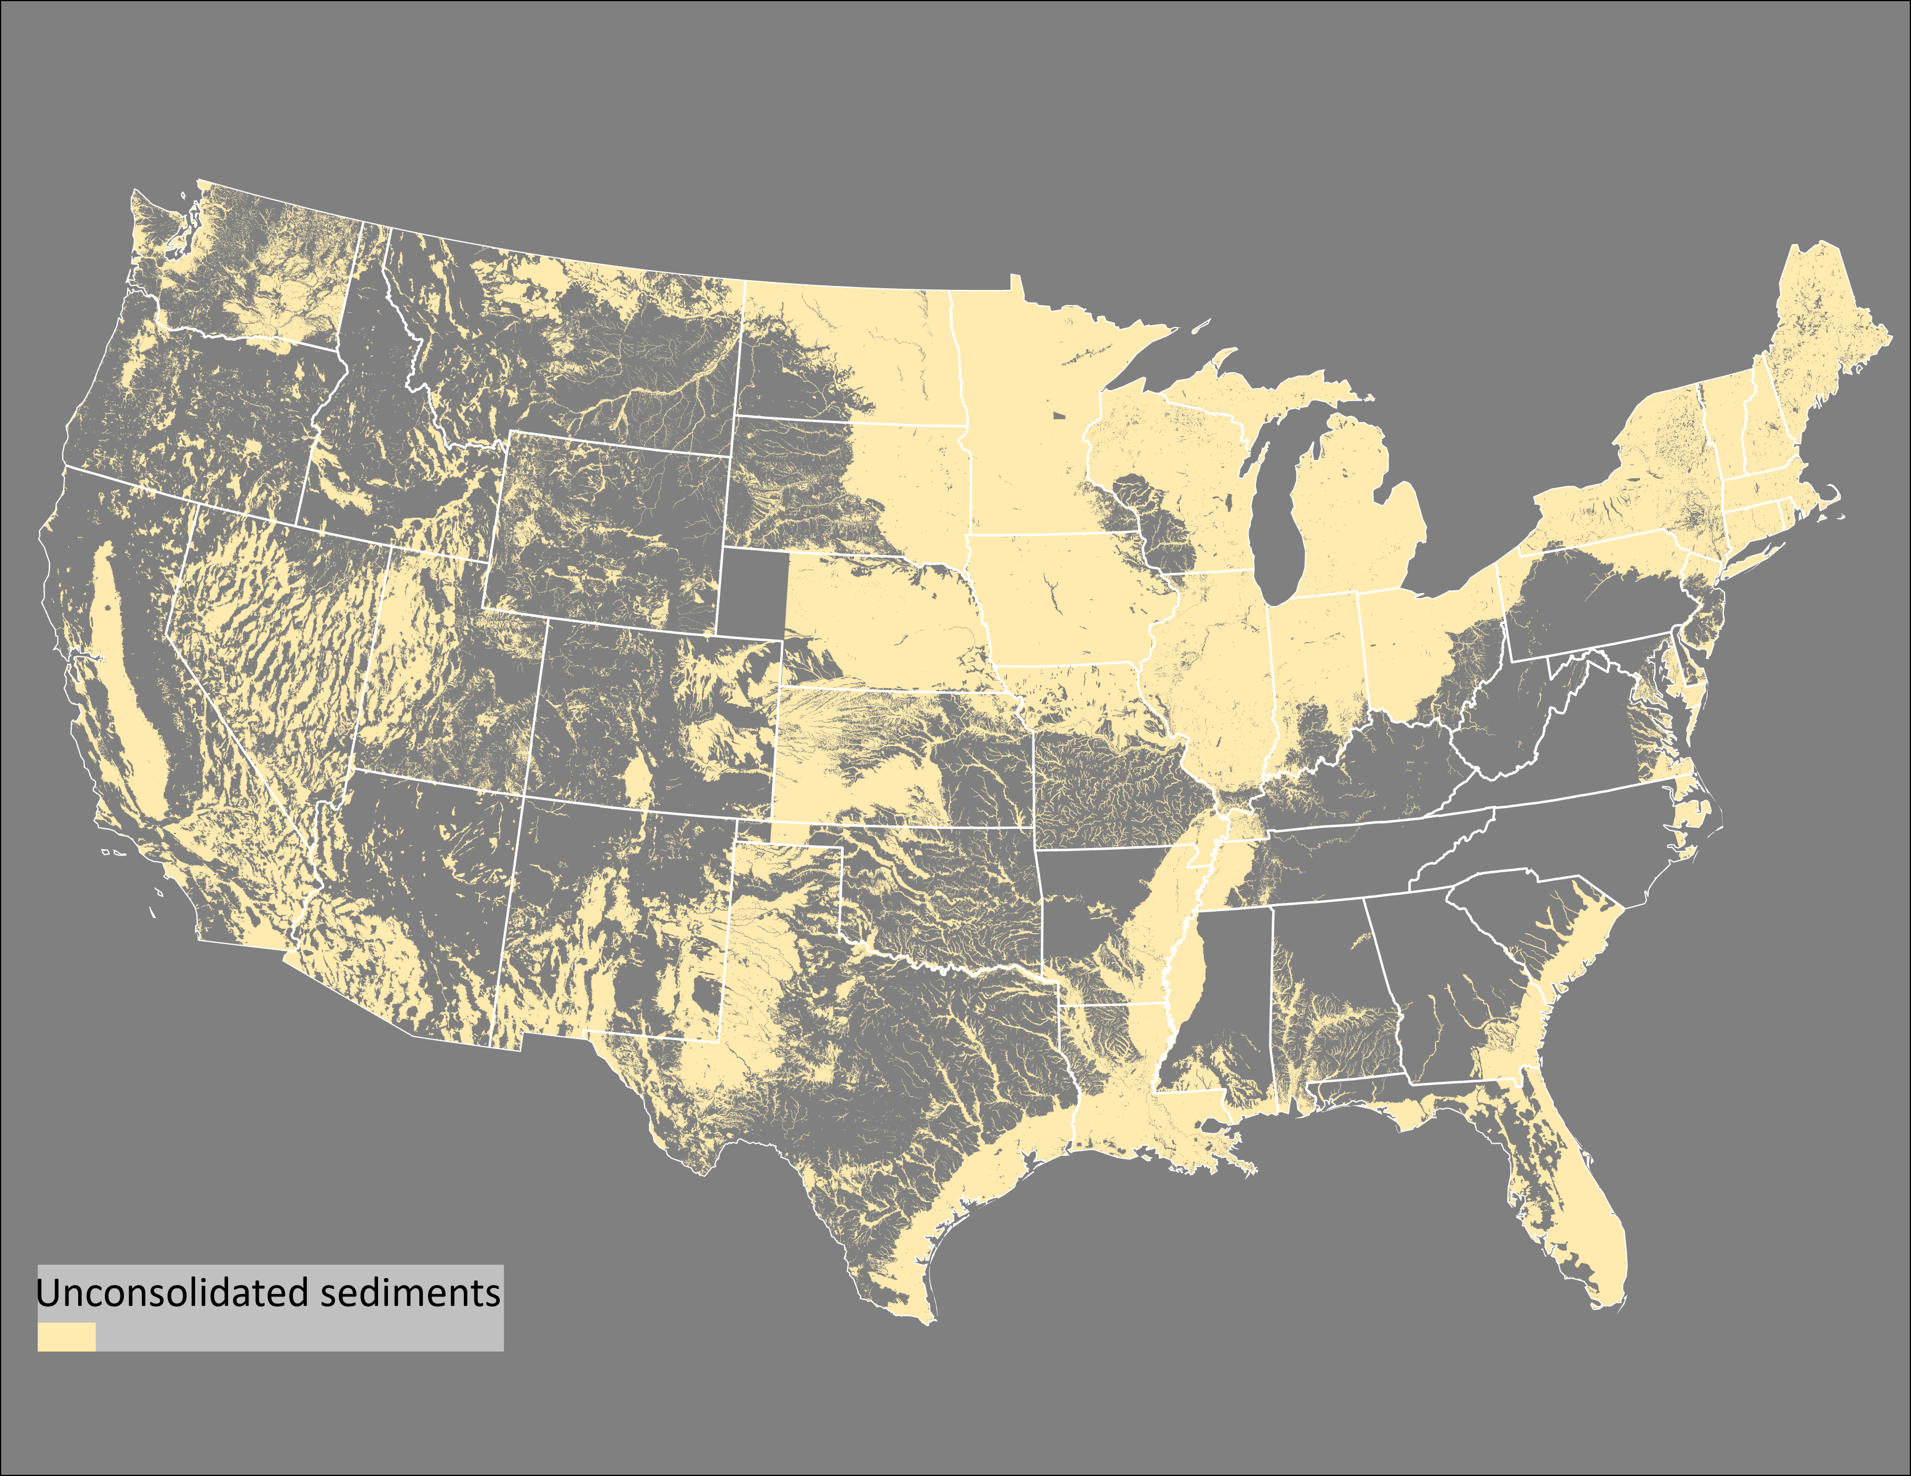
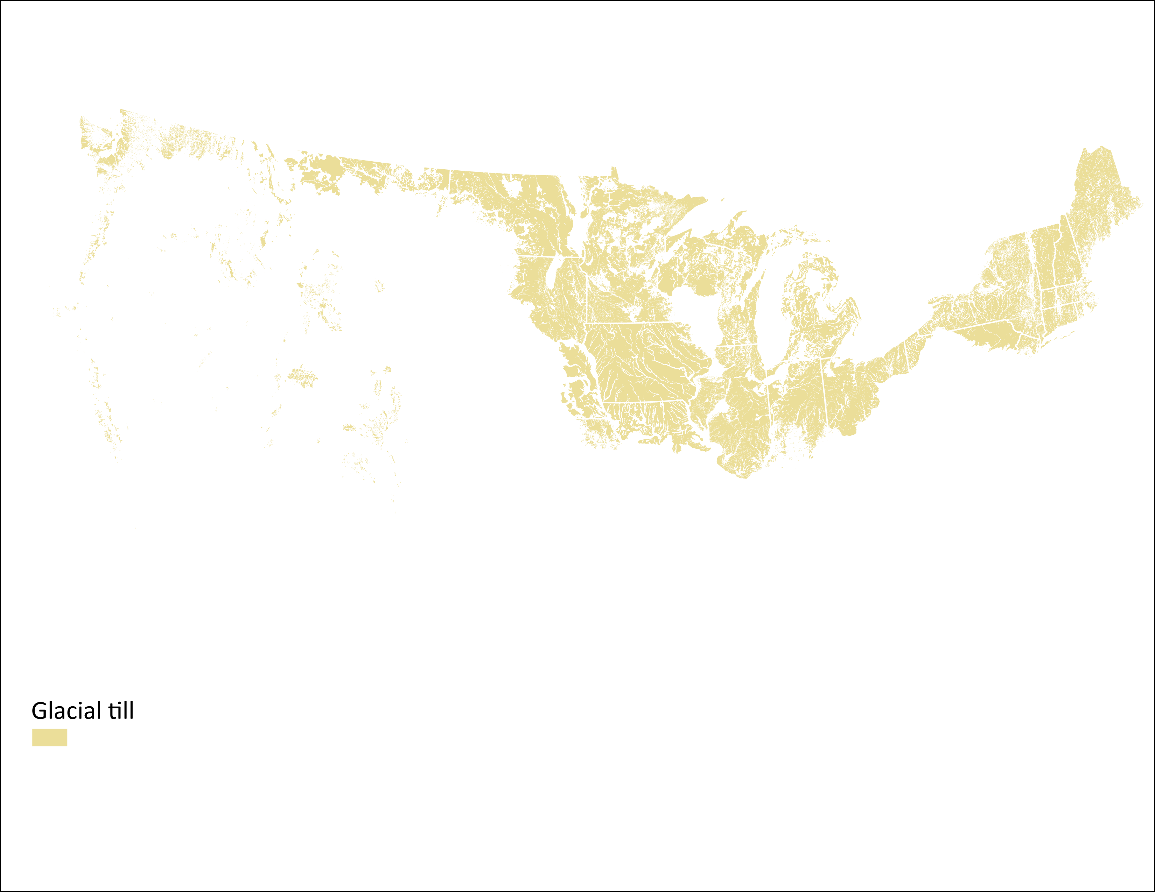
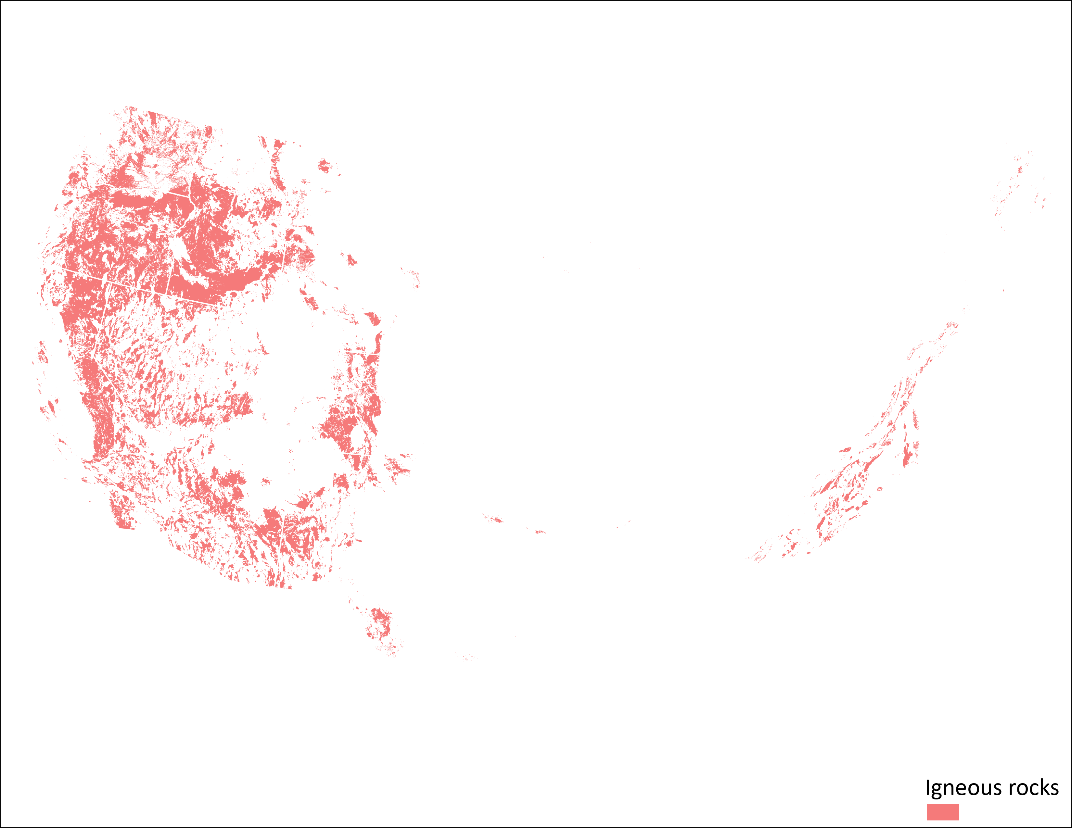
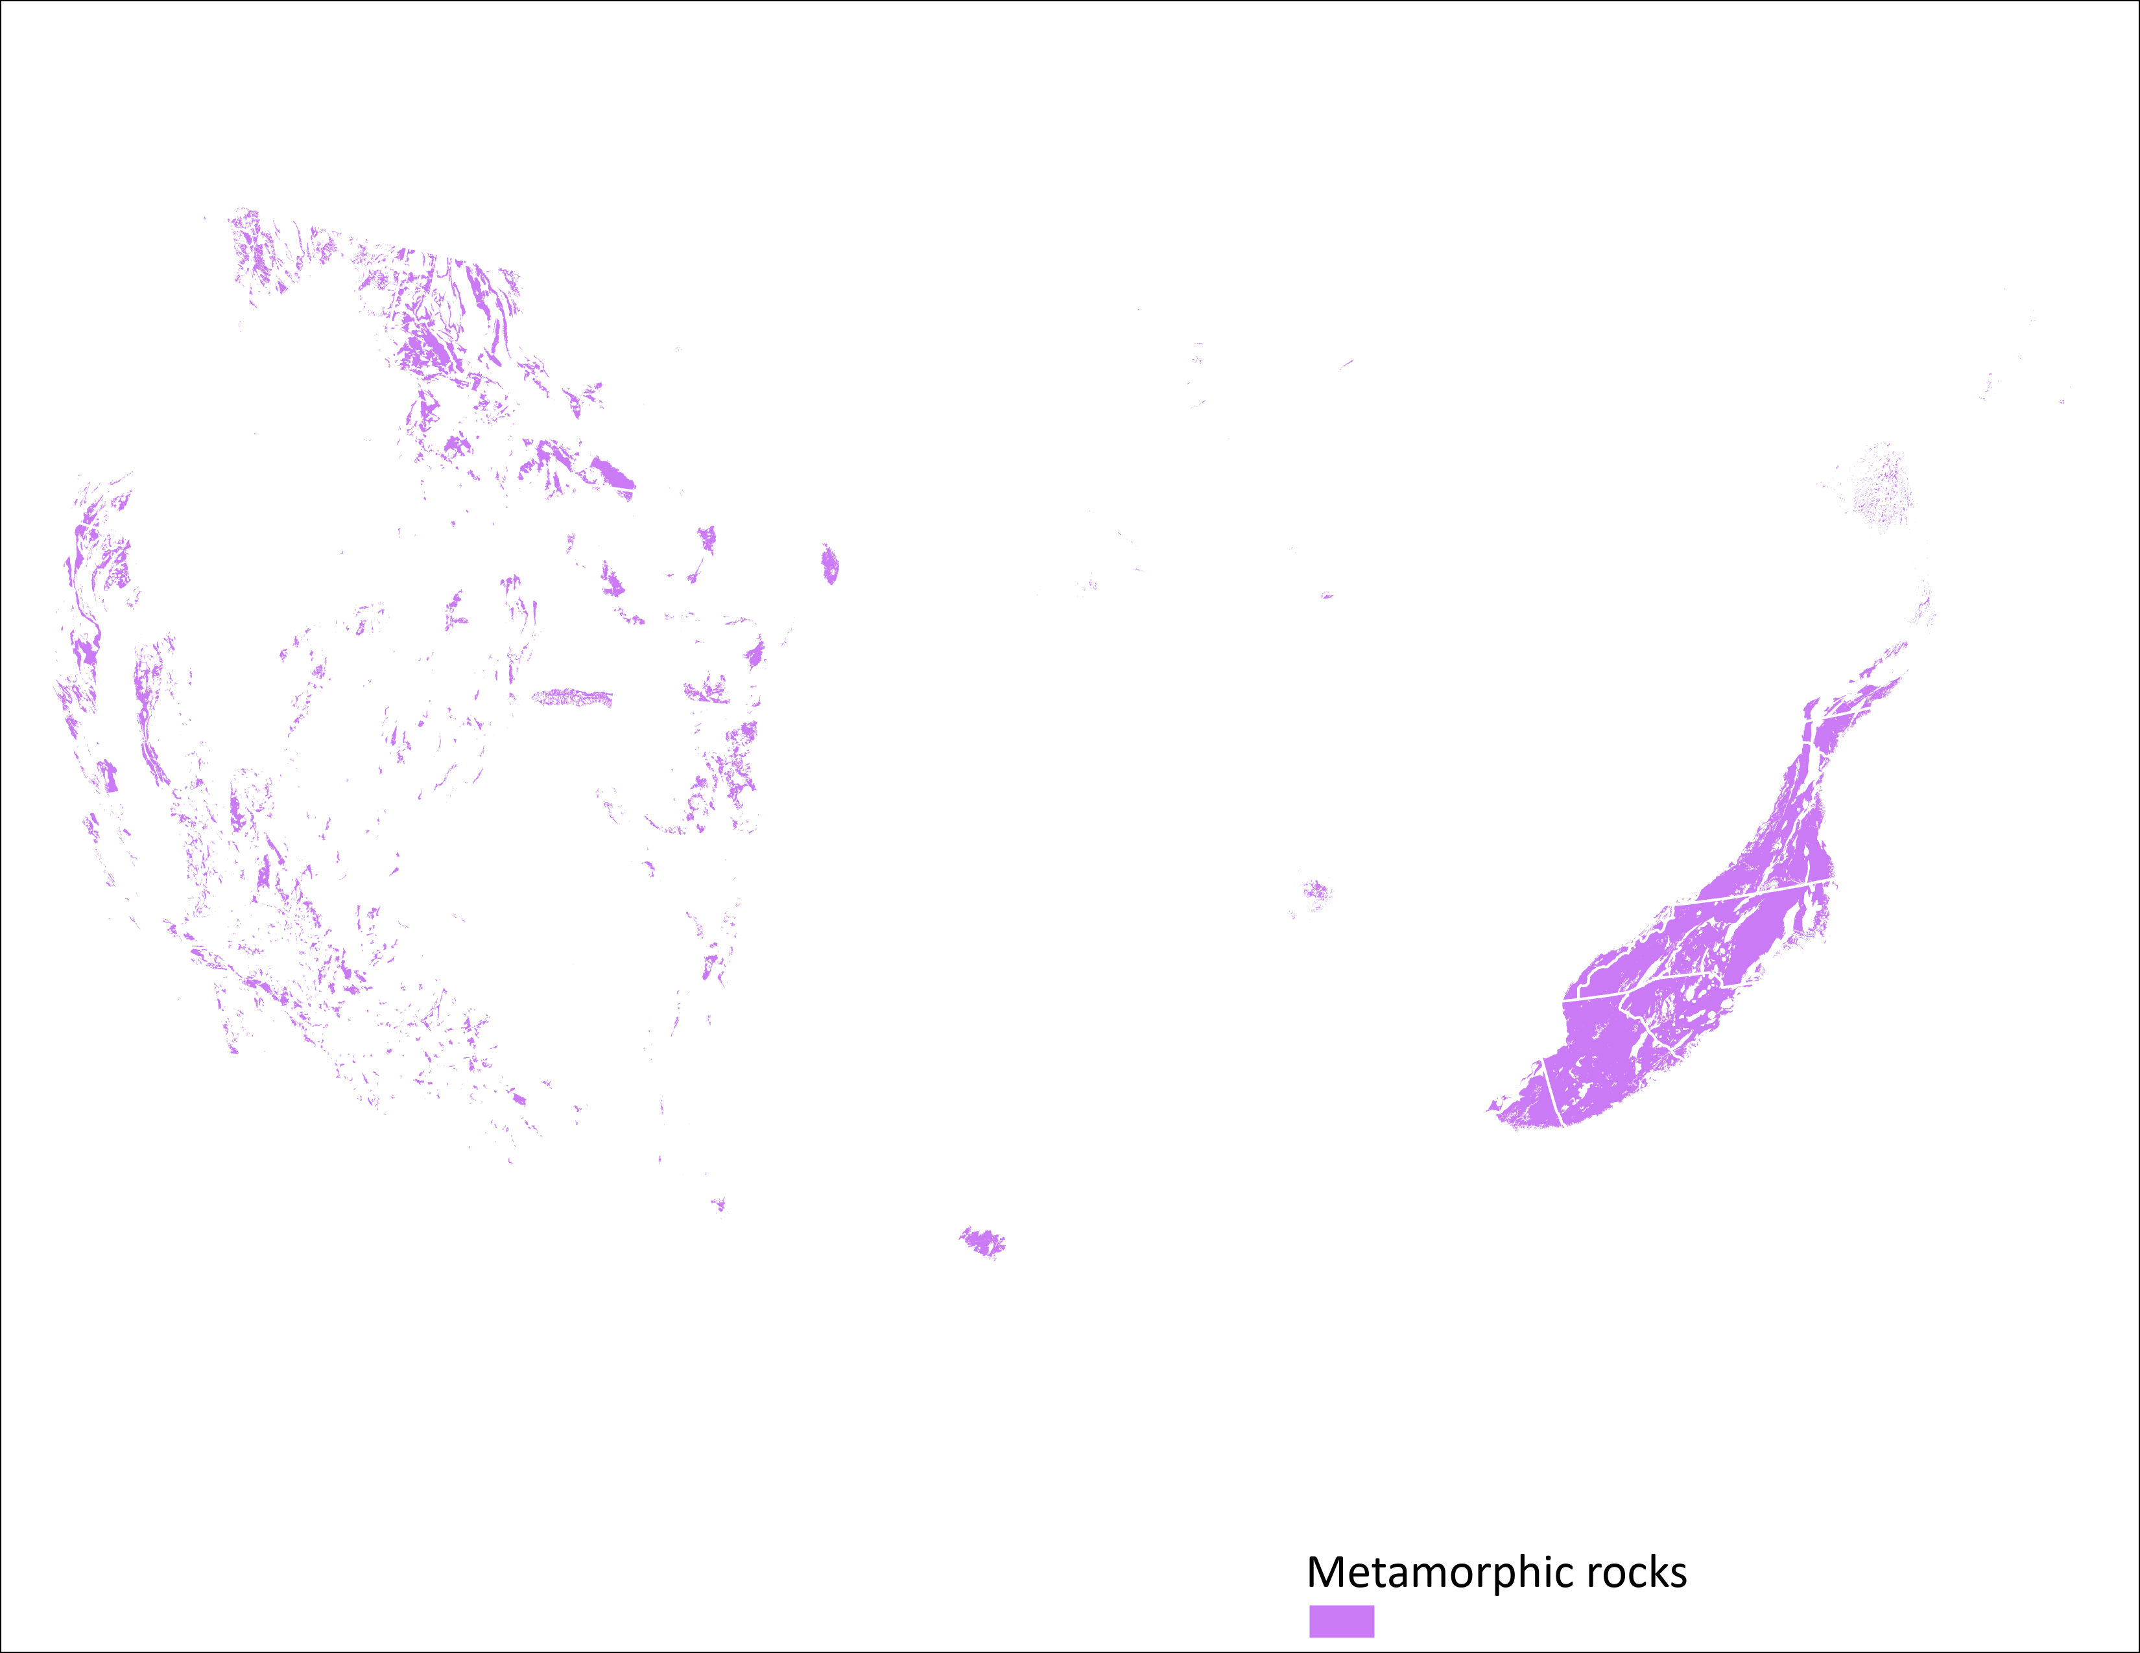
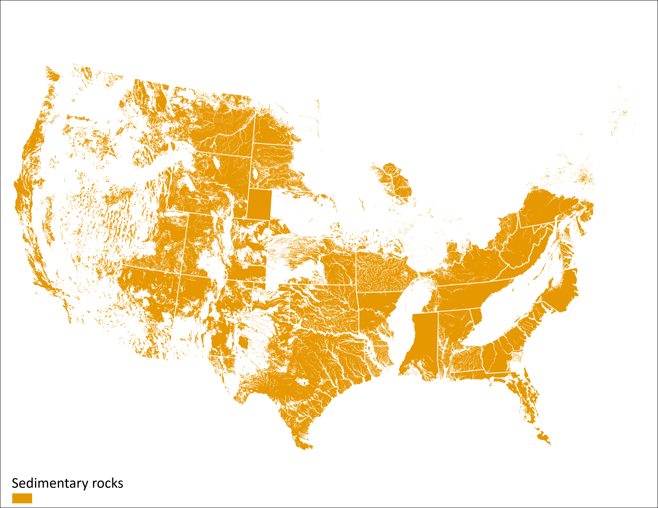

Slide 5
Individual Maps

