Slide 1
Streams Day 1
Key Question: How does water move around us?
Version: March 24, 2022

Slide 2
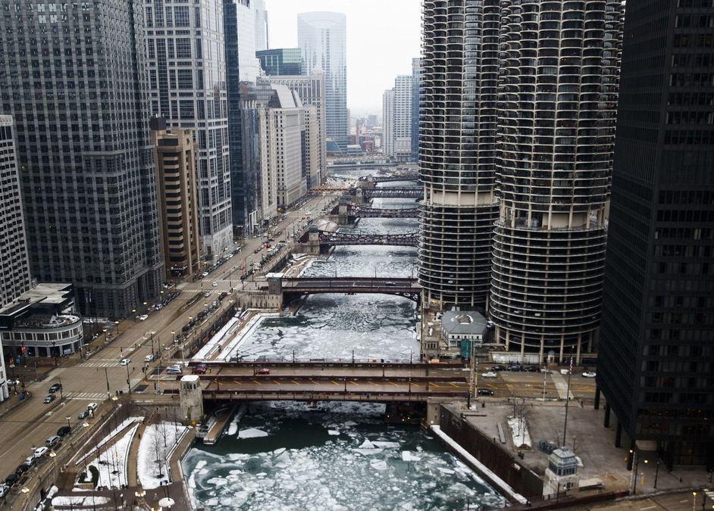
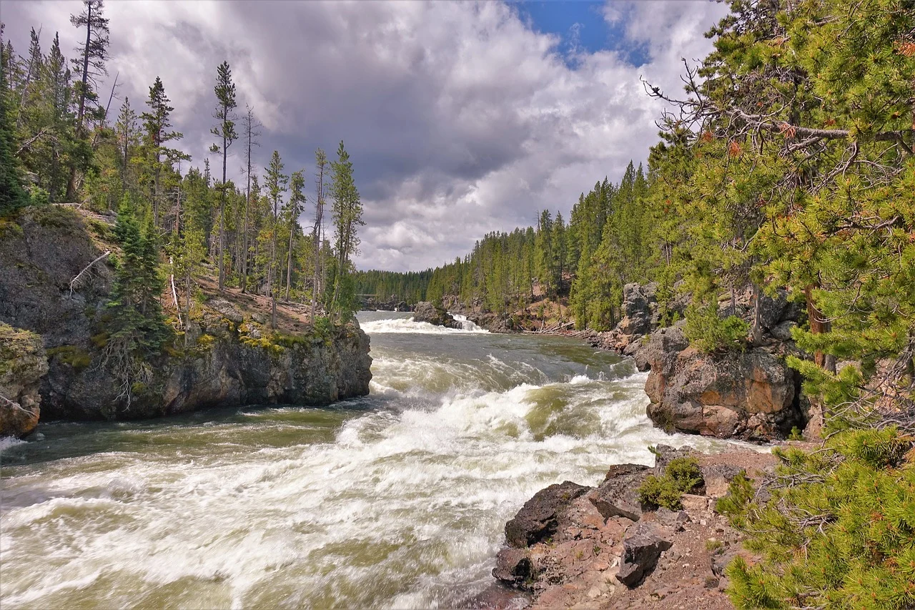
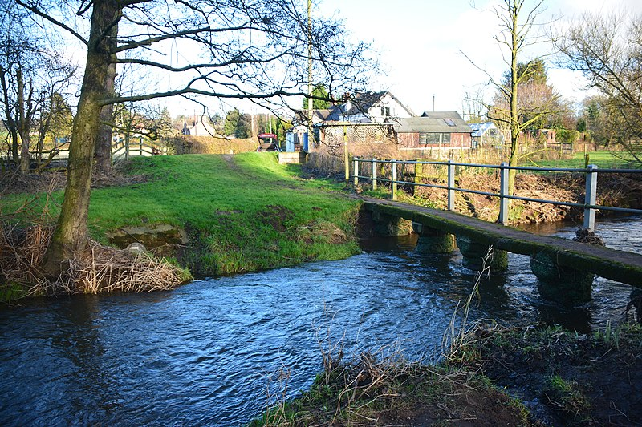
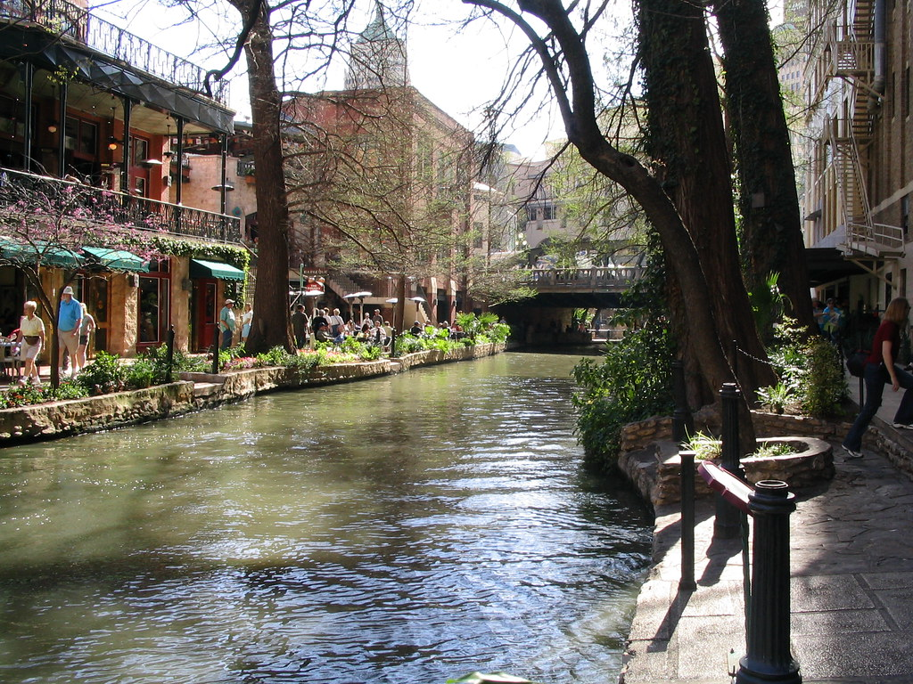
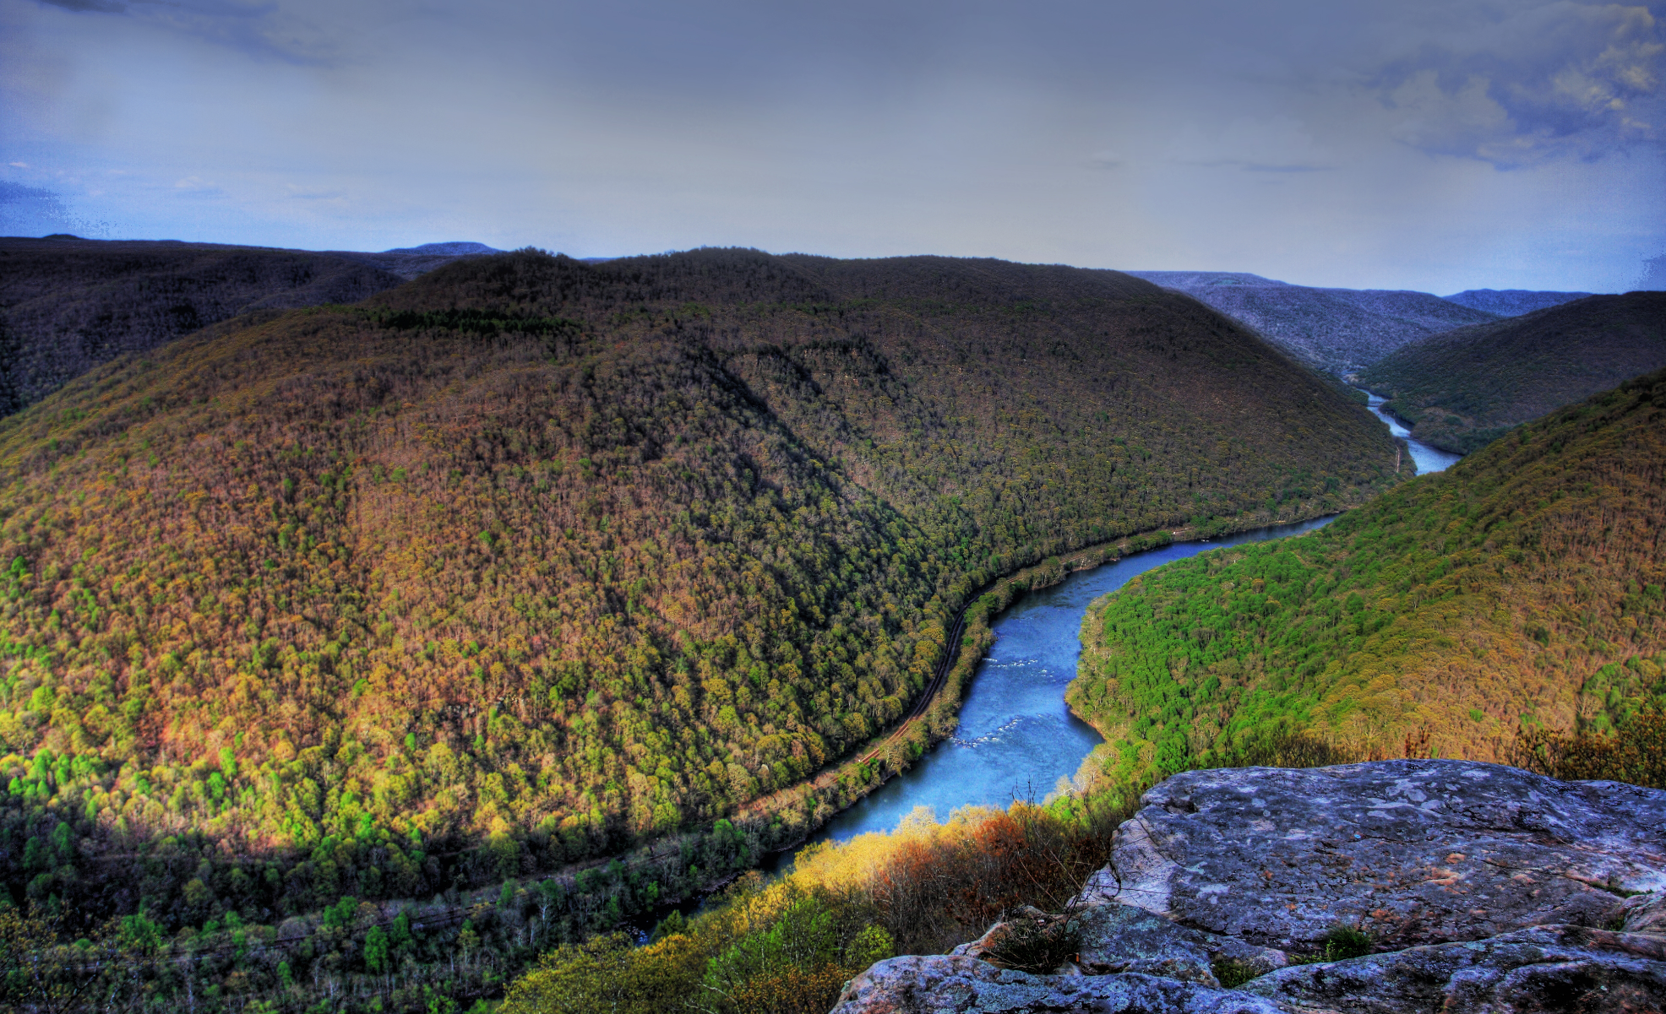
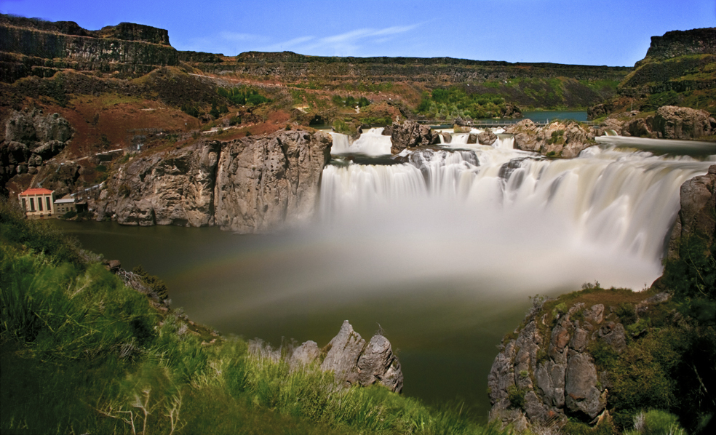
Notes:
All images sourced from Creative Commons, License 3.0

Slide 3
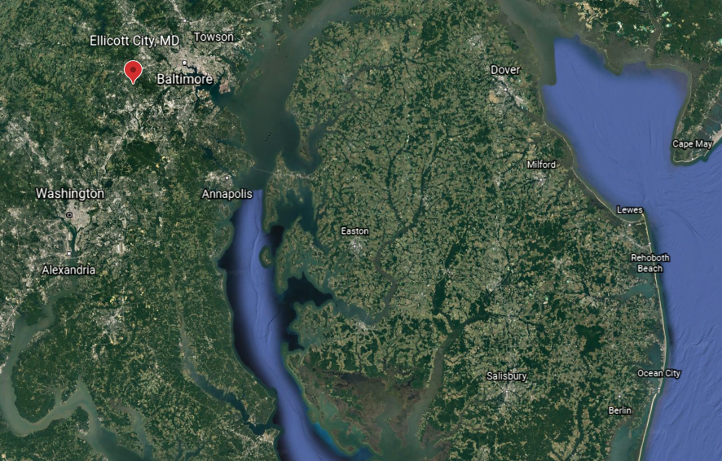
Ellicott City Flood – May 27, 2018
Notes:
Add a map of Ellicott City

Slide 4
banks
riverbed
height
baseflow

Slide 5
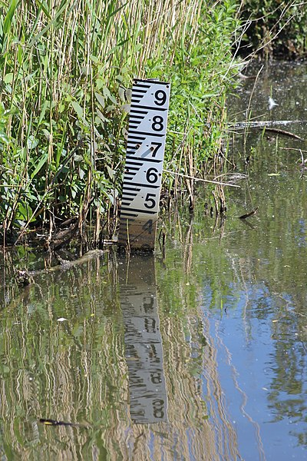
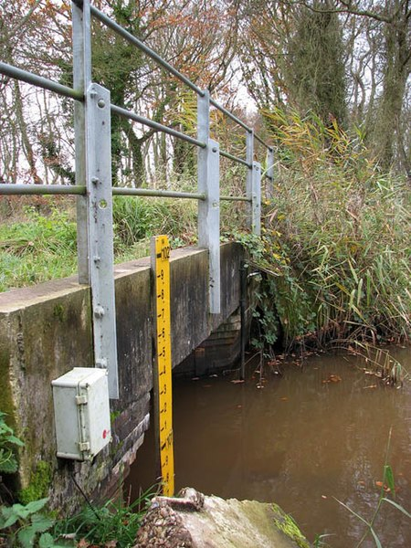
Photo Credit: Martinvl
Photo Credit: Evelyn Simak

Slide 6
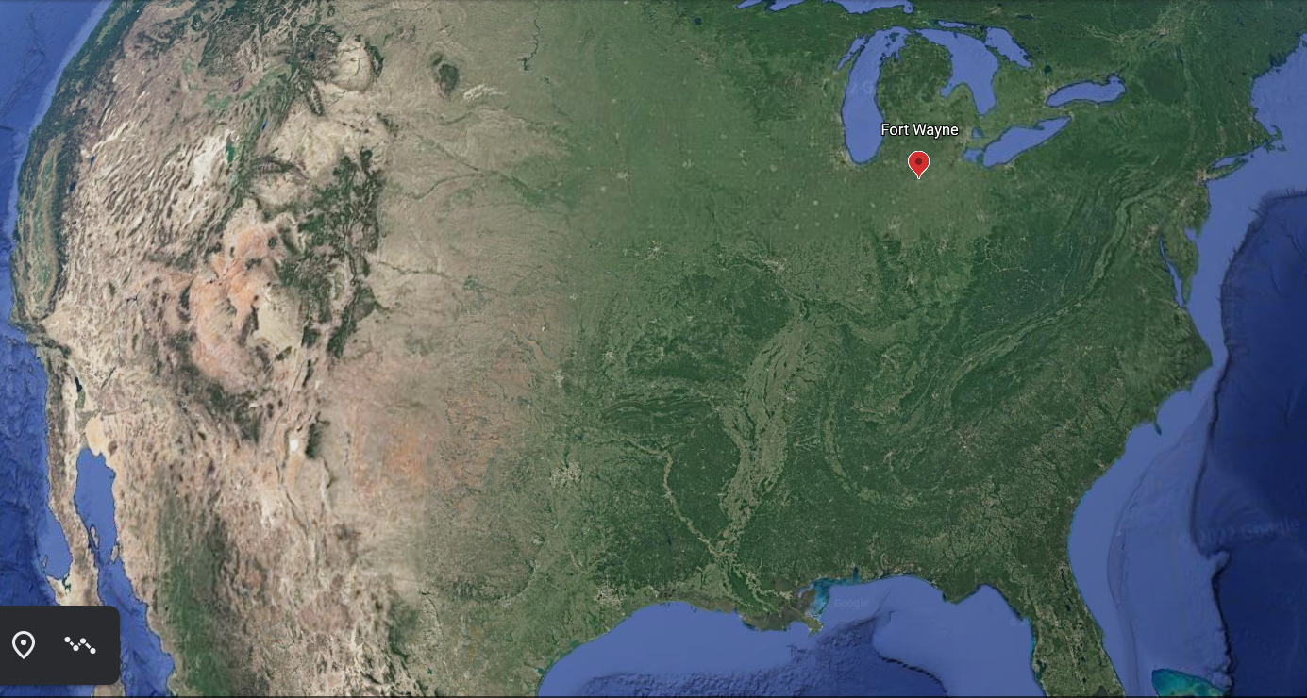

Slide 7
St. Mary’s River Photos
Let’s make some observations of a river at different times.

Slide 8
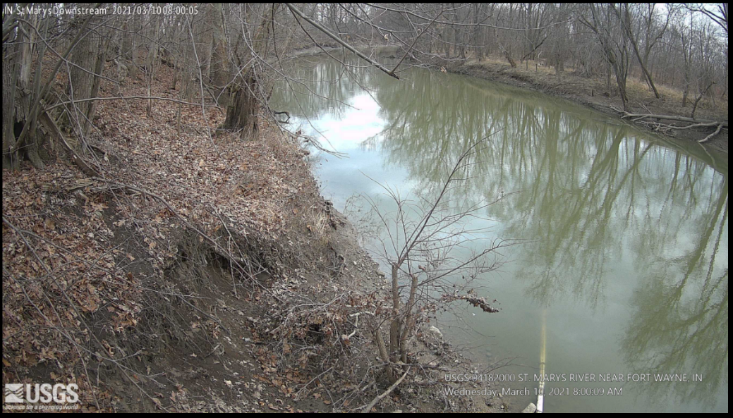
baseflow

Slide 9
baseflow

Slide 10
Date | River Height (feet)
April 1 9 .
April 6 8 .
April 11 8 .
April 16 8 .
April 21 8 .
April 26 8 ½
May 1 11 ½
May 6 8 ½
May 11 14 .
May 16 10 ½
May 21 8 .
May 26 8 .
May 31 8 .

Slide 11
Date | River Height (feet)
April 1 9 .
April 6 8 .
April 11 8 .
April 16 8 .
April 21 8 .
April 26 8 ½
May 1 11 ½
May 6 8 ½
May 11 14 .
May 16 10 ½
May 21 8 .
May 26 8 .
May 31 8 .

Slide 12
St. Mary’s River Hydrograph
4 image matching activity

Slide 14
Exit Slip
At which point do you think the river appears to be near baseflow?
If you were standing by the river, how might it look different on July 11 (A) compared to July 17 (B)?

