Slide 1
Streams Day 2
Key Question: What factors impact how water moves in a natural environment?
Version: March 24, 2022

Slide 2
Awesome Aquifer Kits
How does water get to the river?

Slide 3
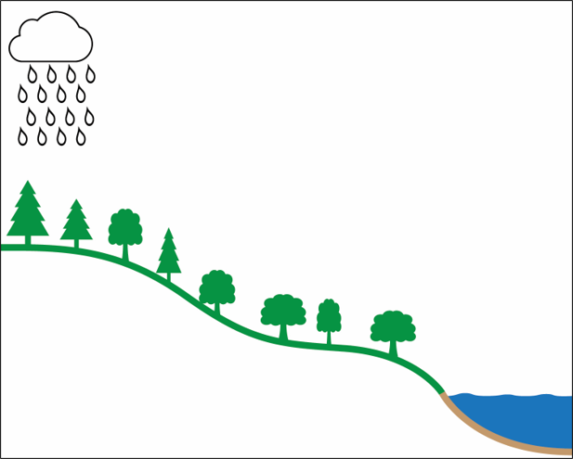
How can water get to the river?
surface water flow
groundwater flow

Slide 4
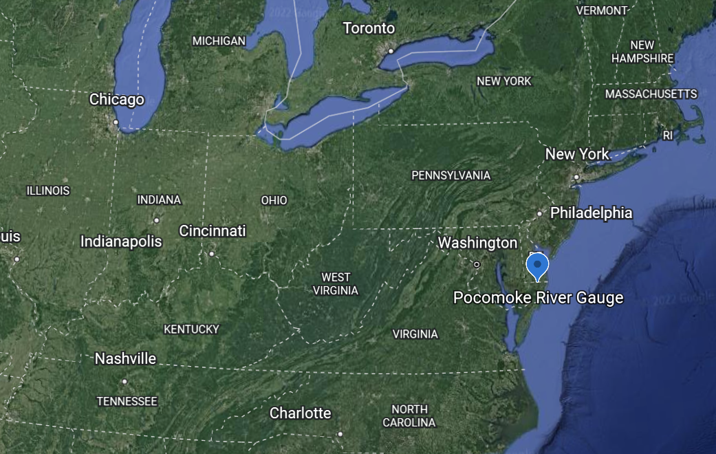
Fruitland Intermediate to the Pocomoke River
Notes:
ADJUST with a country map. Explain here in the notes for teachers to make a flyby video.

Slide 5
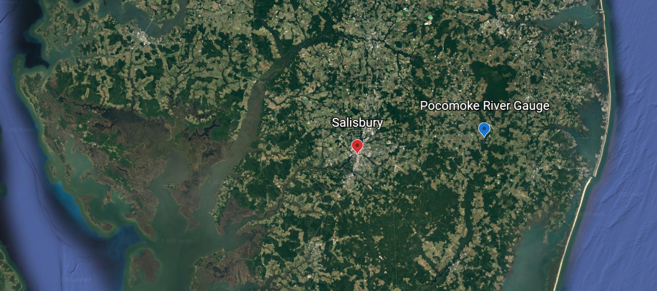
impervious
pervious

Slide 8
When do you think it rained?

Slide 10
Notes:
CHANGE PRECIP DATA AND AXIS

Slide 12
River Height (feet)
Notes:
REDO animation

Slide 13
Stream Tables

Slide 14
Exit Slip
What do you think the hydrograph looked like after June 6?
Examine the data and draw what you think the hydrograph of the Pocomoke River looked like.

