Slide 1
Streams Day 3
Key Question: What factors impact how water moves in a natural environment?
Version: March 24, 2022

Slide 2
Stream Tables

Slide 3
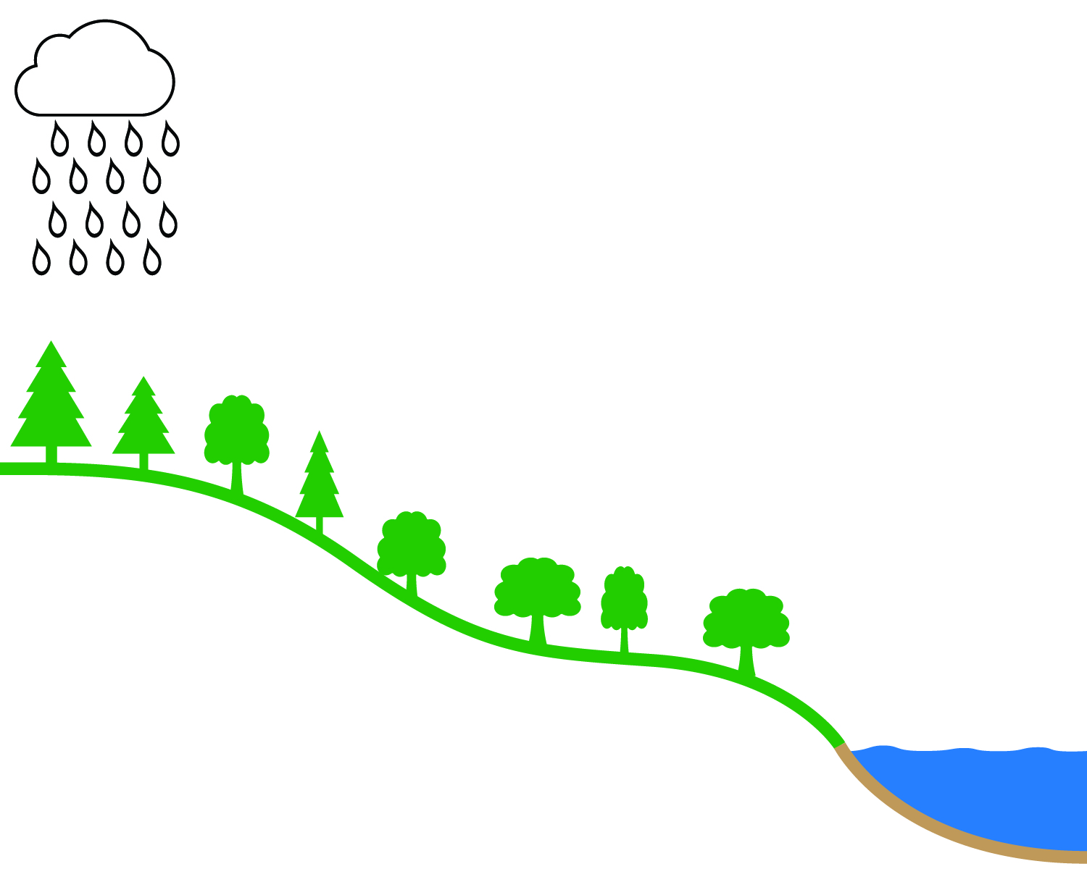
surface water flow
groundwater flow

Slide 4
Think about how the water moved on the stream table with a lot of green space.
How do you think the water moved to the Pocomoke River?
What evidence for this can we see on the hydrograph?

Slide 5
Stream Tables

Slide 6
Think about how the higher intensity rainfall moved to the river.
How was this different from the lower intensity rainfall?
How did different rain events impact the Pocomoke River? Use evidence from the hydrograph.

Slide 7
The Patapsco River near Ellicott City, MD
Notes:
For more student engagement, create a flyby video from your school to Ellicott City. Instructions are located on www.americangeosciences.org

Slide 8
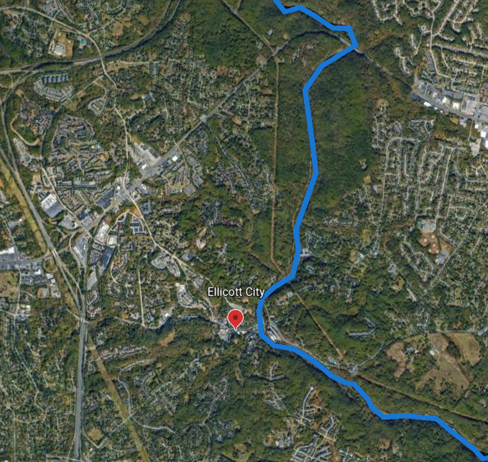
Pocomoke River
Patapsco River

Slide 9
Pocomoke River
Patapsco River

Slide 10
What do you think?
How do you think water moves to a river surrounded by mostly green space?
How do you think water would move to a river near a city? Choose one from each set.
Travels faster
Travels slower
Travels the same speed
Travels mostly as surface water
Travels mostly as groundwater
Travels the same route

