Slide 1
Streams Day 5
Key Question: What factors impact how water moves in an urban environment?
Version: March 24, 2022

Slide 3
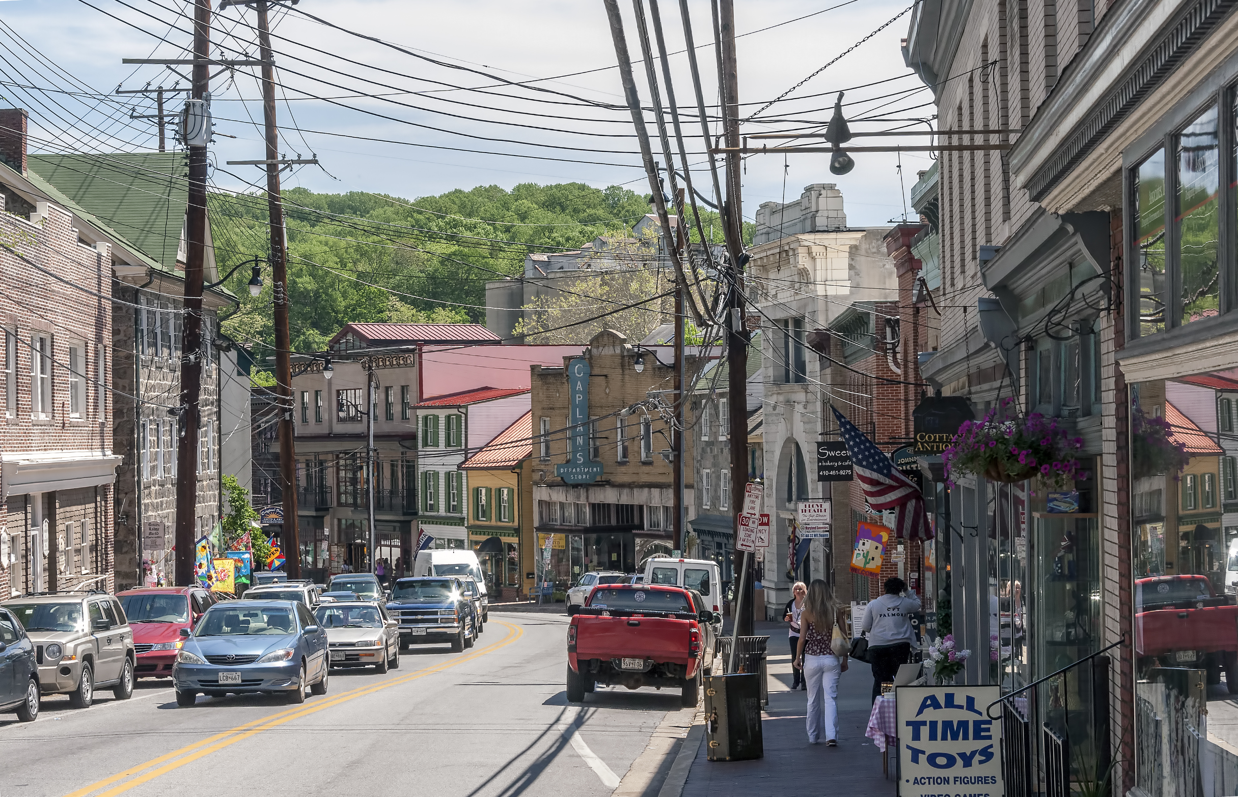
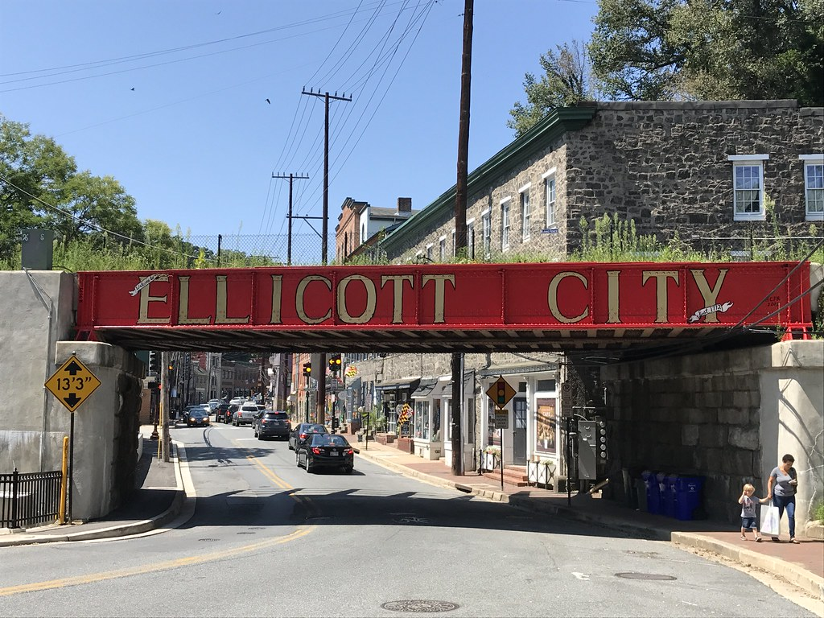
Ellicott City
Video
Notes:
Image sources: https://upload.wikimedia.org/wikipedia/commons/0/0e/Ellicott_City_MD2.jpg
https://live.staticflickr.com/4351/35886920003_e19c559c37_b.jpg

Slide 4
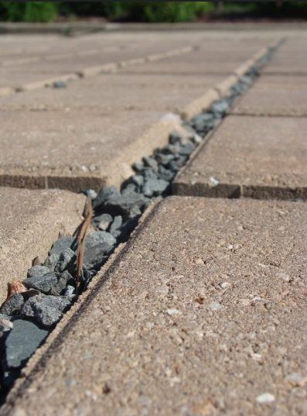
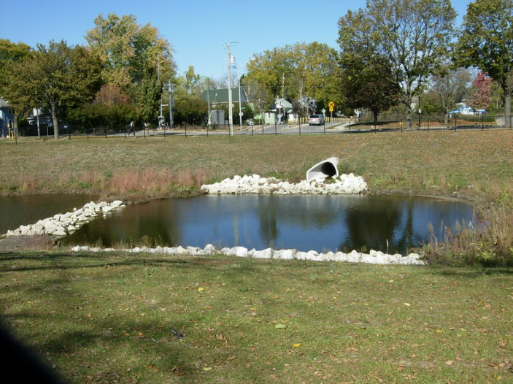
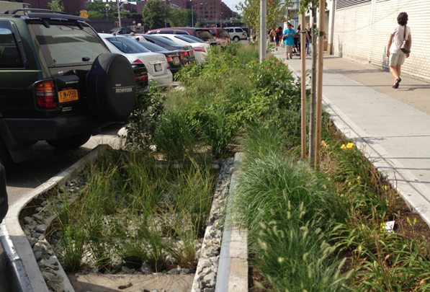
Surface Water Flow Mitigation Strategies
Detention pond
Infiltration basin or rain garden
Porous pavement
Vegetative (landscaping)
Notes:
All images creative commons

Slide 5
Stream Table Stations
Infiltration Basin
Landscaping (vegetation)
Porous Pavement

Slide 6
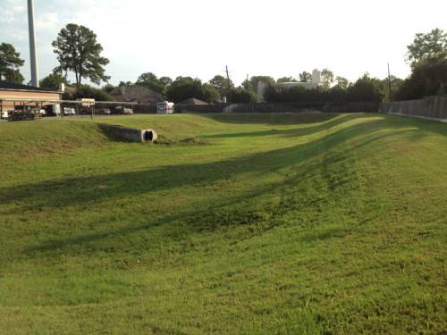
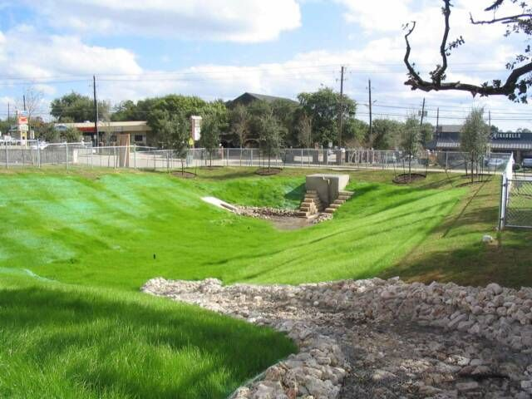
Detention Ponds & Infiltration Basins
Insert a diagram that shows how this mitigation strategy works, such as the image on page 1 at of “Infiltration Basins: Standards ad Procedures to Ensure Performance at https://dot.state.mn.us/research/TRS/2018/TRS1801.pdf
Notes:
Infiltration Basins: Standards and Procedures to Ensure Performance (state.mn.us)
Other images creative commons

Slide 7
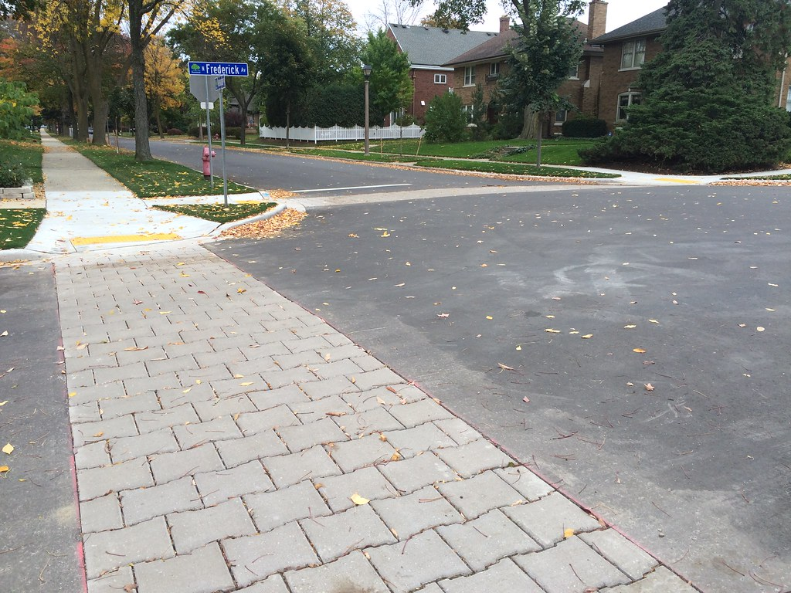
Porous Pavement
Insert a diagram that shows how this mitigation strategy works, such as Figure 1 in the “Influence of AAC grains on some properties of permeable pavement utilizing of CDW and industrial by-product” at https://www.researchgate.net/figure/Permeable-pavement-systems-1-Permeable-pavement-is-usually-classified-into-four-major_fig1_342850342
Notes:
Creative commons image and diagram. Permeable pavement systems [1] Permeable pavement is usually classified... | Download Scientific Diagram (researchgate.net))

Slide 8
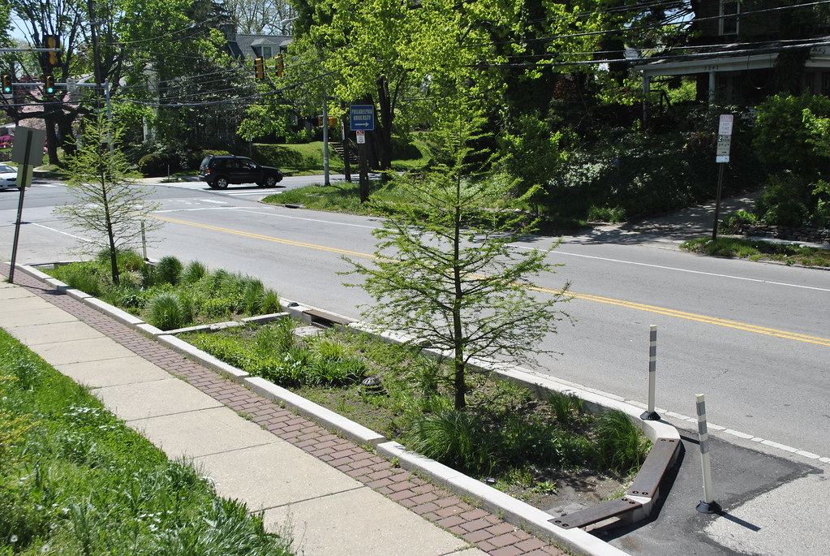
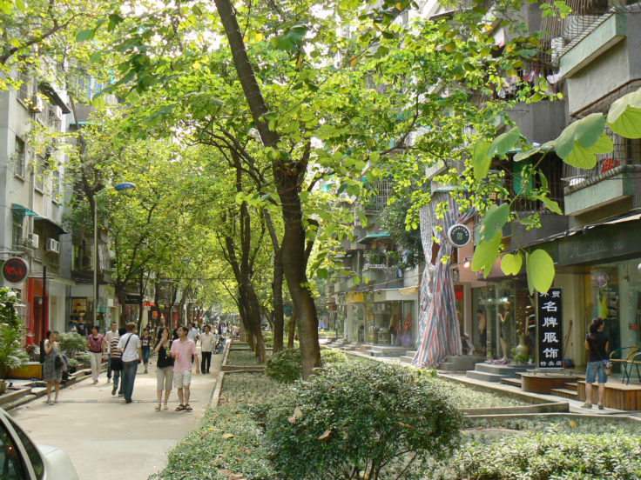
Vegetation (landscaping)
Insert a diagram that shows how this mitigation strategy works, such as “How high points drainage works to recharge our groundwater and protect the creek” at https://aqueductfutures.files.wordpress.com/2013/03/howhighpointworks.jpg
Notes:
howhighpointworks.jpg (1484×852) (wordpress.com)
All other images creative commons

Slide 9
What about us?
Do you think areas around our school or town need surface water flow mitigation? Why do you think that? What evidence could you use to support your thoughts?
Insert an image of your school or town

Slide 10
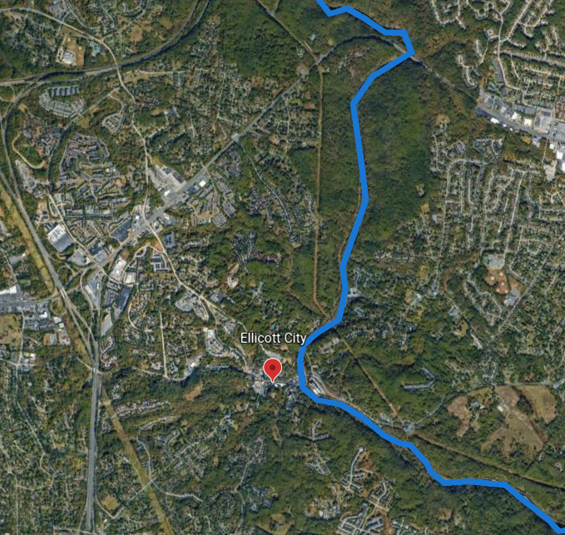
Pocomoke River
Patapsco River

Slide 11
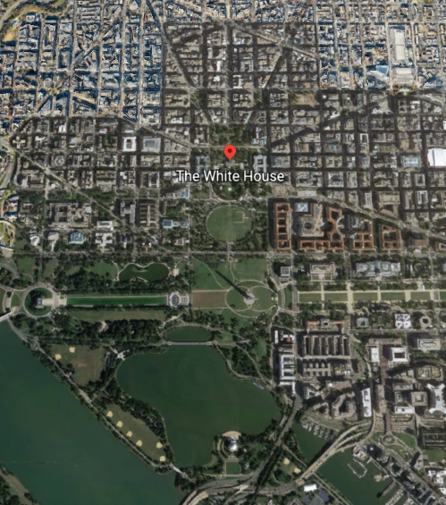
What about near us?
Notes:
**This is an Example slide if you were located near The White House**
You should adjust this slide to your school/town. Take a screenshot of your school/town on Google Earth. Calculate the percentages of pervious/impervious surfaces in the image. Detailed directions and a video can be found at www.americangeosciences.org/streams-of-data.

Slide 12
Mitigating our City
What areas would benefit from surface water flow mitigation strategies?
Draw your ideas on the map!
(insert map from slide 11)
Notes:
Insert the map of your area that you used on slide 11.

Slide 13
Exit Slip
Which strategy that you included on your map do you think would work the best? Explain why.
Which strategy did you hear from others might you want to include on your map? Explain why.
How could you check to see if your strategies would really work?

Slide 14
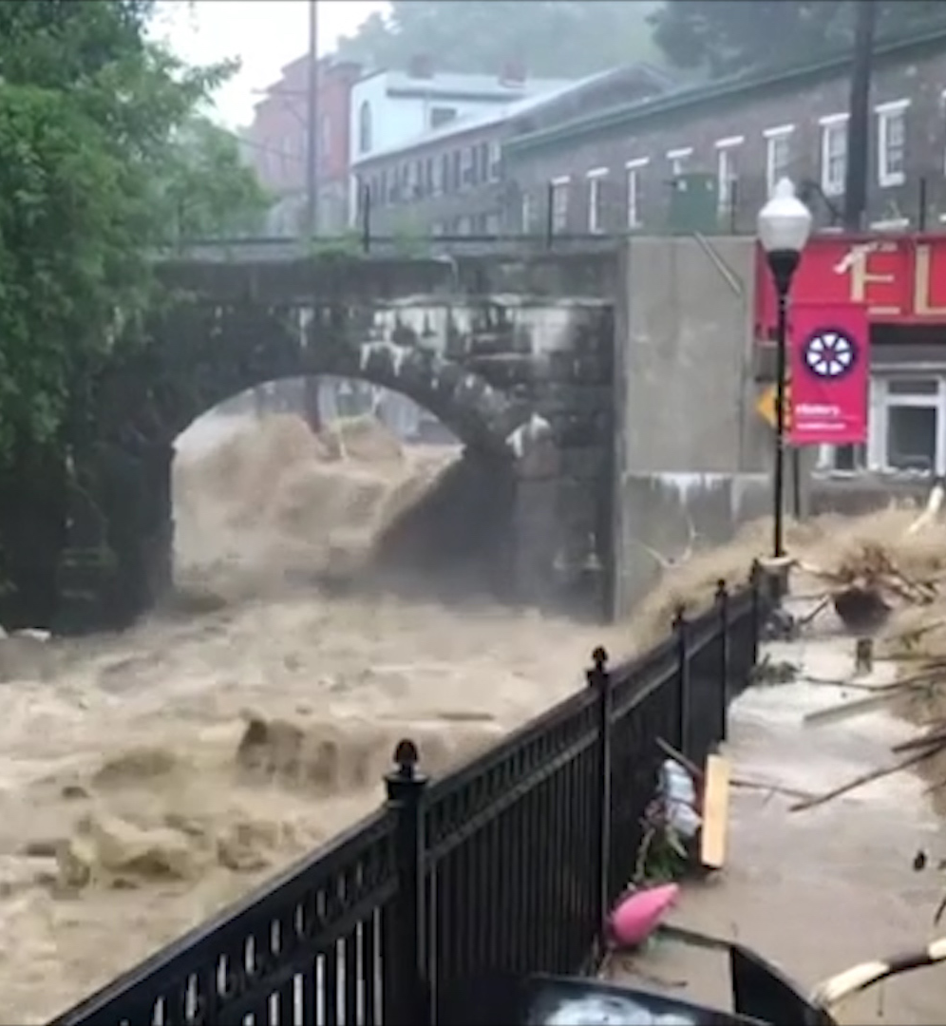
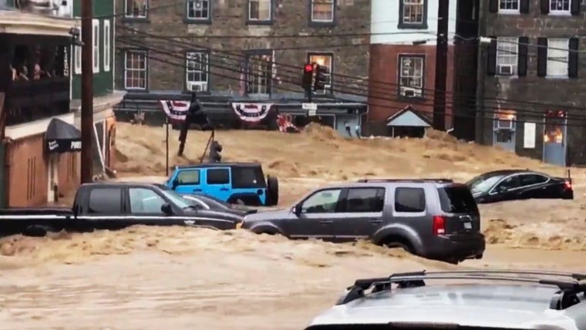
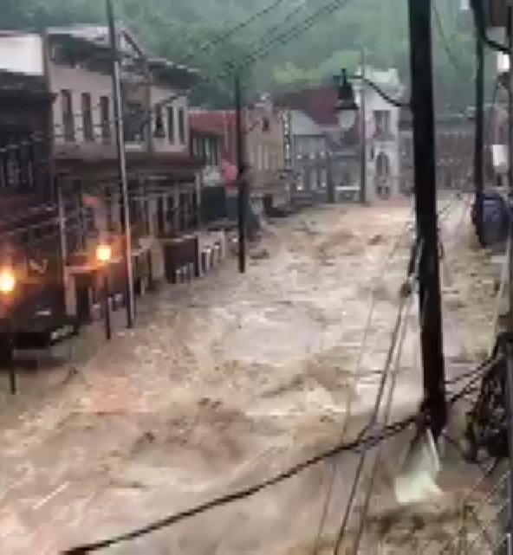
2018 Ellicott City Flood
Ellicott City
Notes:
Alternate slide for Slide 3: static images in case no access to internet

