Slide 1
Linking Earth Science Inquiry to the UN Sustainable Development Goals
Sequoyah McGee, Lindsay Mossa, and Ed Robeck
American Geosciences Institute

Slide 2
Survey using Slido
How familiar are you with the UN Sustainable Development Goals as they apply to education?
Slido.com -- 1521614
Notes:
https://app.sli.do/event/9TyXpTBLv5UvfxPwYAsLzA →Link to get to live poll

Slide 3
The Sustainable Development Goals
Consider some of the biggest problems faced by people in today’s world.

Slide 4
The Sustainable Development Goals
Notes:
“On 25 September 2015, the UN General Assembly adopted the 2030 Agenda for Sustainable Development…At the core of the 2030 Agenda are 17 Sustainable Development Goals (SDGs). The universal, transformational and inclusive SDGs describe major development challenges for humanity. The aim of the 17 SDGs is to secure a sustainable, peaceful, prosperous and equitable life on earth for everyone now and in the future”
UNESCO (2017). Education for Sustainable Development Goals: Learning Objectives. UNESCO: Paris.
https://unesdoc.unesco.org/ark:/48223/pf0000247444/PDF/247444eng.pdf.multi.nameddest=815_18_Learning%20Objectives_int_En.indd%3A.121505%3A370

Slide 5
Why address the SDGs?
Encourage citizens of the Earth
Compatible with SOLs
FCPS’s Global Classroom Project

Slide 6
Why address the SDGs?
SDG | ES SOLs
 | ES.1 | The student will demonstrate an understanding of scientific and engineering practices
 | ES.2 | The student will demonstrate an understanding that there are scientific concepts related to the origin and evolution of the universe
 | ES.3 | The student will investigate and understand that Earth is unique in our solar system
12, 14, 15 | ES.4 | The student will investigate and understand that there are major rock-forming and ore minerals.
 | ES.5 | The student will investigate and understand that igneous, metamorphic, and sedimentary rocks can transform.
6, 7, 12 | ES.6 | The student will investigate and understand that resource use is complex.
 | ES.7 | The student will investigate and understand that plate tectonic theory explains Earth’s internal and external geologic processes.
3, 6, 11, 12, 13 | ES.8 | The student will investigate and understand that freshwater resources influence and are influenced by geologic processes and human activity.
 | ES.9 | The student will investigate and understand that many aspects of the history and evolution of Earth and life can be inferred by studying rocks and fossils
13, 14 | ES.10 | The student will investigate and understand that oceans are complex, dynamic systems and are subject to long- and short-term variations.
3, 9, 11, 13, 15 | ES.11 | The student will investigate and understand that the atmosphere is a complex, dynamic system and is subject to long-and short-term variations.
13, 14, 15 | ES.12 | The student will investigate and understand that Earth’s weather and climate are the result of the interaction of the sun’s energy with the atmosphere, oceans, and the land.

Slide 7
Getting Hands on with the SDGs
ES.8 The student will investigate and understand that freshwater resources influence and are influenced by geologic processes and human activity. Key ideas include
water influences geologic processes including soil development and karst topography;
the nature of materials in the subsurface affect the water table and future availability of fresh water;
weather and human usage affect freshwater resources, including water locations, quality, and supply; and
stream processes and dynamics affect the major watershed systems in Virginia, including the Chesapeake Bay and its tributaries.

Slide 8
Getting Hands on with the SDGs
ES.8 The student will investigate and understand that freshwater resources influence and are influenced by geologic processes and human activity

Slide 9
Awesome Aquifer Kit
The AA kit includes:
clear plastic container
Illustrated activity book
Gravel, sand, and clay
Activated carbon charcoal*
Nylon hose
Plastic tube
Rubber bands
Syringe
Hand pump
2 small plastic measuring cups
Liquid food dye
Coffee filter
*The carbon charcoal must be thoroughly rinsed and dried before it is used for the first time
Notes:
https://awesomeaquifer.com

Slide 10
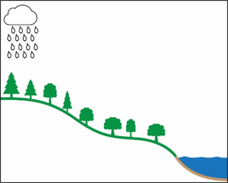
How can water move?

Slide 11
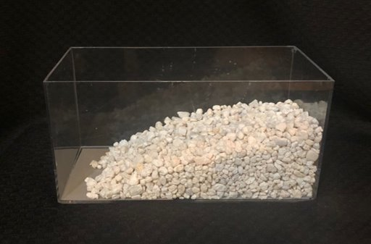
How can water move?

Slide 12
How can water move?
surface water flow
groundwater flow

Slide 13
Awesome Aquifer kit lessons
Groundwater and Surface Water: Are they connected?
Pumping the supply: Is groundwater a renewable resource?
Contamination Clues: How does groundwater become polluted?

Slide 14
Awesome Aquifer kit lessons
Groundwater and Surface Water: Are they connected?
Pumping the supply: Is groundwater a renewable resource?
Contamination Clues: How does groundwater become polluted?
Notes:
Bringing in data:
https://waterdata.usgs.gov/nwis/gw

Slide 16
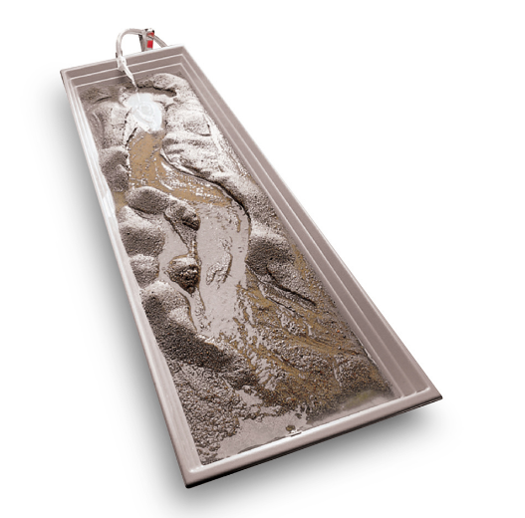
Stream Tables
Credit: Enasco
Notes:
https://www.americangeosciences.org/streams-of-data/models/

Slide 17
Stream Table Modules
Flash flooding due to land cover [6, 11]
Flash flooding due to wildfires [11, 13]
Soil erosion due to human factors and rainfall [2, 6, 13, 14, 15]

Slide 18
Suggested Module Outline
Current Event/phenomena (flash flooding in a city, flash flooding from wildfire, etc.)
Introduction to phenomena
Data (maps, hydrographs, rainfall data, etc.)
Stream table activity
Connecting back to current event/phenomena
Mitigation and looking forward

Slide 19
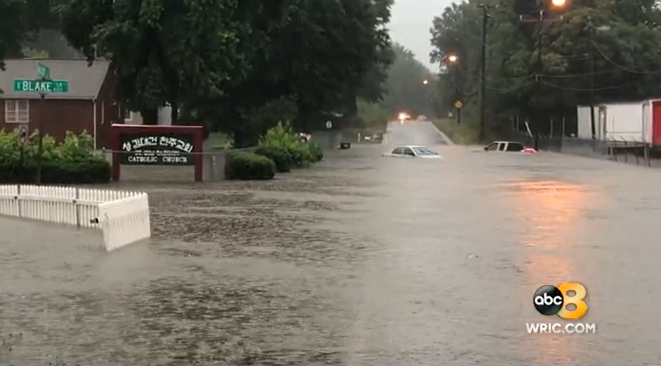
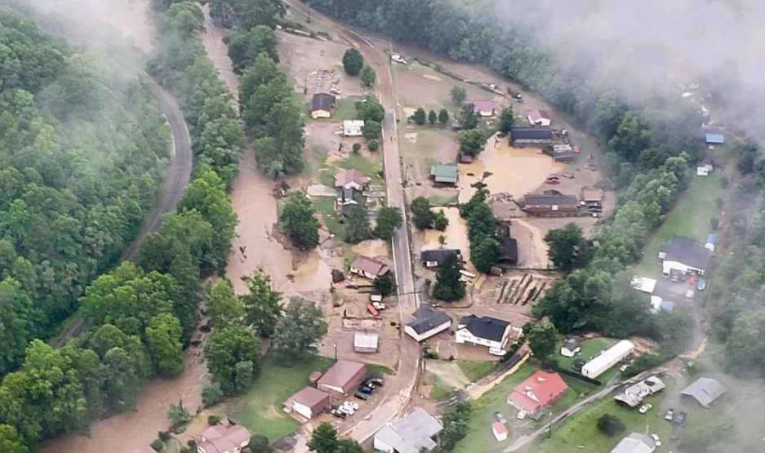
Credit: WRIC ABC 8News
Credit: Virginia Department of Emergency Management

Slide 20
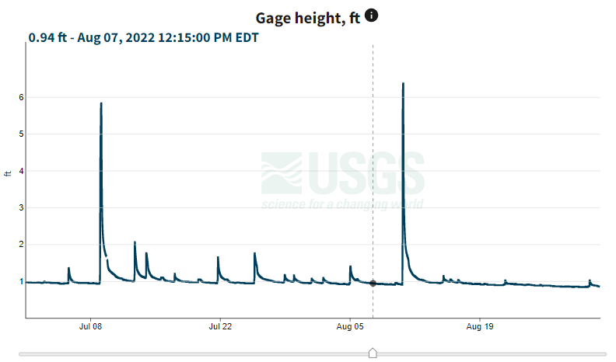
Incorporating Data
Difficult Run above Fox Lake near Fairfax, VA
Notes:
Difficult Run Stream Gauge:
https://waterdata.usgs.gov/monitoring-location/01645704/#parameterCode=00065&startDT=2022-07-01&endDT=2022-08-31

Slide 21
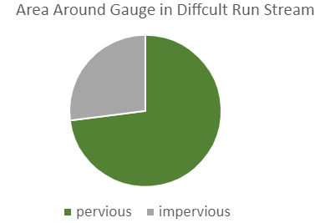

Slide 22
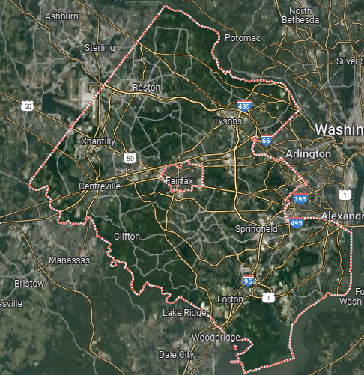
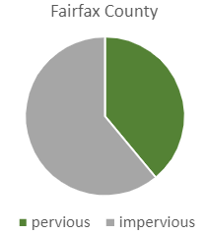

Slide 23
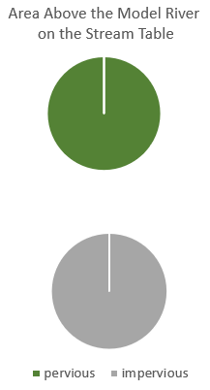
Stream Tables – Land Cover
​ | ​
​ | ​

Slide 24
Roles
Rain maker -- Hold the cup so the holes point uphill on the stream table. Keep the water level between the two red lines.
Rain should only fall on the top half of the surface material. Stop the rain when the river flows enough to move the sawdust or cut a channel through it.
River watchers -- Observe the river the whole time—before, during, AND after the rain. Tell the group when the water moves the sawdust or cuts a channel through it. Note whether or not the river keeps flowing after the rain stops.
Timekeeper -- Start the stopwatch when the rain starts. Stop the stopwatch when the river flows enough to move the sawdust or cut a channel through it. Record the time.
Water watchers -- Observe the area covered by the surface. Note how the rainwater gets to the river.

Slide 25
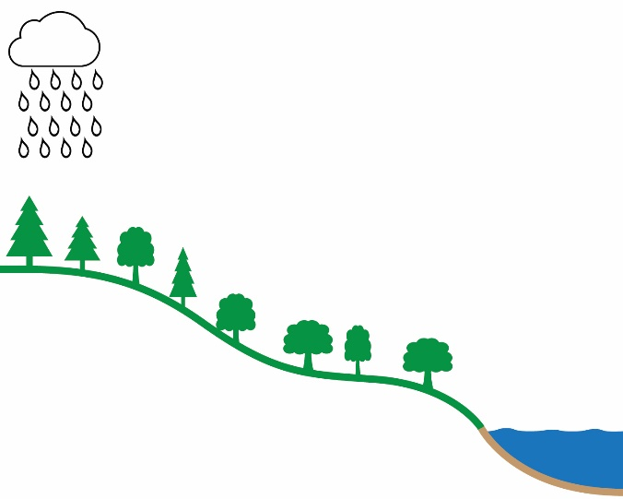
surface water flow
surface water flow
surface water flow
groundwater flow
groundwater flow
groundwater flow?

Slide 26
Stream Table Modules
Flash flooding due to land cover [6, 11]

Slide 27
Stream Table Modules
Flash flooding due to land cover [6, 11]
Flash flooding due to wildfires [11, 13]
Soil erosion due to human factors and rainfall [2, 6, 13, 14, 15]

Slide 28
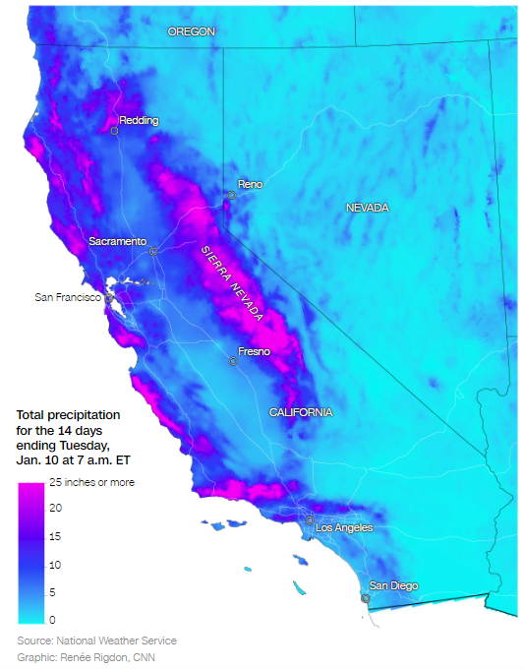

Slide 29
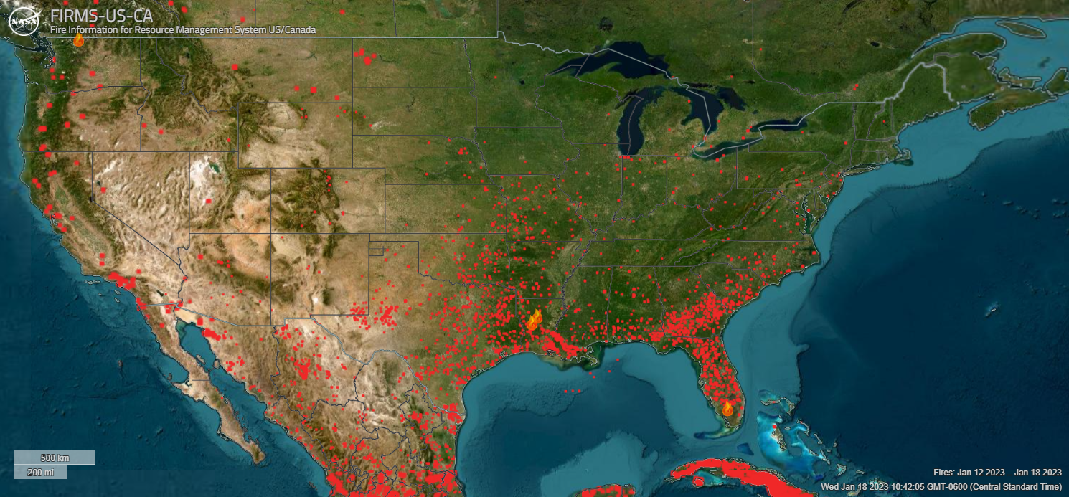
Wildfires
Fires/hotspots
Active Fire
Fire Information for Resource Management System (FIRMS): Live map
Map of reported wildfires between 1/12 – 1/18/2023
Notes:
FIRMS map - “Red squares show satellite derived thermal anomalies which may be from fire, hot smoke, agriculture or other sources”.
https://data.newsleader.com/fires/
https://data.newsleader.com/excessive-rainfall-forecast/

Slide 30
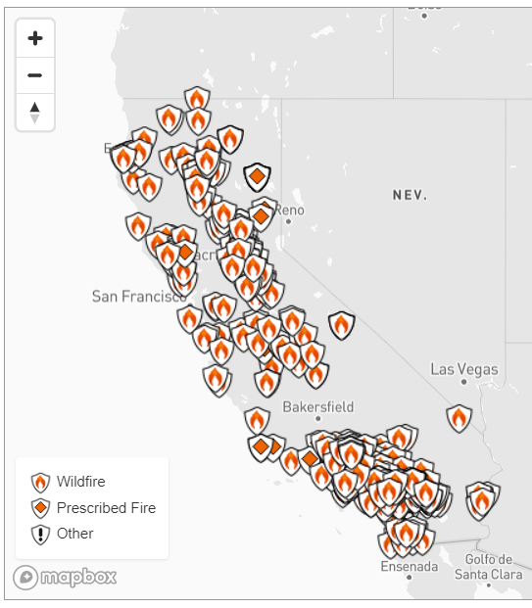
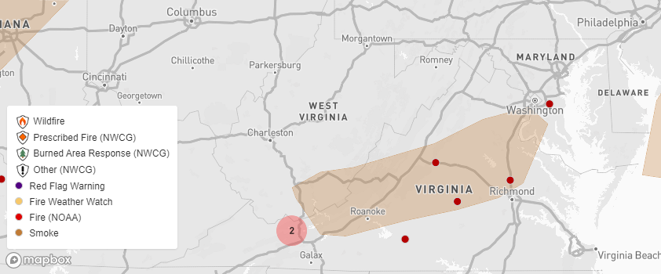
Wildfires
Map of reported wildfires since 2017
Map of reported wildfires since 2017
Fire and Smoke on 1/18/2023
All maps from: News Leader
Notes:
All Maps from News Leader, using data from The National Wildfire Coordinating Group (NWCG), Geospatial Multi-Agency Coordination Wildland Fire Support/USGS, NOAA Office of Satellite and Product Operations.
https://data.newsleader.com/fires/
https://data.newsleader.com/fires/
https://data.newsleader.com/excessive-rainfall-forecast/
https://dof.virginia.gov/wildland-prescribed-fire/learn-about-wildland-and-prescribed-fire/wildfire-in-virginia/

Slide 31
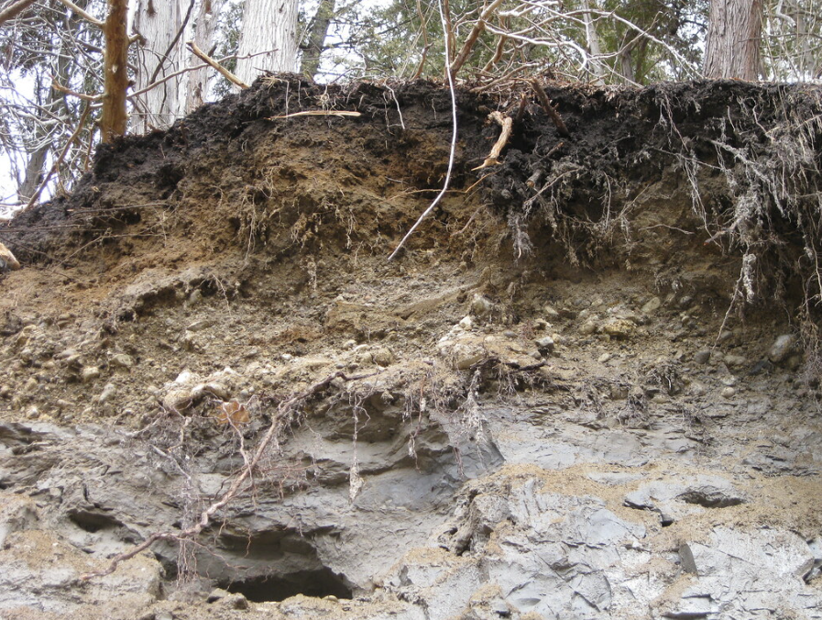
Soil
Credit: Smithsonian Institution, Soils4Teachers
Credit: USDA
Notes:
Pamunkey = Virginia’s state soil

Slide 32
Stream Tables – Wildfires
Sand sprayed with Scotchgard = hydrophobic soil
Images???

Slide 33
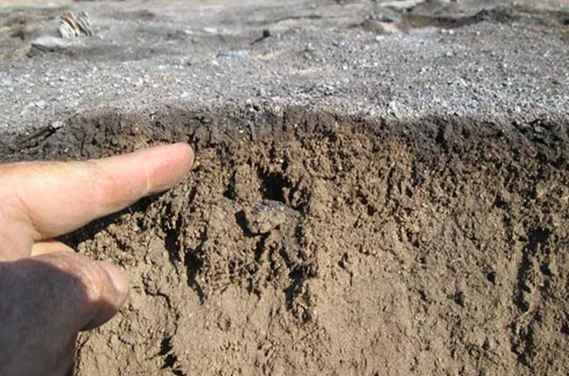
Wildfire changes soil
Credit: Smithsonian Institution, Soils4Teachers
Credit: USDA

Slide 34
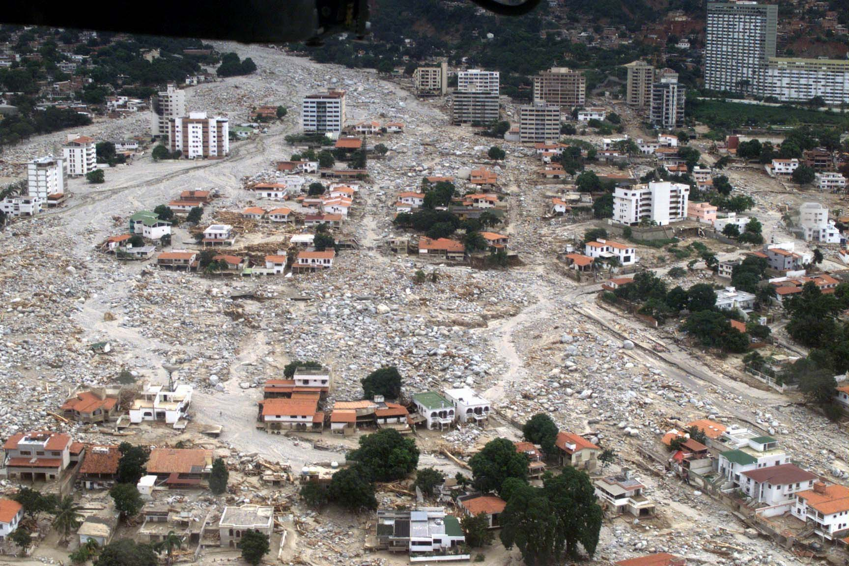
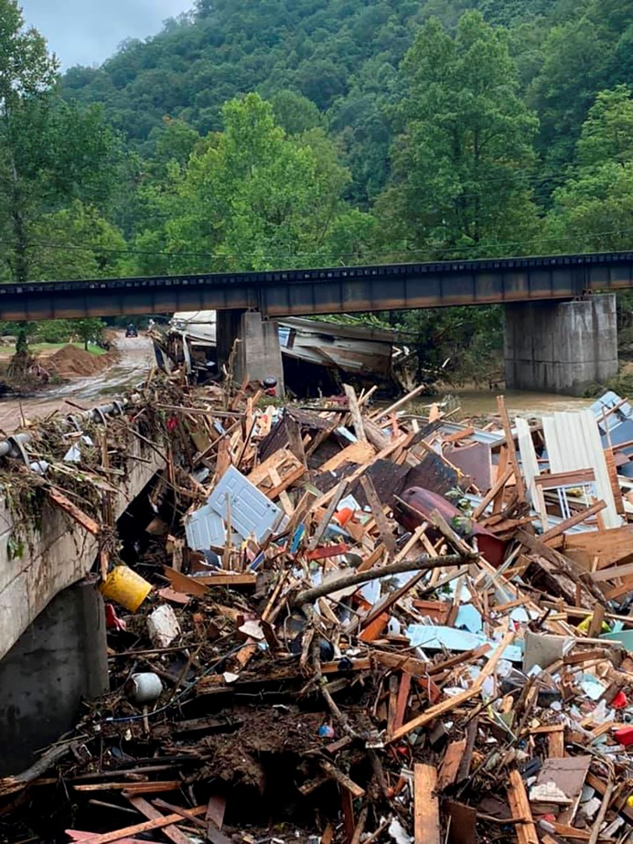
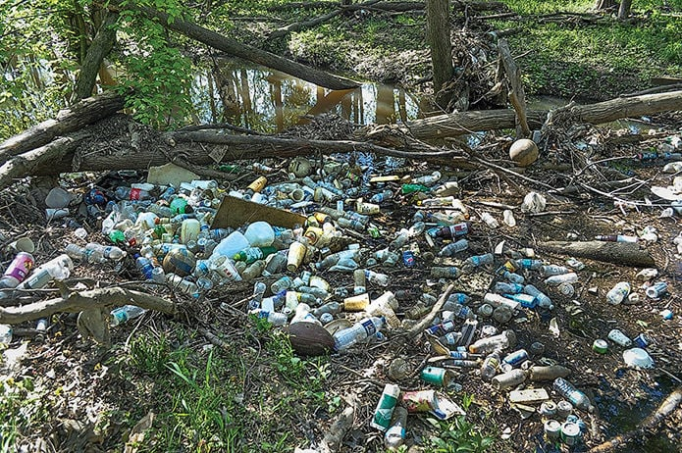
Effects of flooding
Credit: US Geological Survey
Credit: Bristol Virginia Professional Fire Fighters Association
Credit: Whitney Pipkin
Notes:
Two Virginia images, one CA image (debris flow top Right)
https://vasos.org/about-water-pollution-and-va-sos/

Slide 35
SDG discussion
ES.8 The student will investigate and understand that freshwater resources influence and are influenced by geologic processes and human activity

Slide 40
Thank you!
Questions?
Online resources
SDGs
Awesome Aquifer Kit
Setup for Stream Tables
ESW Online Toolkit
Ed Robeck
ECRobeck@americangeosciences.org
Lindsay Mossa LMossa@americangeosciences.org
Sequoyah McGee
SMcGee@americangeosciences.org

Slide 41
